Slide 1
Machine Learning-Enhanced Acoustic Emission Technique for Impact Source Identification and Differentiation in Steel Pipes
Presented by;
Oluseyi Samuel Fatukasi
Dr. Judith Abolle-Okoyeagu
Dr. Anil Prathuru
Oludare Solademi
School of Computing, Engineering & Technology
Robert Gordon University
United Kingdom

Slide 2
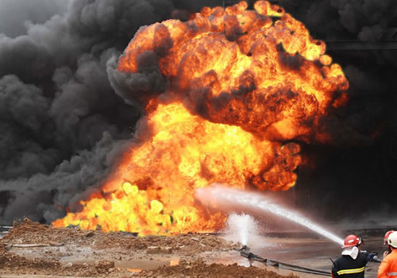
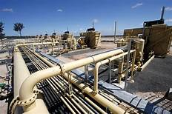
Introduction
Carbon steel pipes are used for oil and gas transportation.
External impacts of various magnitudes are sources of defects in steel pipes.
Pipe defects start as micro-cracks and may progress to cause failure of pipelines.
Failures of pipelines are associated with disasters.
2023 Pipelines’ significant incident consequences is $216,784,416.
External Impacts caused about 47% of subsea pipeline failure-IAGA (Zhang et al., 2023).
There is need for SHM of pipes to ensure sustainable reliability and integrity.
Aim
To develop a machine learning-enhanced acoustic emission technique for impact source identification and differentiation in steel pipes.

Slide 3
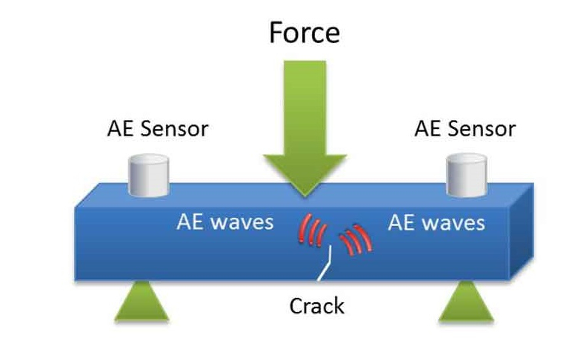
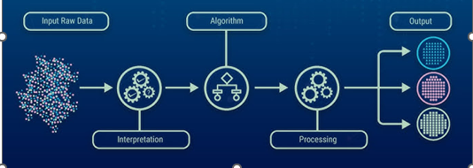
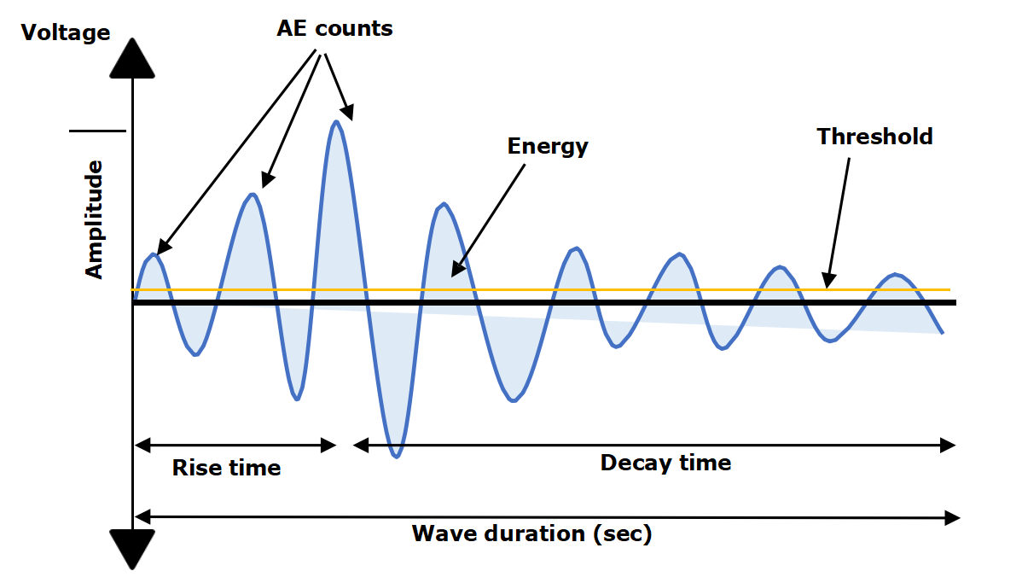
Background
Acoustic Emission Testing (AET) is a Passive NDT.
Materials crack initiation and growth degradation release the elastic stress waves.
Conventional AE analysis often struggle to differentiate between closely related damage mechanisms.
The integration of ML models will enhance the accuracy of AET’s differentiation of external impacts sources in steel pipe.
AET at a glance
Supervised Machine Learning

Slide 4
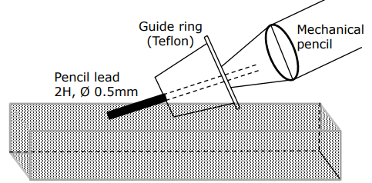
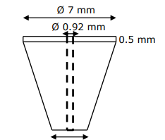
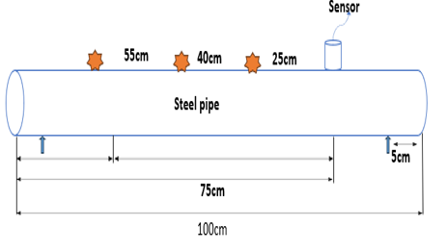
Pencil Lead Break (PLB) Experiment
The PLB experiment aims to calibrate AE set-up.
The test object is 100cm carbon steel pipe, 15cm internal diameter, 1cm thickness.
20 PLBs were broken at 25cm, 40cm & 55cm distance to the sensor.
The experiment was repeated on damped pipe.
Data sampled at 2.5M/s.
PLB test illustration (ASTM E 976 – 99)
Ø 2 mm
Guide Ring Dimension
Pencil lead break experiment set-up

Slide 5
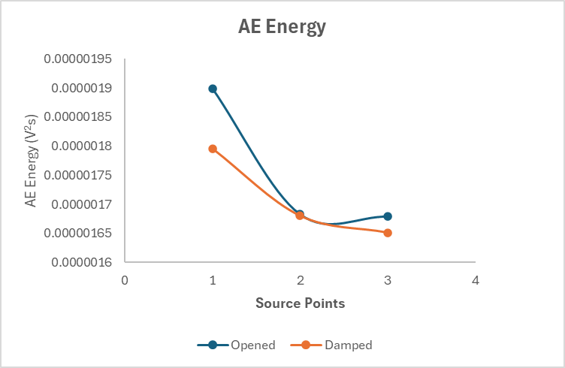
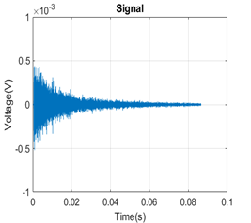
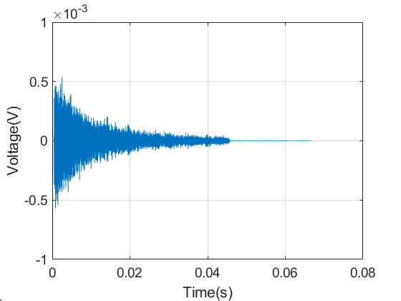
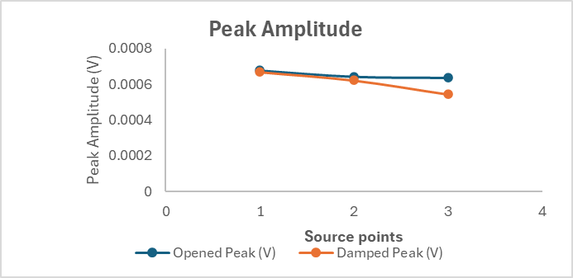
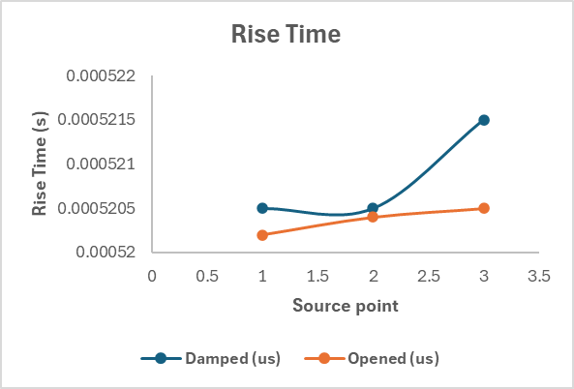
Pencil Lead Break Results
Time Domain Analysis
Open-ended pipe exhibited higher Energy and peak amplitude across 3 source points.
Open pipe exhibited highest AE Energy (0.0000019V²s).
Open pipe recorded highest peak amplitude (0.0007Volts).
AE energy and amplitude decrease with longer distances due to wave attenuation.
The number of rise decreases as the PLB source is farther away from sensor.
Raw time domain signal from open pipe
Raw time domain signal from damped pipe

Slide 6
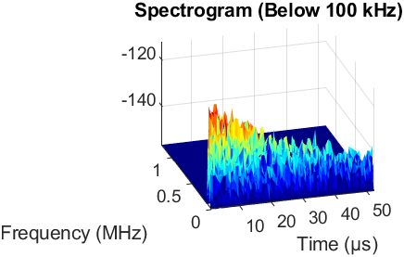
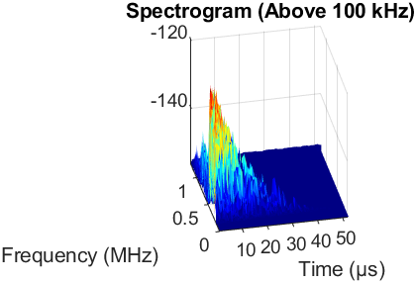
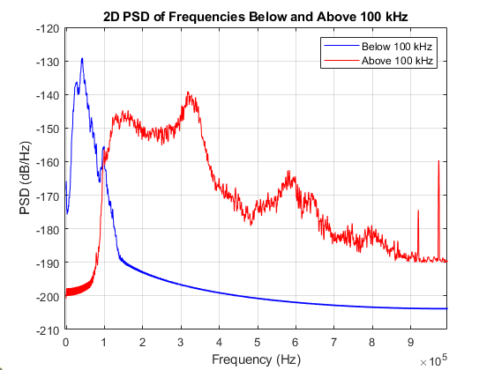
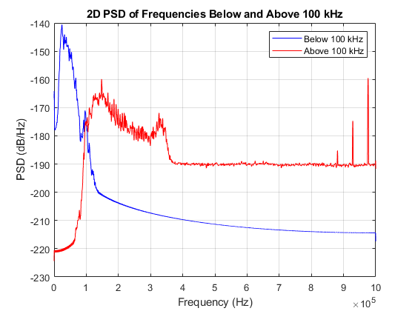
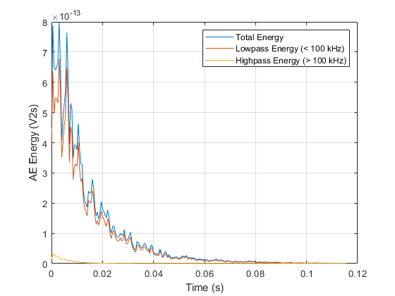
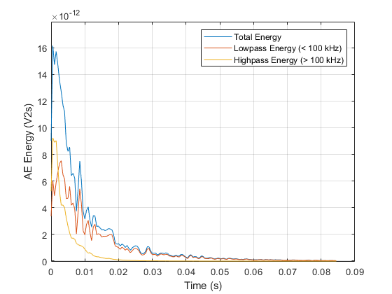
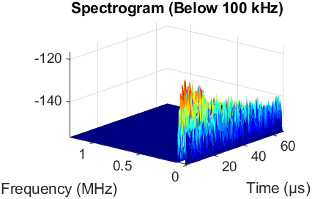
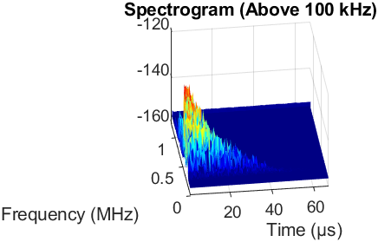
Time -frequency Analysis
Digital filtering is applied to frequencies below and above 100KHz.
Both pipe set-ups recorded higher AE energy in Low pass Cut-off frequency (< 100KHz).
Both set-ups recorded the highest AE energy at the 25cm source point.
Open pipe exhibited peak energy at 49 kHz and 2.46µs time at low pass band.
Damped pipe recorded highest AE energy at 48KHz frequency and time 1.6µs.
Open Pipe
Damped Pipe
a)
b)
c)
d)
3D spectrograms for:
(a) low pass (b) high pass for open pipe
(c) low pass and (d) high pass for damped pipe

Slide 7
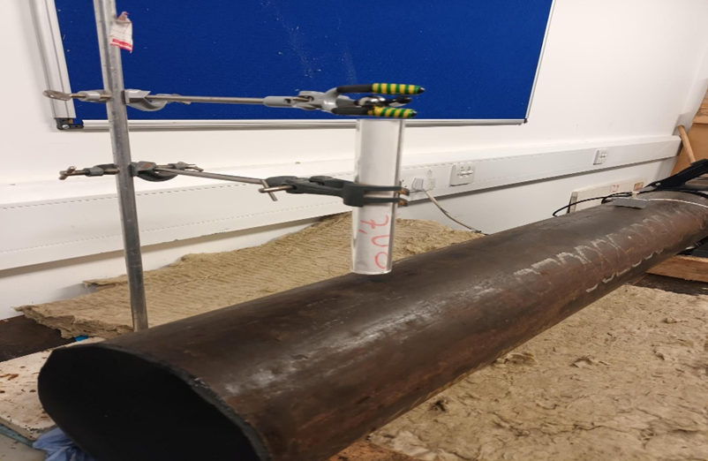
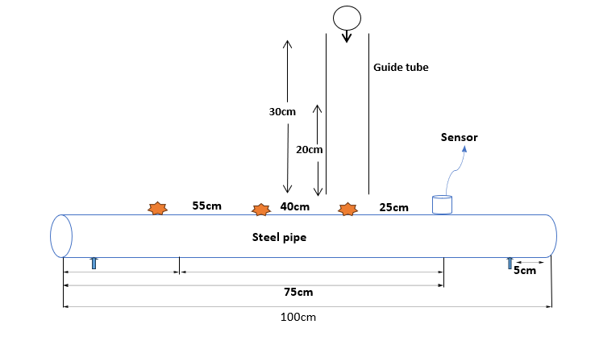
Drop ball Experiment
9g and 17g steel balls dropped from 20cm and 30cm heights.
AE source points are located at 25cm, 40cm, and 55cm source to sensor distances.
The experiment consists of 12 variables of 100 tests each (1200 tests)
FFT, STFT were performed on the AE wave signals.
The extracted time series features (AE energy, peak amplitude, and rise time) were used to train supervised ML models.
Schematic representation of Drop ball impact experimental set-up.

Slide 8
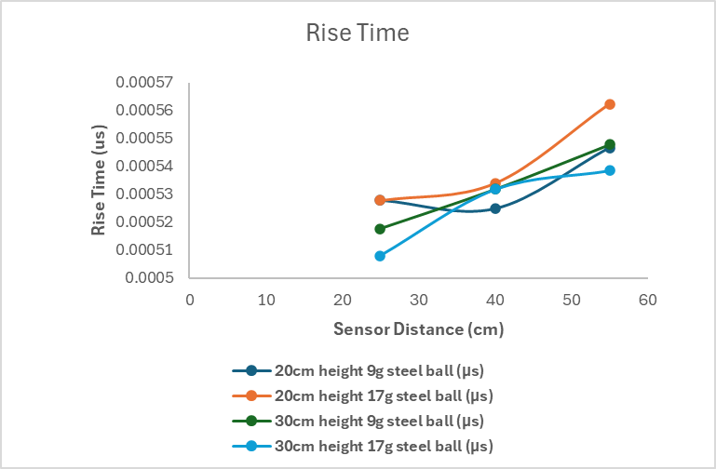
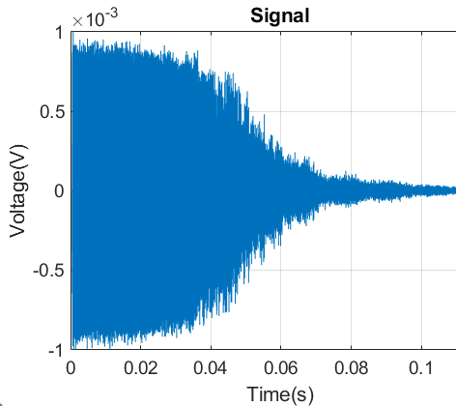
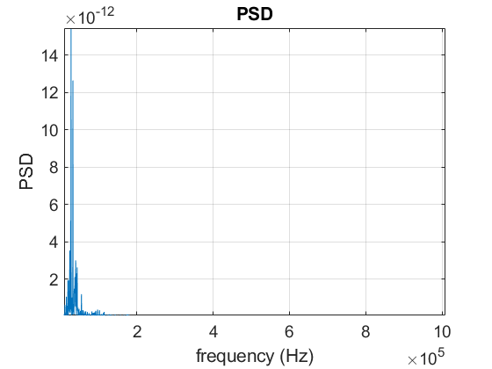
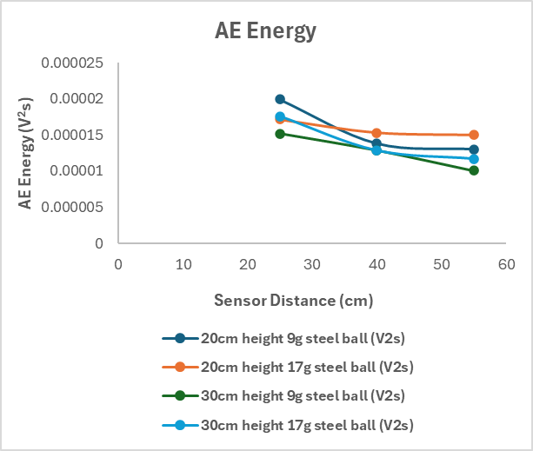
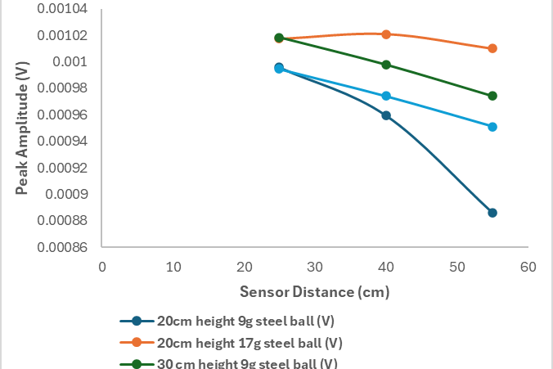
Drop Ball Results
Steel ball impacts produced distinct burst-type AE signatures.
The highest AE energy and peak amplitude are recorded at 25cm source points.
AE energy and peak amplitude decreases with further distance.
Rise time exhibits linear increase with propagation distance

Slide 9
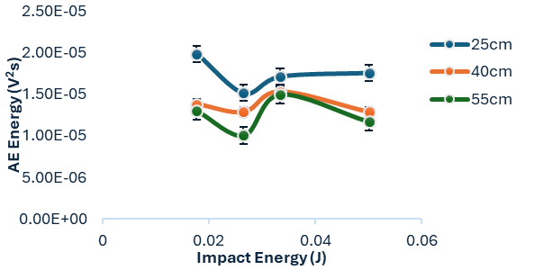
Effect of Ball mass and drop heights
The highest AE energy (1.98986 x 10⁻⁵ V²s) was recorded from the impact energy (0.017658J) of 9g ball from 20cm height at 25cm source point.
All the impact scenario recorded highest AE energy at the closest distance (25cm) to the sensor.
Impact energy exhibits direct proportionality to both mass variation (9g to 17g).
Similar trend was recorded with increase in drop heights at all sensor distances.
Ball Mass (g) | Drop height (cm) | Impact Energy (Joules) | Measured Energy (V2s) 25cm | Measured Energy (V2s) 40cm | Measured Energy (V2s) 55cm
9 | 20 | 0.017658 | 1.98986E-05 | 1.38265E-05 | 1.30295E-05
9 | 30 | 0.026487 | 1.51707E-05 | 1.28698E-05 | 1.00552E-05
17 | 20 | 0.033354 | 1.71538E-05 | 1.53241E-05 | 1.49961E-05
17 | 30 | 0.050031 | 1.76061E-05 | 1.28698E-05 | 1.17108E-05

Slide 10
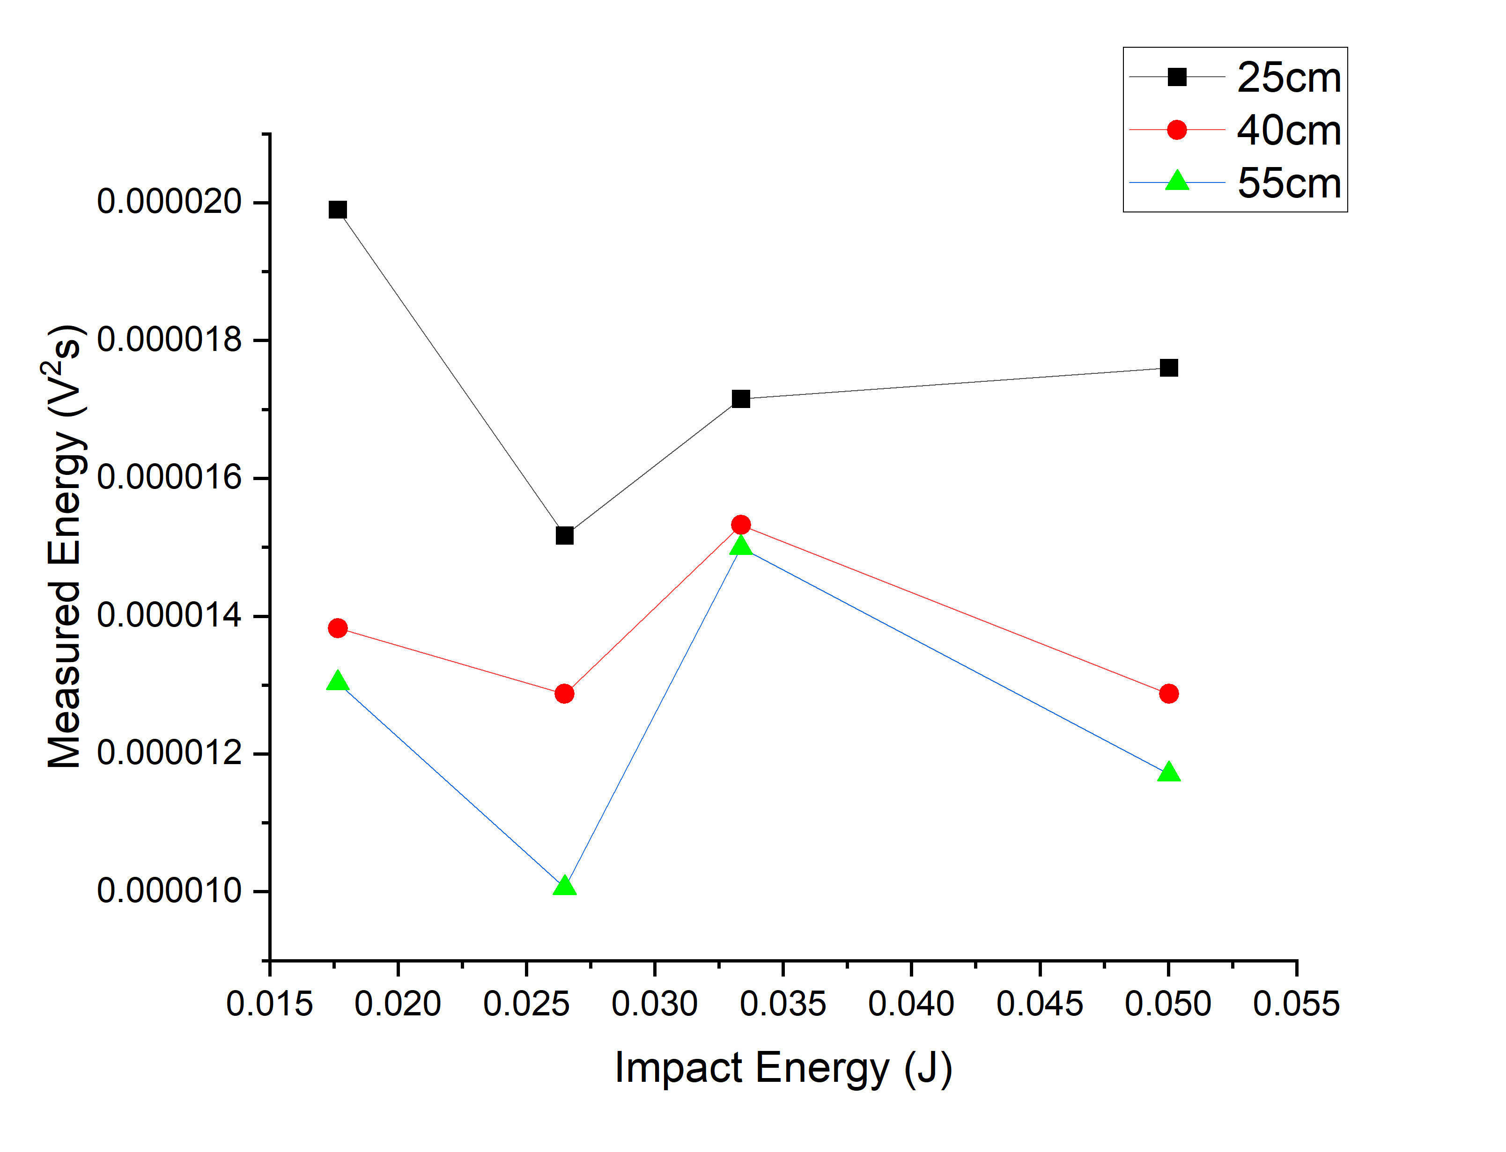
Effect of Sensor Distance
AE energy decrease as the distance from the impact point increases in all variables.
All variables produced highest energy at 25cm source points.
Attenuation coefficient ‘α’ of 0.014 observed when 9g and 17g steel ball was dropped from 20cm & 30cm heights.
Slightly lower attenuation coefficient ‘α’ of 0.004 recorded from 17g balls dropped from 20cm height.
This represent a unique behaviour at higher mass/lower height combination.

Slide 11
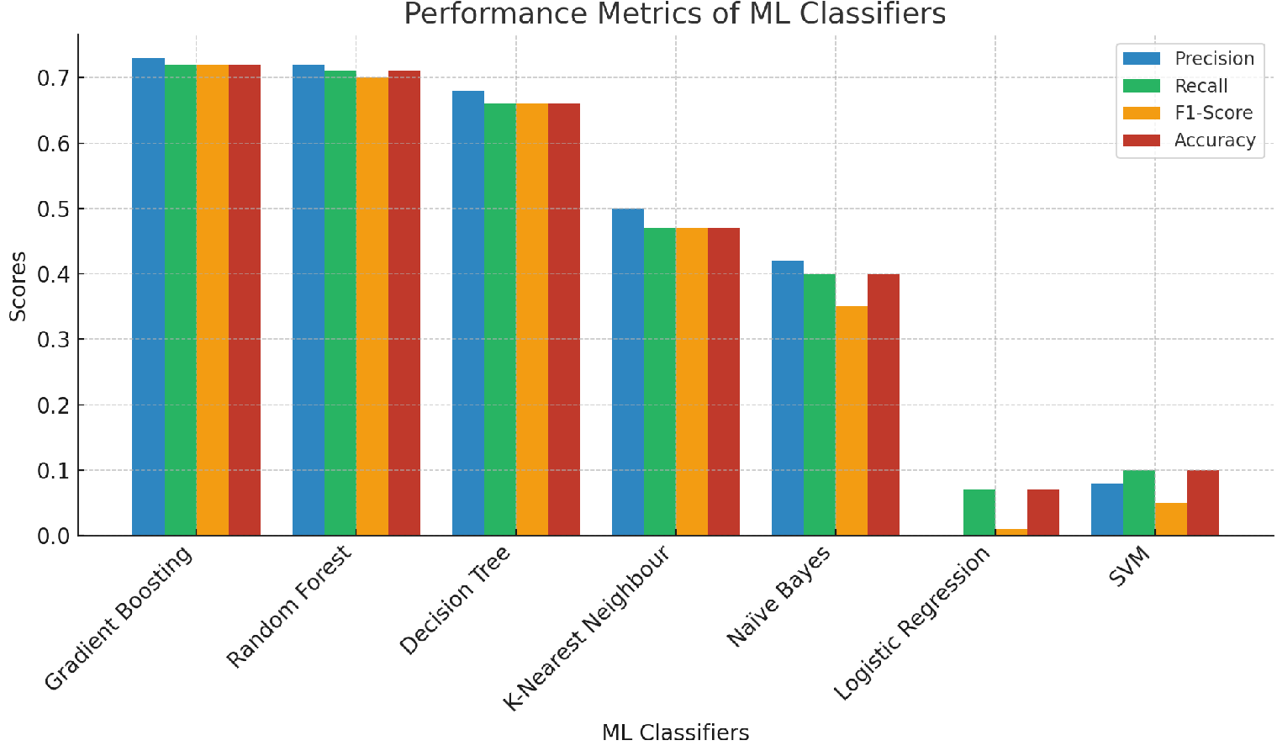
Machine learning classification
3600 data sets were loaded in jupyter notebook using Panda.
X and Y values are defined.
Categorical Y values were encoded (0 -11).
80% of the data was used for training, and 20% was used for validation.
Random state was used for reproducibility.
7 Classification ML models defined.
Gradient boosting produced the highest accuracy 0.72 based on a weighted average.
 | ML Classifiers | Precision | Recall | F1- Score | Accuracy
1 | Gradient Boosting | 0.73 | 0.72 | 0.72 | 0.72
2 | Random Forest | 0.72 | 0.71 | 0.70 | 0.71
3 | Decision Tree | 0.68 | 0.66 | 0.66 | 0.66
4 | K- Nearest Neighbour | 0.50 | 0.47 | 0.47 | 0.47
5 | Naïve Bayes | 0.42 | 0.40 | 0.35 | 0.40
6 | Logistic Regression | 0.00 | 0.07 | 0.01 | 0.07
7 | SVM | 0.08 | 0.10 | 0.05 | 0.10

Slide 12
Conclusion
The impact sources were accurately identified and classified by the ML model developed.
Increasing impact energy will increase acoustic energy and wave amplitudes.
The elastic stress caused by dropping steel balls of different masses from heights was effectively characterized and differentiated in steel pipe.
AE features (amplitude, energy, rise time, frequency content) showed clear differences between impact scenarios.
A robust methodology for impact source classification in pipeline monitoring was developed.

Slide 13
Acknowledgements / Thank You / Questions
The authors express gratitude to PTDF Nigeria for funding research project via Robert Gordon University (RGU) UK.
Special thanks to Dr. Judith Abolle-Okoyeagu who offered professional supervision for this research work.
The author also acknowledged the contribution of Dr Anil Prathuru to the success of the laboratory experiments.
Thank you all.

Slide 14
References
Abolle-Okoyeagu, C. J., Torralba, J. P., Yuhang, C., & Reuben, R. L. (2022). Impact source identification on pipes using acoustic emission energy. e-Journal of Nondestructive Testing, 28(1).
Droubi, M.G., Reuben, R.L. and White, G., 2012. Statistical distribution models for monitoring acoustic emission (AE) energy of abrasive particle impacts on carbon steel. Mechanical Systems and Signal Processing, 30, pp. 356-372.
Modeling of impact energy generated by free falling ball', ESTEEM Academic Journal, 5(1), pp. 11–24.
Guo, F. et al. (2022) 'Deep learning approach for damage classification based on acoustic emission data in composite materials', Materials, 15(12), pp. 4270.
Lee, S., Park, C. and Yoon, D. (2024) 'Source location and anomaly detection for damage identification of buried pipelines using kurtosis-based transfer function', Structural Health Monitoring, 23(3), pp. 1742–1765.

