Slide 1
Materials challenges and opportunities in high-temperature steam electrolysis with geothermal heat
26-27 Feb 2025 - GEOTHERMAL 2025
Prof Nadimul Faisal
School of Computing, Engineering and Technology
Robert Gordon University, Aberdeen
n.h.faisal@rgu.ac.uk
Notes:
Welcome to the 5-minute TECHBYTE.
Hello, I am Nadimul Faisal.
I will be presenting about ‘Materials challenges and opportunities in high-temperature steam electrolysis with geothermal heat’.

Slide 2
High temperature steam and water
Temperature ranges of geothermal sources
Low-temperature resources: Below 150 °C (closer to the Earth's surface)
Moderate-temperature resources: 150–200 °C (typically 1–3 km)
High-temperature resources: Above 200 °C, with some reaching 370 °C (regions with volcanic activity)
Notes:
High-temperature steam electrolysis is a promising technology that leverages solid oxide electrolysis cells to split water into hydrogen and oxygen with high efficiency.
When coupled with geothermal heat, it becomes even more attractive, offering a renewable, low-carbon pathway for large-scale hydrogen production.
Geothermal sources vary in temperature depending on depth, geological conditions, and location. They are generally classified into three categories as can be seen in the list.
When integrating steam electrolyser system with geothermal heat, materials could face several degradation challenges due to the unique chemical and thermal environment of geothermal sources.

Slide 3
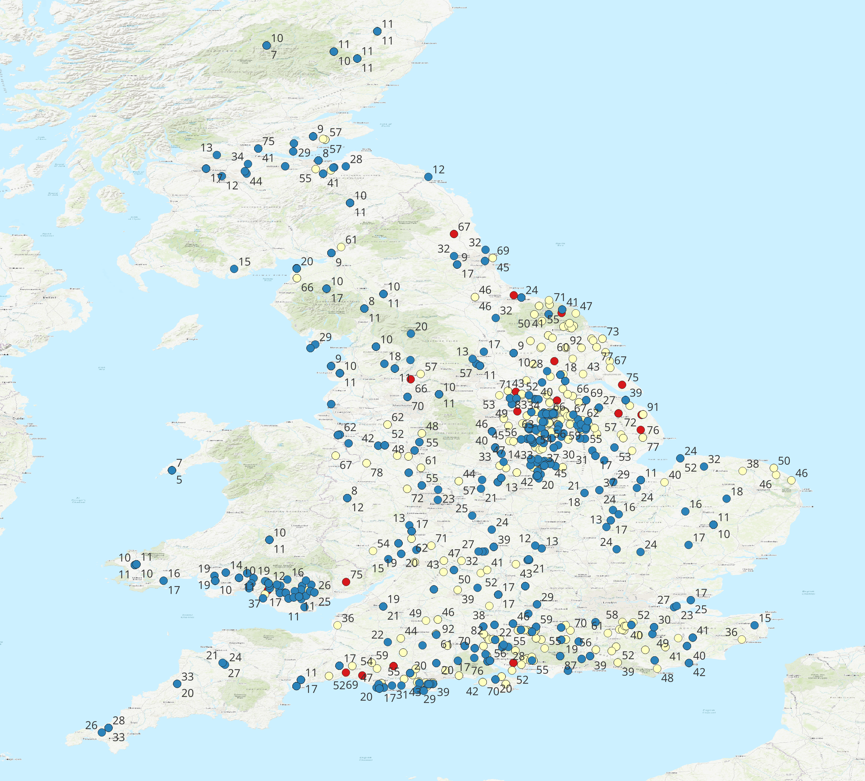
Geothermal GIS – Temperature spread
Temperature
Ranges (°C)
Temperature
Ranges (°C)
Great Britain
Nevada, US
Acknowledgement: MAHMOUD ALGAIAR, PhD student, Robert Gordon University
(UK Data source: BGS)
Notes:
Geothermal temperature vary significantly between regions, influencing the feasibility and efficiency of geothermal energy applications.
Here's an overview of the geothermal temperature in the Great Britain and Nevada:
For Great Britian, it is approximately between 2–113°C.
For Nevada, it is approximately between 26-236°C.
These variations highlight the differing geothermal temperature of the two regions.

Slide 4
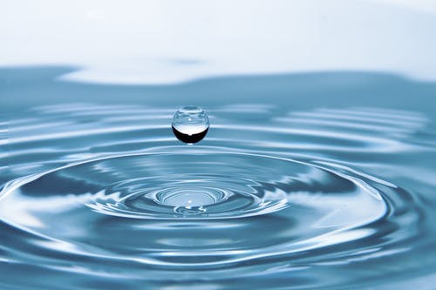
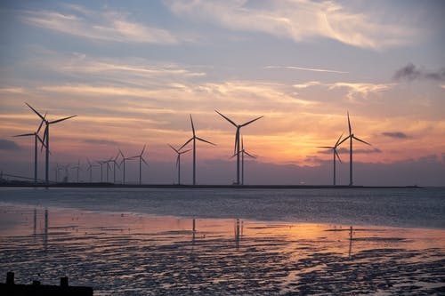
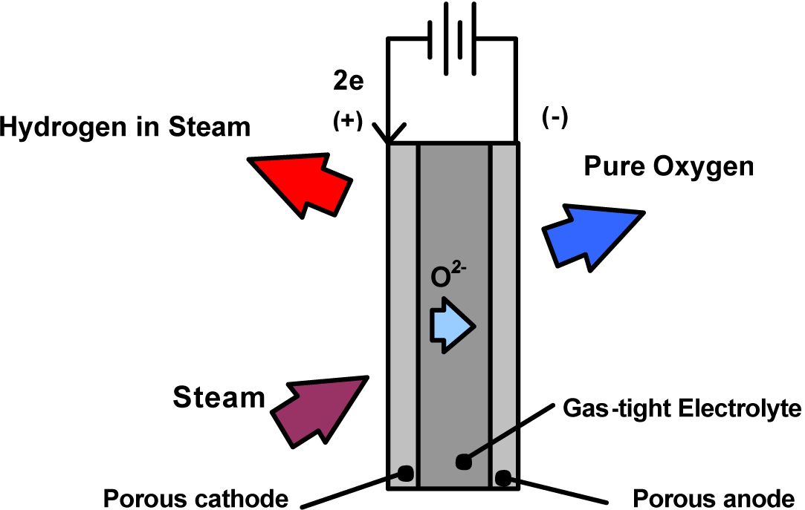
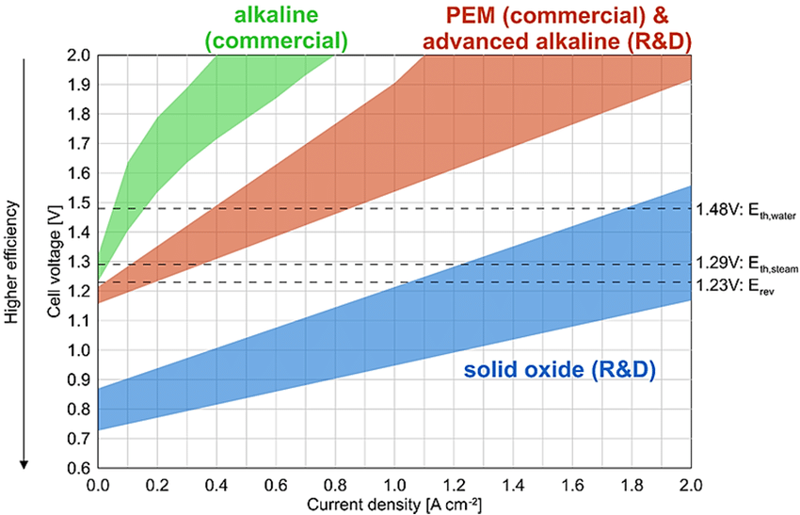
Main electrolyser types
Water & electricity
Proton exchange membrane (PEM)
50–80°C
Water & electricity
Anion exchange membrane (AEM)
40–80°C
Water & electricity
Alkaline water electrolysis (AWE)
60–90°C
Hydrogen production
(water splitting)
Water, electricity & heat
Solid oxide water electrolysis (SOWE)
Water, electricity, sunlight & heat
H₂
700–900°C
Water & heat
Thermochemical water splitting (TWS)
Over 500°C
Water & sunlight
Photolysis water splitting (PWS)
20–80°C
Water & sunlight
Photoelectrochemical (PEC) water splitting
25–80°C
Feedstocks
Technologies (water based)
Notes:
There are several main types of electrolysers used for hydrogen production, each with distinct operating principles, efficiencies, and material requirements.
PEM: Compact design with fast response times. High cost due to expensive catalyst materials.
AEM: Lower cost than PEM due to non-precious metal catalysts.
AEL: Mature, well-established technology
SOWE/SOSE: Can use waste heat (e.g., from geothermal sources) to reduce electricity demand. Expensive high-temperature materials required.
TWS: Uses high temperatures (above 500°C) to drive the endothermic reaction using thermochemical cycles.
PWS: Direct solar-driven process using only sunlight, without external electrical or thermal energy input.
PEC: Direct Solar-to-Hydrogen Conversion – No need for external electricity.
Higher Temperatures can accelerate reaction kinetics, leading to faster hydrogen and oxygen evolution rates. However, this must be balanced with the stability of the materials used.

Slide 5
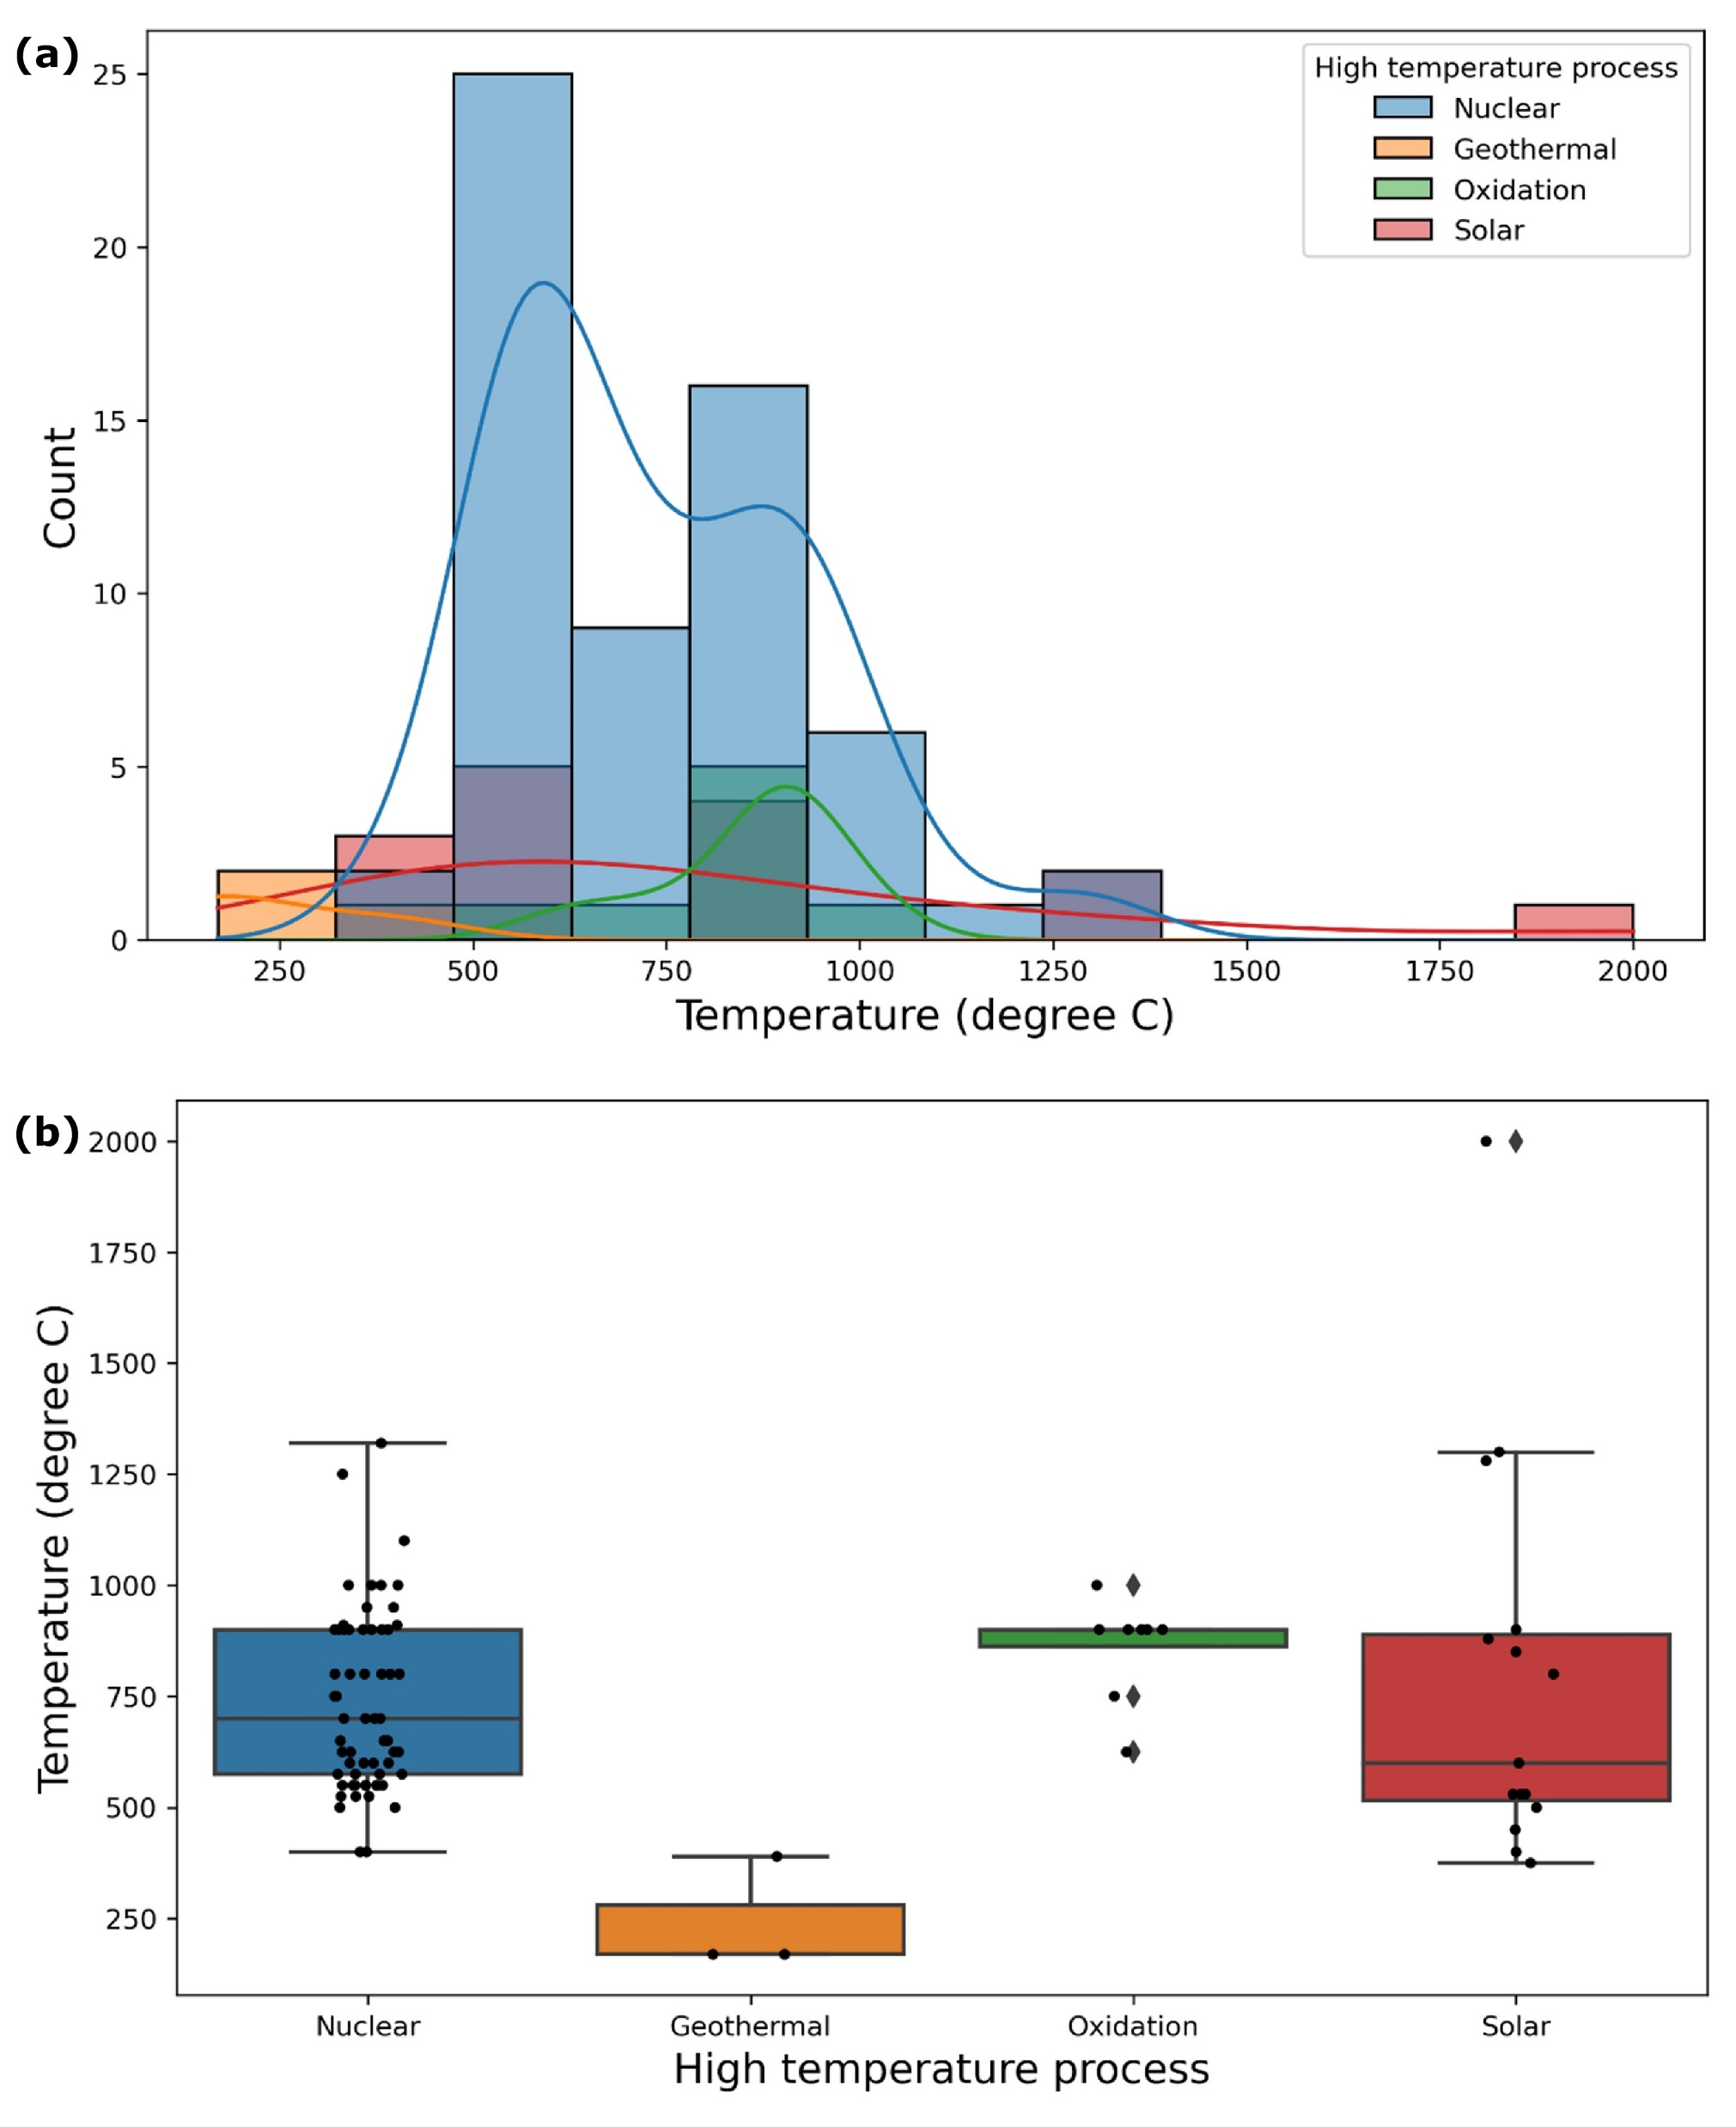
High temperature processes
Increase in temperature eliminates the need for expensive catalysts.
Ramkumar Muthukrishnan, Yakubu Balogun, Vinooth Rajendran, Anil Prathuru, Mamdud Hossain, Nadimul Faisal, High Temperature Corrosion of Materials, 101, 309–331, 2024. https://link.springer.com/article/10.1007/s11085-024-10312-4
Notes:
These are typical temperature ranges in some high temperature processes, including geothermal.
This research was part of an investigation where we investigated corrosion rates of materials (including coatings) in some high temperature processes.

Slide 6
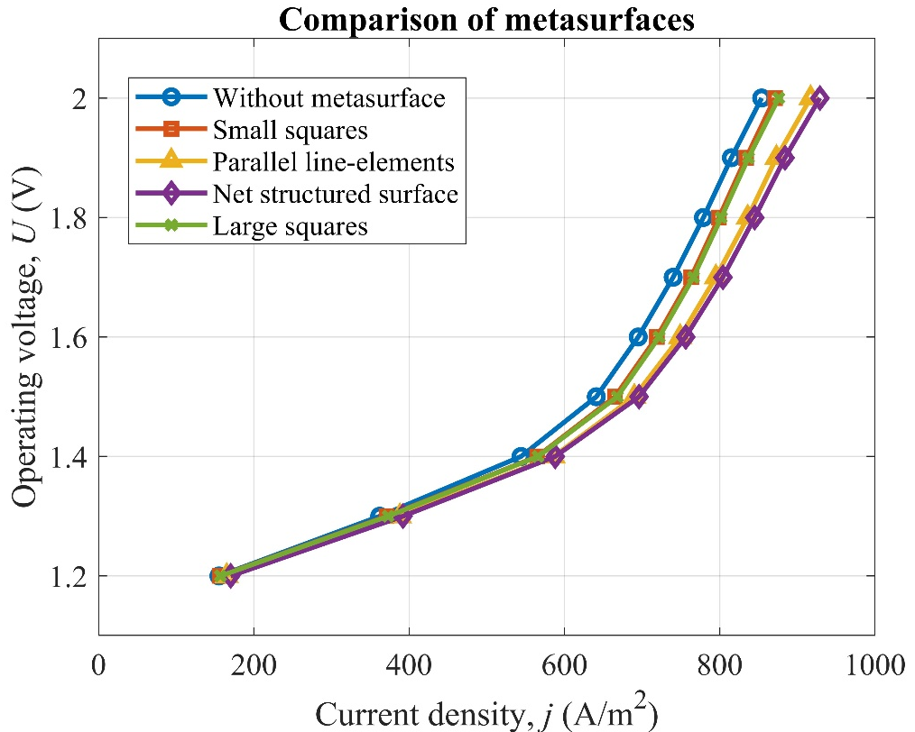
Design & modelling
METASIS project
EP/W033178/1
Victoria et al. Journal of Power Sources (2025); https://papers.ssrn.com/sol3/papers.cfm?abstract_id=5015628
Victoria et al. Engineering Fracture Mechanics (2025); https://papers.ssrn.com/sol3/papers.cfm?abstract_id=5021100
Notes:
Through METASIS research, the goal was to improve the efficiency of steam electrolysis system, particularly in the context of materials and manufacturing.
Research was into tubular design, new materials for cathode, electrolyte and anodes as well as having a meta-surface on the anode side that can enhance the efficiency.

Slide 7
Cell fabrication stages
Electrodeposition of silver on SS & Ti tubes
Half cell fabrication (dip coating slurries, current collector & cathode functional layer)
Full cell fabrication (electrolyte and anode layers, anode current collector and sealing)
Ultrasonicated slurries, high-temperature sintering (950-1100 C)
Notes:
Manufacturing of multi-layer system is a complex process.
The research included using three different manufacturing techniques (electrochemical deposition, dip coating, and air plasma spray coating) to develop various layers of the tubular structure.
The challenges are in the control of layer thickness, porosity, microstructure, interface issues, etc.

Slide 8
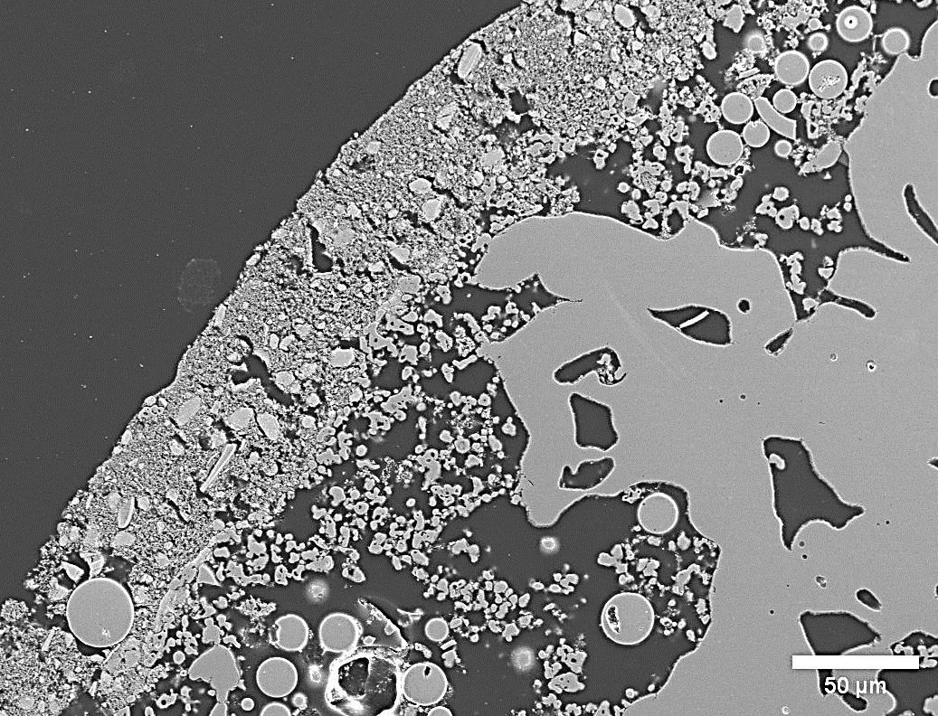
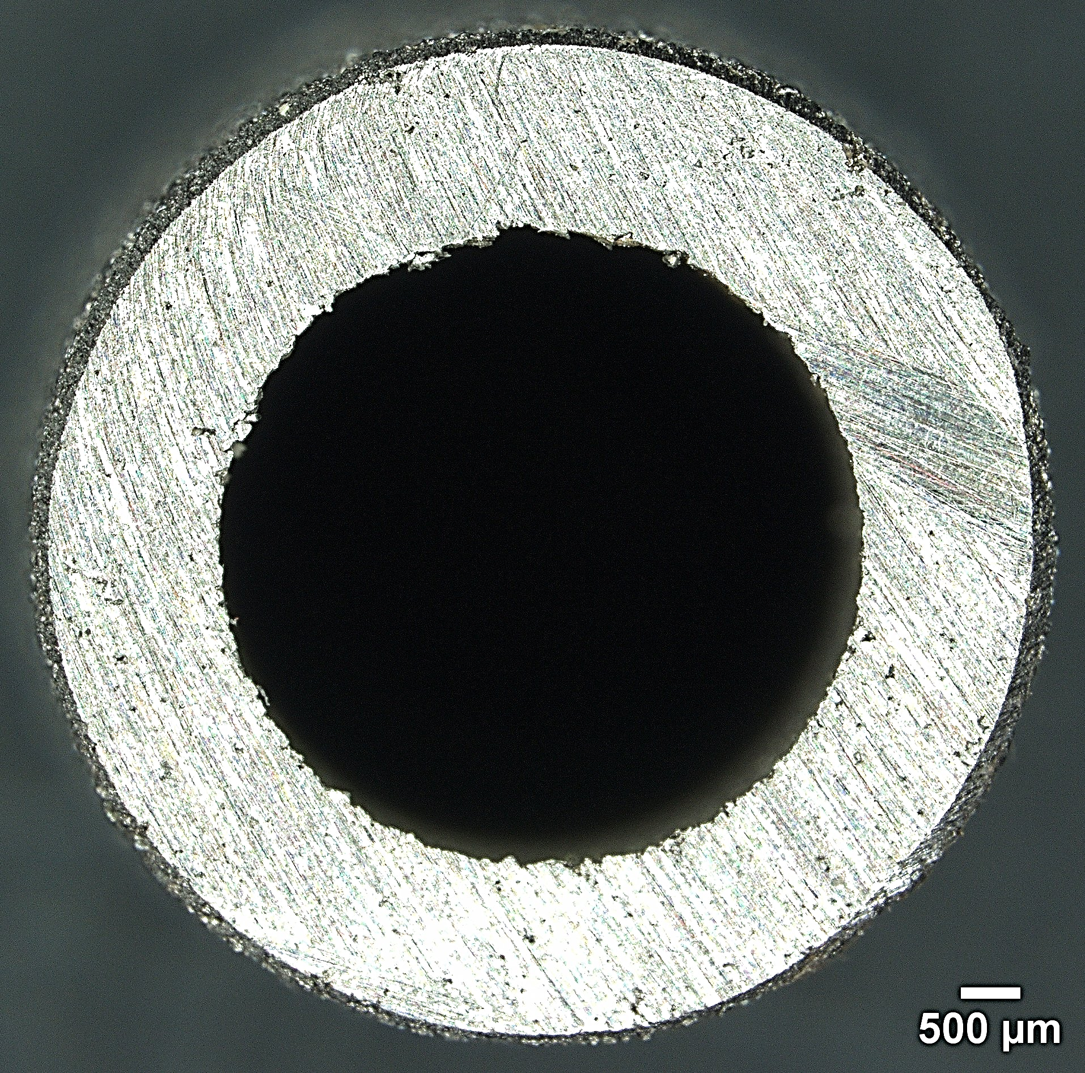
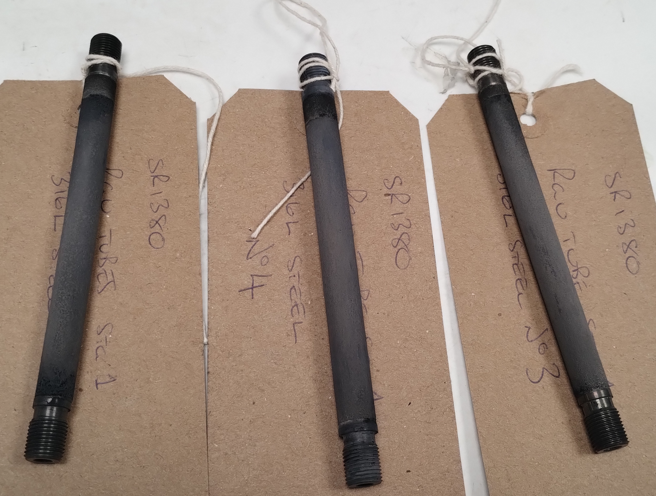
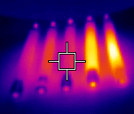
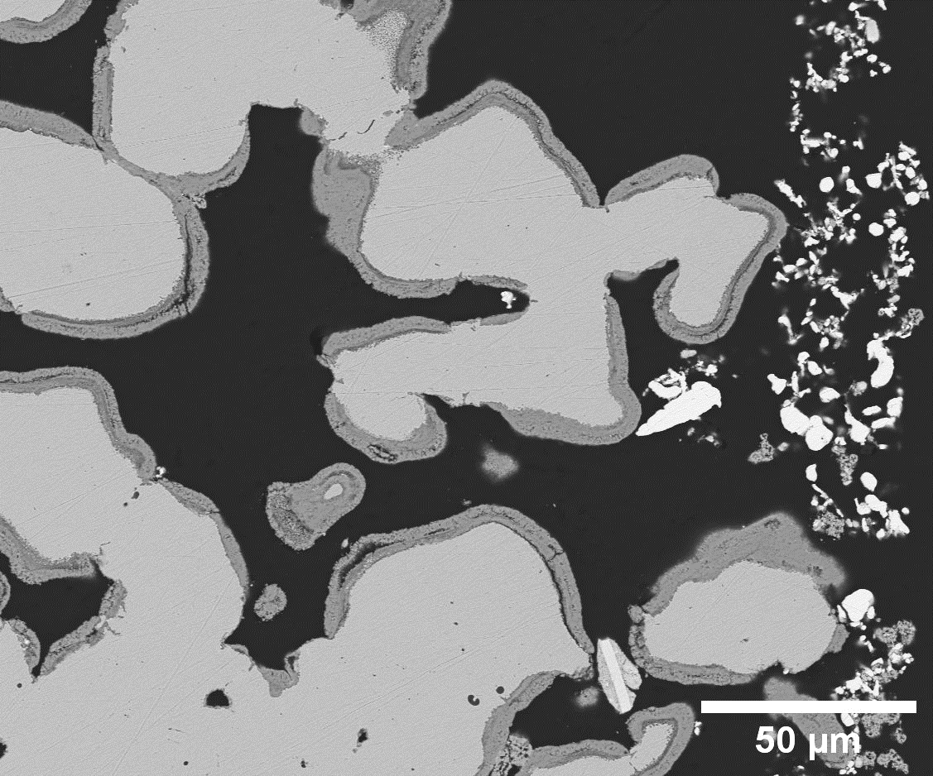
Anode: avg. 49 µm
Electrolyte: avg. 8 µm
Investigation
Cathode: avg. 112 µm
Ti tube
Ag layer thickness 26 µm
Notes:
These are some of the example images.
Left: single tube
Centre: cross-section of the tube
Right (bottom): IR imaging of the coated tubes.
Some of the challenges include oxidation of porous metal support during manufacturing. It also includes materials and layer degradation/delamination during electrolysis process at high temperature operations.

Slide 9
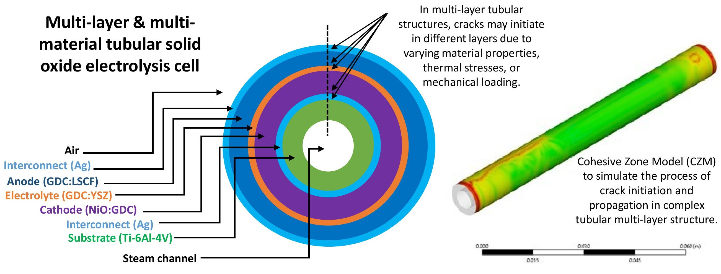
Designing steam electrolysers for geothermal steam applications
Thank you
n.h.faisal@rgu.ac.uk
High-temperature stability
Thermal expansion mismatch, creep, deformation
Corrosive geothermal environment
Dissolved salts (NaCl, KCl), acidic gases (CO2, H2S), mineral deposits (silica, calcium carbonate)
Electrolyte materials
Materials degradation, contamnation
Electrode degradation
Nickel oxidation, sulphur poisoning, delamination
Durability and longevity
Thermal cycling, electrochemical degradation
Integration with geothermal systems
Variable steam quality, scaling and fouling in heat exchanges
Emerging solutions
Advanced coatings, new materials, hybrid systems (pre-heating)
Temperature
Ranges (°C)
Temperature
Ranges (°C)
Acknowledgement (METASIS team): Dr Victoria Kurushina, Dr Anil Prathuru, Prof Mamdud Hossain, Prof Qiong Cai, Dr Bahman Horri, Vinoth Rajendran
Notes:
Designing steam electrolysers for geothermal steam applications presents several unique challenges that must be addressed to achieve efficient and reliable hydrogen production.
It includes:
High-temperature stability - Thermal expansion mismatch, creep, deformation
Corrosive geothermal environment - Dissolved salts (NaCl, KCl), acidic gases (CO2, H2S), mineral deposits (silica, calcium carbonate)
Electrolyte materials - Materials degradation, contamnation
Electrode degradation - Oxidation, sulphur poisoning, delamination
Durability and longevity - Thermal cycling, electrochemical degradation
Integration with geothermal systems - Variable steam quality, scaling and fouling in heat exchanges
Opportunities including application of advanced coatings, new materials, and developing hybrid systems (pre-heating)
Overall, addressing these challenges in designing steam electrolysers for geothermal steam applications requires multidisciplinary approaches, including advanced materials research, system optimization, and innovative engineering solutions.
Thank you.

