Slide 1
Personally Significant Learning Environments (PLsE)
Moira Stephens¹, Chris Patterson¹, Ann Price², Vico Chiang³, Erna Snelgrove-Clarke⁴, Fiona Work⁵
1 University of Wollongong, Australia
2 Christchurch University, England
3 Hong Polytechnic University, Hong Kong
4 Dalhousie University, Canada
5 Robert Gordon University, Scotland

Slide 2
Outline
An idea from personal experience
Technology as “resources that are converted into commodities” Economics model Technology as extensions of self
Focus groups in 4 countries
Early data reported last year
Notes:
Technology is often thought to a modern concept. However, more broadly speaking - Technology is commonly defined as relating to manufactured or artificial objects vs natural objects. Technology ("science of craft", from Greek τέχνη, techne, "art, skill, cunning of hand"; and -λογία, -logia^{[3]}) is the collection of techniques, skills, methods and processes used in the production of goods or services or in the accomplishment of objectives, such as scientific investigation - prehistoric technology - converting resources into tools. The control and creation of fire, printing press, telephone, computer etc
Marshall McLuhan was particularly interested in “Technology as Extension of the Human Body”. An extension of our body and/or of our senses occurs when we extend the reach of our embodied mind beyond our natural limited means. As examples: the shovel is an extension of our hands and feet as we dig a trench, the spade is like our cupped hand as we remove dirt from a hole, a microscopy or telescope extends our vision to study smaller or larger dimensions.

Slide 3
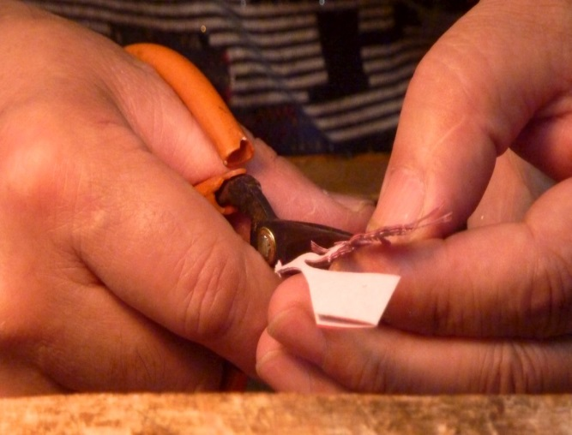
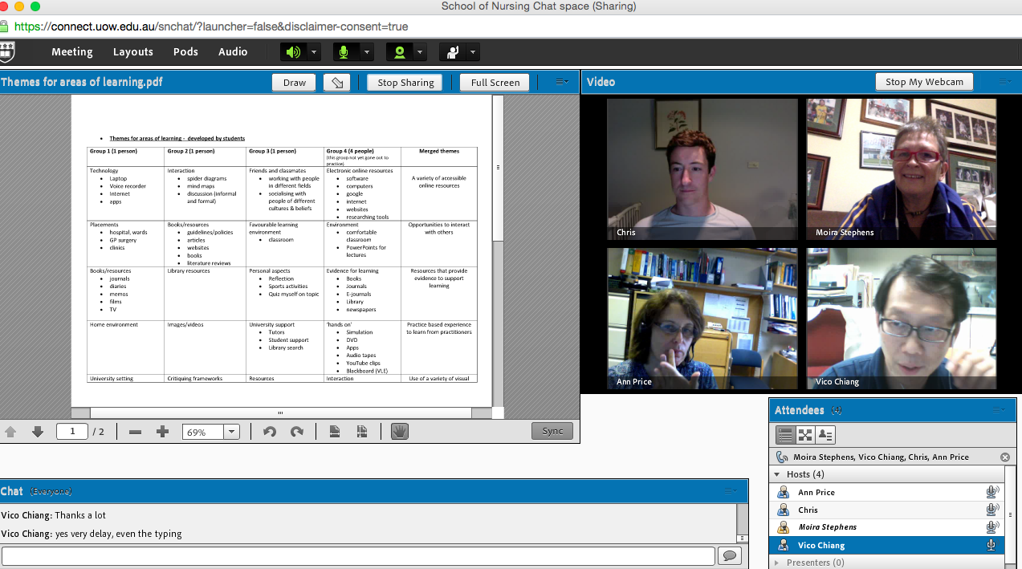
Personal Learning Environment
Notes:
Although, stating PLE occurs where digital and non-digital features are individually combined by learners, Sangeetha’s (2016) orientates discussion of PLE towards the integration and use of digital technologies.
This is representative of the limited scope of PLE in current literature – one that does not include features that are not digital technologies.
Personal learning environments (PLE) have been shown to be a critical part of how students negotiate and manage their own learning.
Understandings of PLEs appear to be constrained by narrow definitions that focus primarily on one kind technological engagement with a range of web tools and associated applications.
We suggest that there is a gap in the literature around PLEs for students currently enrolled in undergraduate nursing degrees.

Slide 4
Aim
The aim of this study was to provide in-depth insights into how undergraduate students of nursing manage and experience their learning through a range of formal and informal components that comprise their PLE
To understand what a PLE looks like for these cohorts
Notes:
this project aimed to investigate the ways that nursing students utilized technology, as well as material environments, embodied and emotional states in ways that constituted personally significant learning environments. Rather than examining technology as a separate and/or sole entity related to learning environments, we endeavoured to examine the ways that it is woven into the everyday practices and environments of current students of nursing paying particular attention to subjective or cultural differences.

Slide 5
This was an international multi-site qualitative study, utilizing focus groups.
It is a sequential exploratory project that comprised two key phases of study
An international multi-site study:
University of Wollongong, Australia (investigators: CP and MS);
The Hong Kong Polytechnic University (investigator: VC);
Canterbury Christ Church University, England (investigator AMP);
Robert Gordon University, Scotland (investigator: FW);
and Dalhousie University, Canada (investigator: ESG).

Slide 6
Design
Qualitative Approach
Focus groups
Semi-structured interviews
Taped & transcribed
Nominal group techniques
Students themed technologies, approaches and ways of working
Individual visual representation of PLE
Notes:
Face to face focus groups were facilitated by investigators
set schedule of 10 questions
All groups were conducted in English except Hong Kong where the spoken language was Cantonese
Eight groups totalling 46 students took part in focus groups. The nominal group activities and the open ended nature of the questions meant that students were free to define PLEs according to their experiences. Some had not heard of the term PLE, others had encountered the term before but included several components that went well beyond current technological definitions

Slide 7
Analysis
Large quantity of data
Thematic analysis independently by the investigator(s) of each site
Each site then compared data and emerging findings for the development of shared analytic ideas and eventual consensual categorisation of themes
Notes:
Analysis was conducted with conventional content analysis through coding (Hsieh & Shannon, 2005).
This initial analysis was at the broadest level of abstraction in order to identify main emerging categories.
To ensure rigour, investigators, via a series of meetings through voice over IP (VoIP) technologies, met to discuss emergent findings. Any differences in emergent findings and themes from each site analysis were discussed, debated and resolved in these team meetings.
This process concluded when team consensus regarding the final thematic findings were reached.

Slide 8
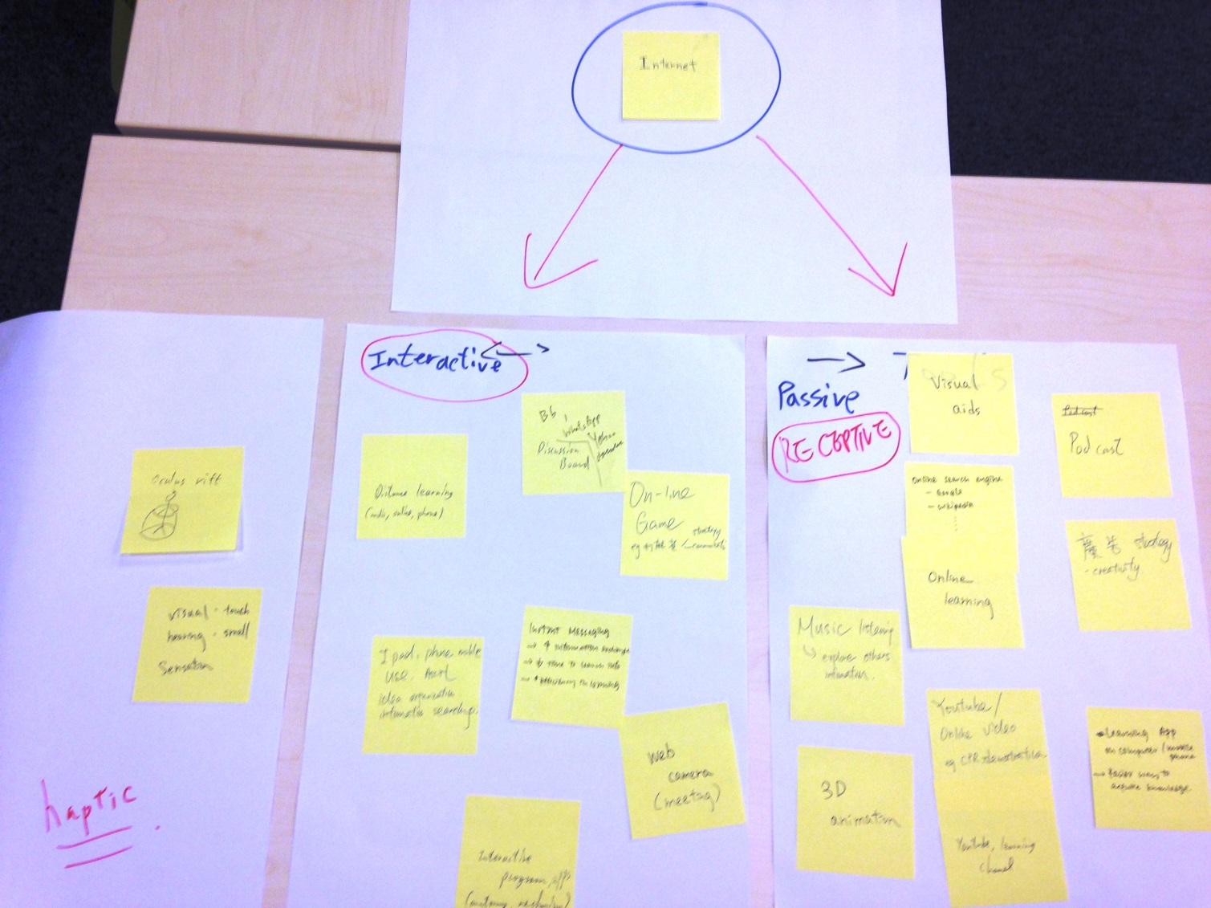
Findings
HKPU G1
Notes:
Nominal group techniques (Chapple & Murphy 1996) facilitated participants to consider both experiences and components of their PLE
Participants individually generated and recorded ideas onto sticky notes and then discussed and themed the ideas as a group.
Participants also created visual representations of their PLE in the form of a sketch or conceptual map.
The themed sticky notes and visual representations were photographed and stored for subsequent analysis.
The research team were motivated to employ this approach because of the belief that current definitions of PLEs were constrained by a narrow focus on the technological challenges and befits of online learning systems.
Whilst the focus groups took place in very different geographical locations, there were strong similarities in student understandings of effective PLEs.

Slide 9
What do you understand by the term – Personal Learning Environment?
“you yourself, how do you learn” (CCCU 3 )
“I think this term [PLE] also means some personal habits, that’s about learning. When doing revision, some people like to listening to music when reading, or doing revision. So that’s apart from the physical environment, it can possibly be the own preference for what the environment is, personal habits, and the way he/she likes it. That’s about many things that work together.” (HKPU 1)
“Coke, Pringles… peer support…public place …study nest …. Running..” (RGU)
“where ever you learn best” (RGU 2)

Slide 10
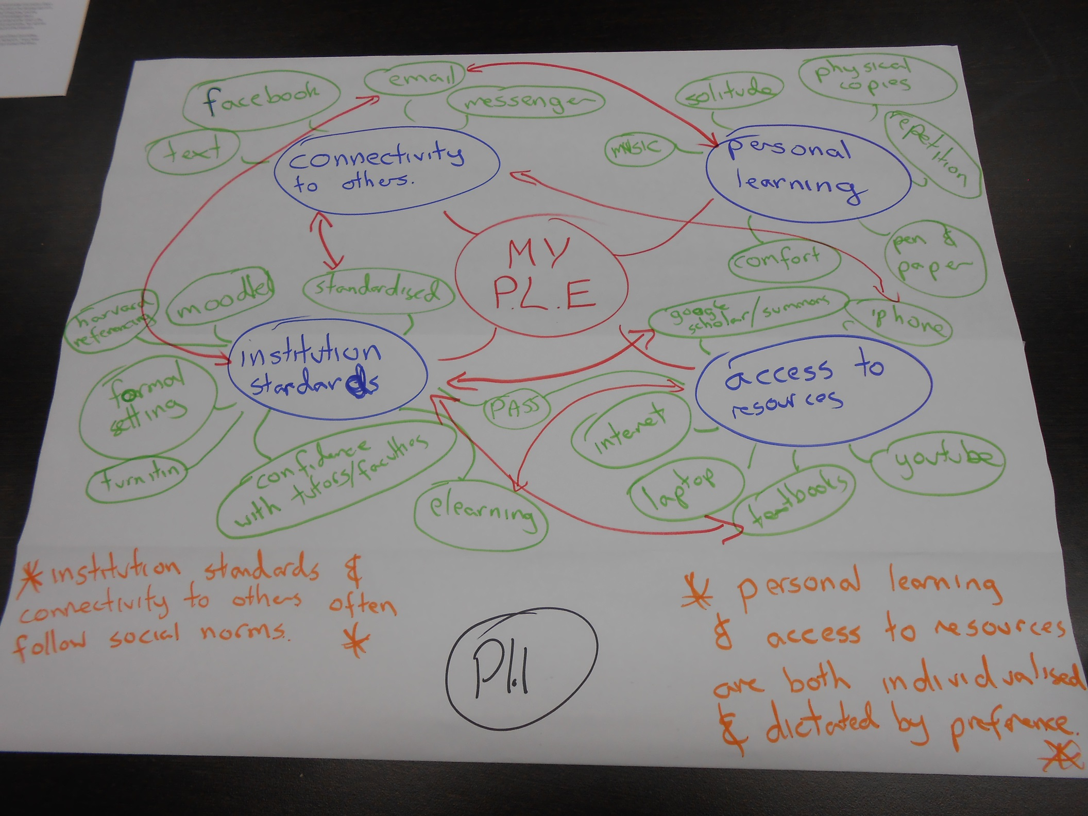
UOW

Slide 11
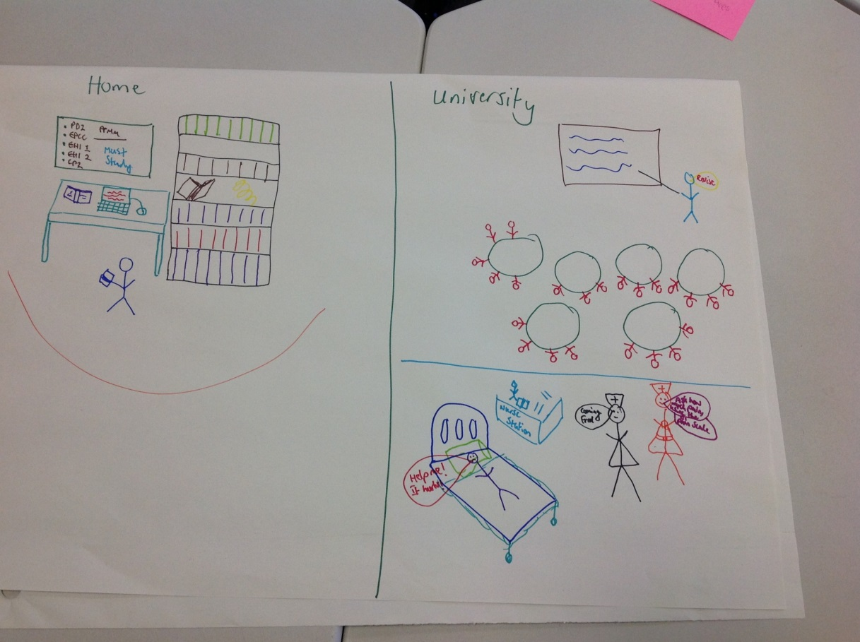
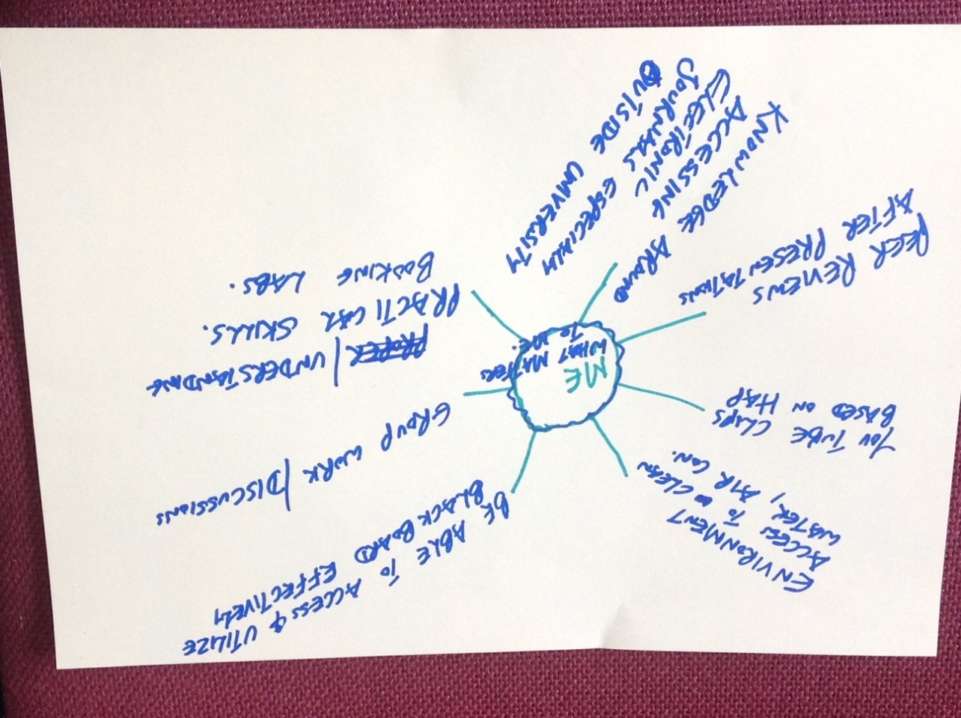
CCU

Slide 12
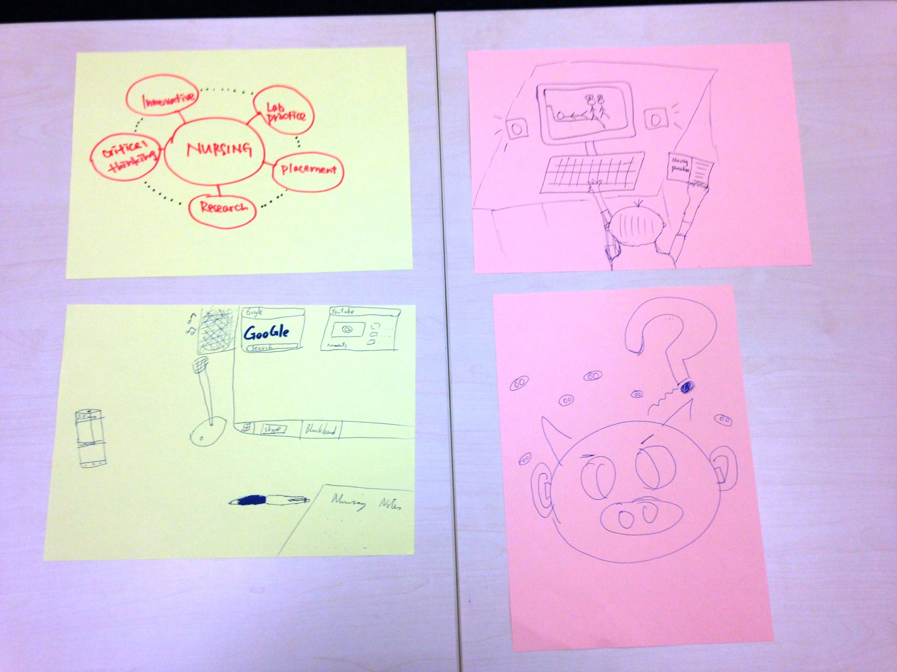
HKPU

Slide 13
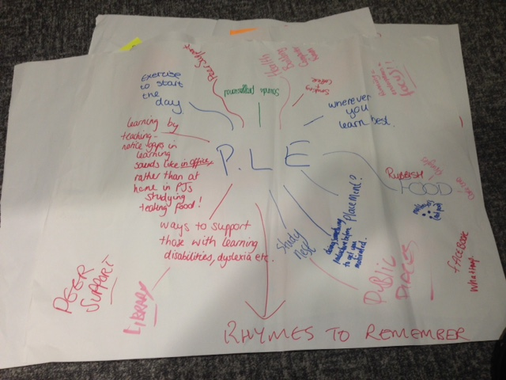
RGU

Slide 14
Key Themes
Technologies
Learning Modalities
Influencing Factors

Slide 15
Technologies
Hard
Virtual
Notes:
Students also think broadly about technology. Hard – physical items such as devices, desktops, laptops, notebooks, pens, stationary, desks, headphones, journals dvds, flashcards
Virtual technologies included the internet itself, the www, VLEs, software, programmes and apps – students differentiated between the virtual technologies that they preferred to use and those that they were expected to use – inluded specific apps and spaces

Slide 16
Learning Modalities
“ when we are in practice we do work with our mentors and other staff members so we try to ask everything”.
Participants identified that they experienced a range of teaching methodologies in nursing studies and described these modes of delivery as a component of their PLE
Notes:
Learning styles and multiple intelligences clearly at play as the participants described and discussed their modalities of learning – broad – F2F Lectures, workplace experience, individual and group study modes.
Personal prefernces again reflected learning styles with notes taking, listening to audio, practice etc
PLE noted to be particuarily effective when it included peer support

Slide 17
Influencing Factors
Interpersonal factors
“Sharing .. Stimulation .. You think about creativity .. So learning is just not from books … with someone else you communicate and … learn …”
Intrapersonal factors
“It’s about personal habits. Listening to music …. Preferences … about how things work together {for the individual]”
External factors
“how an area needs to be’ for the purposes of learning” (UOW 1)
Notes:
Interpersonal factors – how and where students communicated and with whom – face to face provides different opportunities to virtual engagement, for e.g.
Intrapersonal factors – attitudes, emotional status and preferences ultimately affect the motivation and outlook on learning. Shaped their learning experience. Need to moderate the PLE to get to know themselves and what works for them
External factors – physical built environment, learner’s ambient environment

Slide 18
Personally Significant Learning Environment
Hard
Learning Style
Attitude/mood/motivation
Technologies
Influencing Factors
Intra-personal
Student’s
Effective Learning Experience
Virtual
Inter-personal
External
Ambient environment
Learning Modalities
Built environment
Notes:
Based on the initial findings of the first round of focus groups this papers present a conceptual model of PSLEs. The dominant themes were used to construct a model of the PSLE . This model is different from understandings of PLE in that it is sensitive not only to technological components but also recognizes the material, emotional and social elements to students’ understanding of an effective learning space.

Slide 19
Technology
“Technology is about socially collaborative conversations, about the co-creation of meaning in communities, about supporting engagement and development in these communities and about collaborating to achieve more than we ever can alone”
Stodd 2016

Slide 20
? VLE
PLSE
https://julianstodd.files.wordpress.com/2016/04/sl-3.jpg?w=640&h=480
Notes:
Scaffolded social learning intertwined with formal learning. Learning made contextual and meaningful through co-creation of meanings built upon the formal learning. Social learning is malleable

Slide 21
Conclusion
There are few studies that investigate PLEs at the subjective level.
We propose a broader understanding of PLEs that acknowledges individual personal and cultural contexts which we call the personally significant learning environment (PSLE). There is a need for greater investigation of how students understand and systematize their PSLE.
The personal learning ecology - a pedagogical understanding of the relations between individual and their environment for learning – informs the PLSE
Notes:
We agree with Williams, Karousou and Makeness (2011; np) who suggest that PLEs might better be considered as ‘personal learning ecologies’.
Here, they acknowledge that there are a range of external, contextual and personal factors that impact on the efficacy of learning through PLEs.
A PSLE is an individual’s learning state and experience based on the inclusion, exclusion and interplay of learning modalities; intrapersonal, interpersonal and external factors; and, technologies. It is a pedagogical understanding of the relations between the individual and environment, for learning.
We raise the question of what constitutes an effective PSLE for undergraduate nursing students. Current definitions of PLE with the predominant focus on digital technologies do not address the varied ways of nurse learning and are not consistent with our findings. There is need for a broader understanding of how students learn in nursing.

