Slide 1
Building intercultural competence through virtual team collaboration across global classrooms
CABS Chartered Association of Business Schools
LTSE 2019 Learning, Teaching & Student Experience 14-15 May, etc. venues, Manchester
Isabella Crawford Robert Gordon University, Aberdeen, Scotland
Stephanie Swartz University of Mainz Applied Sciences, Mainz, Germany
Susan Luck Pfeiffer University, North Carolina, USA
Belem Barbosa University of Aveiro, Aveiro, Portugal
Notes:
Izzy Crawford is a Senior Lecturer and Academic Strategic Lead within the School of Creative and Cultural Business at Robert Gordon University, Aberdeen, Scotland. She holds postgraduate level qualifications in public relations, higher education learning and teaching, and research methods, and is currently studying for a PhD in the field of Collaborative Online International Learning (COIL). Izzy is an accredited member of the Chartered Institute of Public Relations and a Fellow of the Higher Education Academy in the UK.

Slide 2
The Global Workplace
In 2016, the Fortune 500 earned two-thirds of the US GDP and 37% of the global GDP, with 28 trillion in revenue and 1.5 billion in profits.
The number of US workers employed by foreign-owned companies rose 22% over an eight-year period; compared to an average 3.6% increase in employment in U.S.- owned firms (Pew Research Trust 2017).
These companies employ 67 million people in 34 countries.
Notes:
The world is global whether we like it or not. The Fortune 500 leading global companies employ 67 million people in 34 countries. Tertiary level teaching within this global context presents instructors with several challenges. Through easy accessibility to information throughout the world, instructors of all disciplines must continually keep up with new developments, as well as impart critical thinking skills and fundamental subject knowledge to their students. Furthermore, technical savviness, knowledge of foreign languages and intercultural competence are prerequisites for graduates today. These skills are no longer exclusively for global careers but also for positions in middle-sized companies. And to compete and be successful in these world businesses, no matter the level of employment, employees need intercultural communication competency skills.
According to the Society of Human Resources Management: “a global mindset is crucial, no matter where an employee is located. In the past, an organization's leaders, managers and employees needed to understand a culture only if they were going to another country to live. Now, employees work virtually across borders via technology, they work with a variety of ethnicities at home, and they interact with a globally dispersed customer base. So a global mindset and skills are necessary for all employees (para 2.)”

Slide 3
Intercultural competency shortfall?
Theory vs competency
Intra-university projects, UK based clients
Mismatched student and employer perceptions
Need for more intercultural, experiential student projects
Notes:
According to Deardorff (2009), intercultural competence can be defined as possessing the necessary attitudes and reflective behavioural skills and using these to behave effectively and appropriately in intercultural situations. The emphasis in this context is upon attitude and behavioral understanding when entering a multicultural / international environment and effective behavior. This understanding facilitates success in achieving the goals set out for the cross-cultural interaction e.g. increasing staff motivation, carrying through a cross-border merger, or meeting clients to discuss a business venture. There are numerous academic sources which deliver this type of intercultural communication theory however teaching theory doesn’t necessarily translate into competency.
There are many student projects which involve working in teams with students from the same university and clients who operate within the UK, however these do not directly and intentionally develop intercultural competency and communication skills.
Recent research also suggests there is a gap between graduate perceptions of intercultural competency and employer perceptions of competency. The 2018 Jobs Outlook Survey issued by the U.S. National Association of Colleges and Employers found, among other results, that the percentage of graduating seniors and young employees who believed that they were proficient in global/intercultural fluency was much higher than the percentage view of employers (Bauer-Wolff 2018).
There is therefore a need for more intercultural, experiential student projects to bridge this gap and develop the global mind and skill set that employers want and need.

Slide 4
Collaborative Online International Learning (COIL)
Globally Networked Learning (GNL)
Experiential Learning
Heterogenous Groups
Problem solving and innovation
Emerging communication and learning technologies
Cost effective and inter-disciplinary
Notes:
This project can be categorised as Collaborative Online International Learning (COIL) which is part of the emerging field of Globally Networked Learning (GNL). GNL promotes intercultural competence and the attitudes and reflective behavioural skills which are vital for a globalised economy (SUNY COIL Center, 2019; Deardorff, 2009; Tucker et al, 2013).
Experiential learning through a collaborative project across cultures exposes students to differences in a real-life situation. By stumbling over intercultural blocks (which are inevitable) and emerging unscathed, students begin to appreciate the ambiguity inherent to multicultural interactions.
The future workplace will also need employees who are innovators and disruptors if Capitalism is replaced by Talentism (IMF, 2017). Meisek and Haefliger (2011) cited in Essig (2013) suggest that groups should be heterogenous rather than homogenous to be successful and can provide fertile ground for new ideas. The highly heterogenous nature of COIL projects positions them well to encourage new ways of looking at the world and promote creative problem solving through experiential learning.
COIL projects enable innovative, cost-effective, internationalisation strategies for any educational discipline, level or context because they embrace emerging cloud-based communication and learning technologies (SUNY Center for COIL, 2019). Students acquire the skills, confidence and mindset that will help them to navigate the work based technological challenges of the fourth industrial revolution.

Slide 5
COIL Project Learning Outcome
To develop intercultural communication knowledge, sensitivity, understanding and competency
Notes:
The primary goal of this project was:
To develop intercultural communication knowledge, sensitivity, understanding and competency

Slide 6
Project Aims
Improve English language skills
Improve the ability to work with non-native English language speakers
Promote the use of digital channels in cross-border communication
Cultivate team project management skills
Develop an understanding of the communication challenges facing companies operating in a global context
Improve collaborative writing and speaking skills
Notes:
In an attempt to develop a global mindset and skills among students, this international, virtual, collaborative student project specifically aimed to:
Improve English language skills
Improve the ability to work with non-native English language speakers
Develop intercultural competencies
Promote the use of digital channels in cross-border communication
Cultivate team project management skills
Develop an understanding of the communication challenges facing companies operating in a global context

Slide 7
International, virtual collaboration
Four countries: Scotland, Germany, USA, Portugal
October to November 2017 and 2018 – six week project
Over 100 students in virtual teams
Global industry clients / brands
Notes:
Instructors in four countries (USA, Scotland, Germany and Portugal) created a 6-week, cross-cultural, virtual teams’ project designed to achieve the project aims.
It was conducted with postgraduate and undergraduate students in university business programs whose courses ranged from organisational communication and multicultural teamwork to social media communication and public relations.
In 2017 each team was allocated a client with a business presence in one or more of these countries. In 2018 each team selected their own global client e.g. Coca Cola, Nike, McDonalds.
The team overseeing the project consisted of four academics with backgrounds in business communication, marketing, public relations and intercultural competence.
Stephanie Swartz is Professor of English and US-American Culture at Mainz University of Applied Sciences in Mainz, Germany. Originally from New Jersey, she has spent thirty years studying, researching and teaching in Germany. She specializes in business communication, legal English, intercultural competence, negotiation skills and recently has been teaching and researching virtual team communication. She has a PhD from Paderborn University, Germany in American Studies. She has continued certifying in online teaching, which she does on an adjunct basis for Pfeiffer University, Charlotte, North Carolina. (show video)…
Belem Barbosa has received her PhD in Business and Management Studies – Specialisation in Marketing and Strategy from the University of Porto, Portugal. She is Adjunct Professor at the University of Aveiro, being currently programme director of the MSc in Marketing. She is a member of GOVCOPP, the Research Unit on Governance, Competitiveness and Public Policy. Her research interests lie primarily in the area of consumer behaviour, including word-of-mouth communication, internet marketing and sustainability marketing. She is also interested in internationalization of Higher Education Institutions, namely teacher and student mobility, internationalization at home, and soft skills’ development.
Susan Luck is currently Professor of Business in the Graduate School at Pfeiffer University in North Carolina, specializing in organizational communication, electronic communications, negotiations, public relations, and diversity communication. She has a PhD from the University of South Carolina and is an arbitrator for FINAR and a certified mediator for NC Superior Court. A former TV writer, she teaches both online and in the classroom and is the author of Zen and the Art of Business Communications.

Slide 8
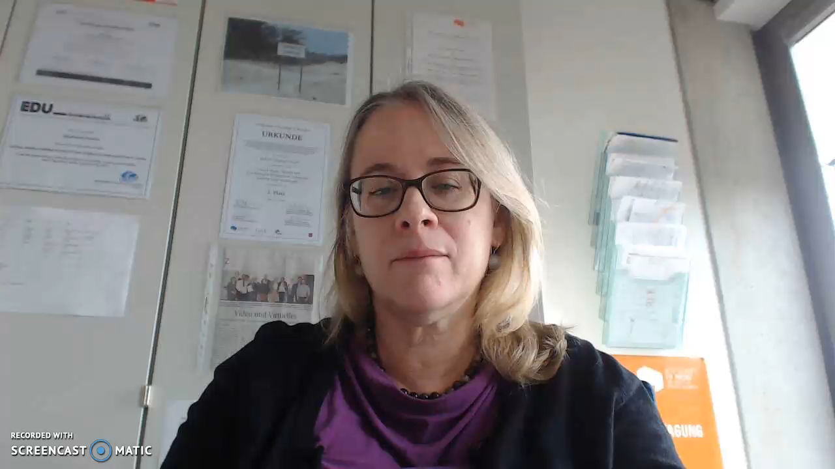
Stephanie Swartz, Professor of English and US-American Culture at Mainz University of Applied Sciences in Mainz, Germany
Notes:
I will now introduce to one of those people - Stephanie Swartz from Mainz University in Germany…(show video).

Slide 9
The Student Brief:
In virtual teams:
Research a named company operating in more than one country
Identify corporate communication issues and solutions
Prepare team presentation
Submit individual reflective summary
Notes:
In virtual teams the students had to:
Research a named company operating in more than one country
Identify corporate communication issues and solutions
Prepare a team presentation
Submit an individual reflective summary
In 2017 the student work focused on the potential difficulties that companies may experience on the foreign market e.g. brand recognition, human resource policies or competitors. Theoretical tools to support a SWOT, PESTLE, Stakeholder and Competitors analyses were provided by the tutors. In 2018, in response to student feedback, the brief was simplified to focus on the online presence of each company.
The output and learning from the activity was used to inform various aspects of the students’ assessed coursework.

Slide 10
The Process
The project involved three main phases:
Initial team building and role allocation
Secondary research into the client
Information sharing among the team and creating the combined presentation
Notes:
Students formed local teams of approximately 2-3 members and created a team identity with logo, slogan as well as a short video clip introducing themselves.
Instructors randomly assigned their local teams to those of their international partners (two nationalities per team).
Teams exchanged information about themselves and held their first icebreaking skype meeting with their counterparts in other countries.
They agreed to a collaborative platform such as Google Drive, SLACK, Facebook group etc. where they uploaded their information and shared files, divided up tasks amongst themselves and agreed to benchmarks along the project timeline.
The teams focused on the assignment, exchanged information and created presentations as well as wrote debriefings on the results.
Students presented the results and gave feedback on the collaboration.

Slide 11
Project Challenges
Different university schedules
Varying course requirements
Built-in project vs. add-on activity
Diverse student backgrounds
Various UG/PG and online/offline disciplines
Different evaluation needs
Notes:
each university had different semester schedules and varying requirements for each course
built-in project vs. add-on
students differed in age, family status, professional careers, ethnic backgrounds as well as English language abilities
courses involved various disciplines within undergraduate and graduate business programs and were taught either online or seated
evaluation of students

Slide 12
Research Question
Do experiential international classroom projects using virtual team collaborations increase intercultural sensitivity and intercultural communication competence in students?
Notes:
The project led the team to develop the following research question:
Do experiential international classroom projects using virtual team collaborations increase intercultural sensitivity and intercultural communication competence in students?

Slide 13
Literature Review
Intercultural Sensitivity (Chen and Starosta, 2000)
Intercultural Communication Competence (Arasaratnam, 2009)
Notes:
According to Chen and Starosta, 1998, intercultural sensitivity is “the ability to recognize differences in behavior, perceptions and feelings during the process of intercultural communication.” This principle was used by Chen and Starosta, 2000 to develop the Intercultural Sensitivity (IS) Scale.
Intercultural communication competence can be defined as “the ability to communicate effectively and appropriately across culturally diverse environments.” This principle was used by Arasaratnam, 2009 to develop the Intercultural Communication Competence (ICC) scale.

Slide 14
Mixed Methods Approach
Online survey based on IS and ICC scales taken before and after project
Post-project qualitative questions to ascertain feelings towards the project and identify areas for improvement
Notes:
Online Survey:
Students completed an online intercultural sensitivity survey based on the Intercultural Sensitivity Scale created by Guo-Ming Chen and William J. Starosta for the University of Rhode Island (2000) which comprised 24 items divided into five factors: Interaction Engagement, Respect of Cultural Differences, Interaction Confidence, Interaction Enjoyment and Interaction Attentiveness and were asked to respond to each item on a five-point Likert scale of 5 = strongly agree, 4 = agree, 3 = uncertain, 2 = disagree and 1 = strongly disagree.
Items from the Intercultural Communication Competence (ICC) scale were also utilized in the survey (Arasaratnam, 2009). Students were asked to respond along the same five-point scale to statements concerning the cognitive, affective and behavioral dimensions of intercultural communication.
Examples of questions Intercultural Sensitivity Scale:
ISS_F1_33[I often give positive responses to my culturally different counterpart during our interaction]
ISS_F1_35[I am open-minded to people from different cultures]
ISS_F1_39[I often show my culturally-distinct counterpart my understanding through verbal or nonverbal cues]
ISS_F1_41[I have a feeling of enjoyment towards differences between my culturally-distinct counterpart and me]
ISS_F1_42[I enjoy interacting with people from different cultures]
ISS_F1_43*[I avoid those situations where I will have to deal with culturally-distinct persons]
ISS_F1_44[I tend to wait before forming an impression of culturally distinct counterparts]
ISS_F2_6*[I don't like to be with people from different cultures]
ISS_F2_14*[I think my culture is better than other cultures]
Examples of questions ICC Scale:
ICC_Cognitive_6[I often notice similarities in personality between people who belong to completely different cultures.]
ICC_Affective_2[I feel that people from other cultures have many valuable things to teach me.]
ICC_Affective_4*[I feel more comfortable with people from my own culture than with people from other cultures.]
ICC_Affective_7*[I usually feel closer to people who are from my own culture because I can relate to them better.]
ICC_Affective_10[I feel more comfortable with people who are open to people from other cultures than people who are not.]
ICC_Behavioral_3*[Most of my friends are from my own culture.]
Qualitative Reflections:
Students were asked to respond to post-project qualitative questions to ascertain feelings towards the project and identify areas for improvement.
They were asked about their personal feelings towards the project, what they found most difficult, their satisfaction with the project, and what they would do differently next time.
They were asked to rate the activity and evaluate both their own and their team members, both at home and abroad, concerning commitment and active participation.
Their answers were compared between native team members and also between international counterparts to see whether tendencies arose concerning positive or negative attitudes towards the project.

Slide 15
Measurement Criteria
increased awareness of verbal, non-verbal and para-verbal communication;
increased appreciation of cultural differences;
reduction of ethnocentristic tendencies and stereotypes;
reduction of fears and increase in confidence in dealing with other cultures;
increased awareness of difficulties in dealing with other cultures.
Notes:
Responses pre and post project were analysed according to five tendencies of intercultural sensitivity and communication competence:
increased awareness of verbal, non-verbal and para-verbal communication;
increased appreciation of cultural differences;
reduction of ethnocentristic tendencies and stereotypes;
reduction of fears and increase in confidence in dealing with other cultures;
increased awareness of difficulties in dealing with other cultures.

Slide 16
Survey Results
Increased awareness of verbal, non-verbal and para-verbal communication
Increased appreciation of cultural differences
Reduction of ethnocentristic tendencies and stereotypes
Reduction of fears and increase in confidence in dealing with other cultures
Increased awareness of difficulties in dealing with other cultures
Notes:
In addition to national cultural differences among the respondents, there existed disparities in gender, ethnicity, generation, educational level, professional experience and family status, as well as areas of study and length of time at university. Key findsings included:
Increased awareness of verbal, non-verbal and para-verbal communication:
Students reported increased sensitivity towards subtle meanings conveyed by their counterparts during intercultural interaction.
Students displayed a greater understanding for the need to watch their counterpart’s behavior more closely to determine their meaning.
Students placed more importance on making affirmative responses during communicating.
Increased appreciation of cultural differences:
Students reported a positive if slight increase in enjoyment towards differences between culturally-distinct counterparts and selves.
Students displayed an increase in respect for the way people from different cultures behave.
A tendancy to avoid those situations where students will have to deal with culturally-distinct persons marginally increased.
Students reported slightly more antipathy towards interacting with people of another culture.
Students stated that they felt more comfortable with people from their own culture and preferring friends from own cultures.
Reduction of ethnocentristic tendencies and stereotypes:
Students registered less openness to diversity and foreign ways of thinking and behaving
Students displayed less value for opinions different from their own.
Students affirmed less difficulty differentiating between similarities in cultures such as Asians, Europeans, Africans, etc.
Students displayed a marginal increase in their feelings that people from other cultures have many valuable things to teach them.
Reduction of fears and increase in confidence in dealing with other cultures:
Students responded that they found it less difficult to talk in front of culturally different people.
They felt less discouraged or useless when engaging with people of different cultures.
Increased awareness of difficulties in dealing with other cultures:
Students reported that they enjoyed the interaction with people from different cultures less and would avoid such interactions more.
Students signaled a decrease in respecting the values of those people after the project.
Students also noted a decrease in informing themselves more when interacting with other cultures.
Students reported an increase in frustration when dealing with people of other cultures.
Students responded that they were less open-minded to people of other cultures.
Ethical principles for doing scientific research were applied, including guaranteeing that the survey was anonymous, confidential, and voluntary.
Quantitative data analysis was performed with IBM SPSS Statistics 24, comprising descriptive and bivariate analyses such as t-Tests and ANOVA. Content analysis of qualitative data was also performed.
In 2018, the majority of the 97 respondents to the surveys were female and their ages ranged from 19 to 55. Approximately 20% were over the age of 30. A third of the respondents described themselves as foreign students; in other words, they did not grow up in the country that they were studying in. The majority of students considered their English good to very good; one third were native speakers of English. The group from RGU was the most diverse and included distance learners.

Slide 17
Qualitative Responses - Positives
new experience and opportunity to work with people from another culture
friendly and inviting atmosphere
real life scenario, finding solutions and solving problems
‘forced’ to work outside comfort zone
experiential ‘learning through doing’
meeting new people, discussing cultural differences, engaging with another culture and hearing other points of view
meaningful changes in their own approach to other cultures
Notes:
Positive aspects of the project:
The students considered it a new experience and opportunity to work and exchange perceptions on the topic with people from another country and another culture.
They appreciated the friendly and inviting atmosphere interacting with the foreign counterparts.
Students valued working in a multicultural team in a real scenario, finding solutions and solving problems.
They appreciated being “forced” to work with different people.
The experiential learning aspect was considered as the most valuable part of the project as well as …
… meeting new people, discussing cultural differences, engaging with another culture and hearing other points of view.
They recognized meaningful changes in their own approach to other cultures.

Slide 18
Qualitative Responses - Negatives
coordinating appointments due to different time zones and schedules
language barriers
coordinating tasks through social media
technological issues (different levels of internet savviness)
differing expectations and deadlines and difficulty agreeing what to do
varying degrees of engagement and reliability between teams
working remotely instead of face-to-face
lack of communication and/or organisation in and between the teams
Notes:
The most difficult or negative aspects of project were:
coordinating appointments to meet due to different time zones and schedules
language barriers
coordinating tasks through social media
technological issues (different levels of internet savviness)
differing expectations and deadlines as well as difficulties agreeing on what to do
varying degrees of engagement and reliability between teams
working remotely instead of face to face
lack of communication and/or organization in and between the teams.

Slide 19
Qualitative Responses – Future Learning
more effort in managing time, assigning roles and delegating tasks
plan better, engage members more, set up more frequent meetings and prioritise the project
value the experience more highly
learn more about the other cultures and enjoy the opportunity of working with foreign students more
Notes:
What students would have done differently:
Students criticized their own, their teams’ and/or their counterparts’ lack of effort in managing time, assigning roles and delegating tasks.
They stated they would have planned better, engaged members more, set up more frequent meetings and prioritized the project higher.
They expressed the disappointment that they did not value the experience as highly as they should have.
In future collaborations they would learn more about the other cultures and enjoy the opportunity of working with foreign students more.

Slide 20
Conclusion
Virtual team collaboration can develop intercultural sensitivity and intercultural communication competence
Valuable contribution to experiential learning pedagogy
Significant potential for enhanced employability and graduate preparedness for the workplace.
Notes:
Positive developments in the areas of Interaction Attentiveness and Interaction Engagement went hand in hand with statistically marginal but nevertheless negative developments in Interaction Engagement and in Respect for Cultural Differences after interacting with people of other cultures.
While many of the negative responses in the areas of Interaction Engagement and Respect for Cultural Differences would appear to defeat the goals of increasing intercultural competence, there are results which give support to the belief that intercultural collaborative projects such as this one can impact students positively and more effectively than classroom instruction.
When comparing the results before and after the project, students appear to have gained an understanding of cultural differences through their interactions and experienced a rise in sensitivity concerning their own communication styles as well as the differences in styles of their counterparts.
The difficulties of the project itself, the pressure of wanting a good grade on the project for some, whereas others not receiving a grade at all, the disparities in motivation among team members as well as language skills etc., could all have had an influence on the positive or negative perception of the culturally distinct counterparts and thus on the values reported in the surveys.
Seemingly negative tendencies in some of the results after the collaborative project may indicate a rise in consciousness concerning the difficulties of real interaction with other cultures. What appears simple in theory to students before the project becomes more daunting when put to the test in a real-life situation.
Further reasons for negative trends proceeding the project may be found in the results concerning what students disliked most about the project (time zones, diverging deadlines and expectations) as well as what they would do differently (invest more time) and their suggestions for future collaborations.
The negative results run counter to the objectives of an intercultural collaborative project and need to be investigated further. However, if intercultural competence can be seen as involving an understanding that cultural differences do exist, that there are potential pitfalls involved in interacting across cultures, and that awareness of these factors can better facilitate successful collaboration (Deardorff, 2006), the findings from this project confirm that a virtual team collaboration, however short and small in scope, develops intercultural sensitivity and intercultural communication competence in students.
While the project was time-consuming and sometimes difficult to embed it into an already demanding curriculum, the instructors consider the project a valuable contribution in experiential learning and will continue to incorporate the project in their courses.
This type of project offers significant potential for enhanced employability and graduate preparedness for a global workplace.

Slide 21
Future Projects and Research
Improve timing, composition, task distribution and support for student teams
Strengthen communication platforms and preparation
Develop more consistent, integrated assessment criteria
Include more frequent multi-way tutor communication
Evolve and refine evaluation methods
Notes:
Future collaborations will ensure more equal conditions among the teams: aligning the project content, syncing the time line and assignment deadlines better and adjusting the assessment criteria so that demands on students are similar.
Tasks should be divided across locations, creating a closer dependence on each other for project success. Inclusiveness should be promoted with the help of digital means, for example through the use of a single platform, SLACK, to collaborate as well as using ZOOM to record teleconferencing sessions in future projects.
After improving project conditions, data from pre and post surveys from future collaborations will be compared with the results of initial data to examine whether there are significant differences in results.

Slide 22
Relevant Literature
Arasaratnam, L. A. (2009). The Development of a New Instrument of Intercultural Communication Competence. http://www.immi.se/intercultural/nr20/arasaratnam.htm
Chen, G.M. & Sarosta, W. J. (1998). Foundations of intercultural communication. Boston: Allyn & Bacon
Chen, G. and William J. Starosta (2000). The Development and Validation of the Intercultural Sensitivity Scale. The University of Rhode Island Digital Commons. http://digitalcommons.uri.edu/cgi/viewcontent.cgi?article=1035&context=com_facpubs
Deardorff, D. (2006). The identification and assessment of intercultural competence as a student outcome of internationalization. Journal of Studies in International Education.10 (3), 241-266.
Deardoff, D. (2009) Theory Reflections: Intercultural Competence Framework/Model. http://www.nafsa.org/_/file/_/theory_connections_intercultural_competence.pdf
Hall, E.T. (1990). Understanding Cultural Differences, Boston: Nicholas Brealey Publishing
Hofstede, G. (1991). Cultures and Organizations: Software of the Mind, Intercultural Cooperation and Its Importance for Survival, Maidenhead: Mc Graw-Hill
Lewis, R.D. (2006). When Cultures Collide. Leading Across Cultures, Boston: Nicholas Brealey Publishing
Mehrabian, A. (1972). Nonverbal Communication. Chicago, IL: Aldine-Atherton
Meisek and Haefliger (2011) cited in Essig, L., (2013). Frameworks for educating the artist of the future: teaching habits of mind for arts entrepreneurship. Artivate: A Journal of Entrepreneurship in the Arts, 1 (2), pp65-77.
Notes:
Some sources which informed this presentation and may be of interest…
Arasaratnam, L. A. (2009). The Development of a New Instrument of Intercultural Communication Competence. http://www.immi.se/intercultural/nr20/arasaratnam.htm
Chen, G.M. & Sarosta, W. J. (1998). Foundations of intercultural communication. Boston: Allyn & Bacon
Chen, G. and William J. Starosta (2000). The Development and Validation of the Intercultural Sensitivity Scale. The University of Rhode Island Digital Commons. http://digitalcommons.uri.edu/cgi/viewcontent.cgi?article=1035&context=com_facpubs
Deardorff, D. (2006). The identification and assessment of intercultural competence as a student outcome of internationalization. Journal of Studies in International Education.10 (3), 241-266.
Deardoff, D. (2009) Theory Reflections: Intercultural Competence Framework/Model. http://www.nafsa.org/_/file/_/theory_connections_intercultural_competence.pdf
Hall, E.T. (1990). Understanding Cultural Differences, Boston: Nicholas Brealey Publishing
Hofstede, G. (1991). Cultures and Organizations: Software of the Mind, Intercultural Cooperation and Its Importance for Survival, Maidenhead: Mc Graw-Hill
Lewis, R.D. (2006). When Cultures Collide. Leading Across Cultures, Boston: Nicholas Brealey Publishing
Mehrabian, A. (1972). Nonverbal Communication. Chicago, IL: Aldine-Atherton
Meisek and Haefliger (2011) cited in Essig, L., (2013). Frameworks for educating the artist of the future: teaching habits of mind for arts entrepreneurship. Artivate: A Journal of Entrepreneurship in the Arts, 1 (2), pp65-77.

Slide 23
Thank You!
Questions
Notes:
Thank you for listening, any questions?

Slide 24
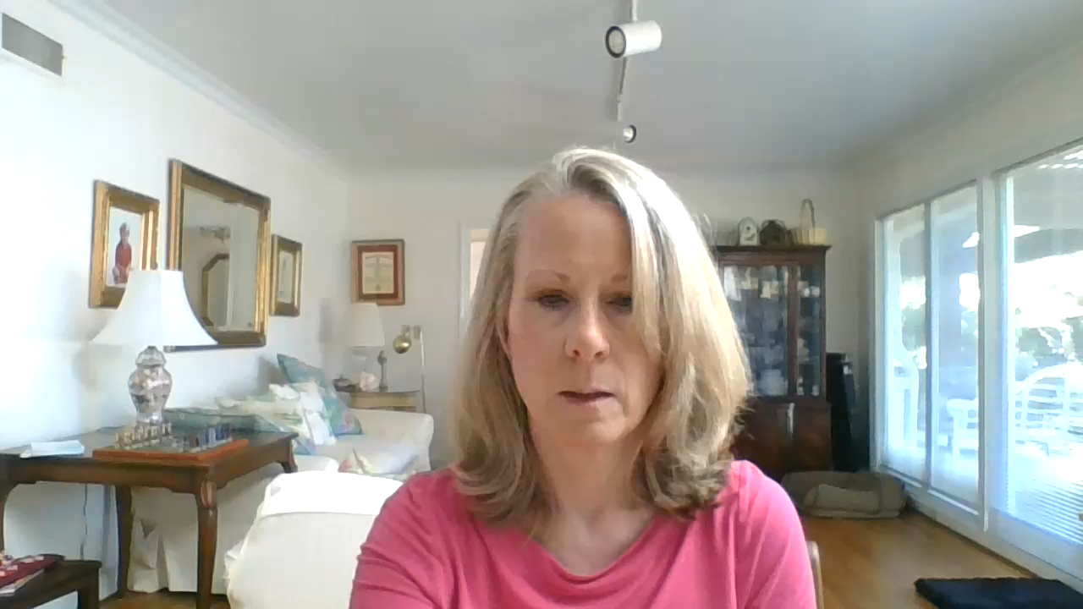
Susan Luck, Professor of Business in the Graduate School at Pfeiffer University in North Carolina

