Slide 1
It’s a small world after all:
An Intercultural Experiential Exercise in Business Communication
Isabella Crawford, Robert Gordon University Scotland; Stephanie Swartz, University of Mainz Applied Sciences Germany; Susan Luck, Pfeiffer University North Carolina; Belem Barbosa, University of Aveiro Portugal.
Notes:
Hello and thank you for coming to see my presentation today. My name is Izzy Crawford and I lecturer in corporate communication within the School of Creative and Cultural Business here at RGU. In the next twenty minutes I’m going to tell you about an international, virtual student project which I was involved in during semester 1 this year, and what I learned from the experience.
Unfortunately my colleague in Germany, Stephanie Swartz, is unable to be here in person today but will be joining us by video shortly…

Slide 2
The Global Workplace
In 2016, the Fortune 500 earned two-thirds of the US GDP and 37% of the global GDP, with 28 trillion in revenue and 1.5 billion in profits.
The number of US workers employed by foreign-owned companies rose 22% over an eight-year period; compared to an average 3.6% increase in employment in U.S.- owned firms (Pew Research Trust 2017).
These companies employ 67 million people in 34 countries.
Notes:
The first question to address is why I felt it was necessary to engage in an international, virtual student project.
The world is global whether we like it or not. The Fortune 500 leading global companies employ 67 million people in 34 countries.
Tertiary level teaching within this global context presents instructors with several challenges.
Through easy accessibility to information throughout the world, instructors of all disciplines must continually keep up with new developments, as well as impart critical thinking skills and fundamental subject knowledge to their students.
Furthermore, technical savviness, knowledge of foreign languages and intercultural competence are prerequisites for graduates today.
These skills are no longer exclusively for global careers but also for positions in middle-sized companies.
And to compete and be successful in these world businesses, no matter the level of employment, employees need intercultural communication competency skills.
According to the Society of Human Resources Management:
“a global mindset is crucial, no matter where an employee is located. In the past, an organization's leaders, managers and employees needed to understand a culture only if they were going to another country to live. Now, employees work virtually across borders via technology, they work with a variety of ethnicities at home, and they interact with a globally dispersed customer base. So a global mindset and skills are necessary for all employees (para 2.)”

Slide 3
Intercultural competency shortfall?
Theory vs competency
Intra-university projects, UK based
Mismatched student and employer perceptions
Need for more intercultural, experiential student projects
Notes:
According to Deardorff (2009), intercultural competence can be defined as possessing the necessary attitudes and reflective behavioural skills and using these to behave effectively and appropriately in intercultural situations. The emphasis in this context is upon attitude and behavioral understanding when entering a multicultural / international environment and effective behavior. This understanding facilitates success in achieving the goals set out for the cross-cultural interaction e.g. increasing staff motivation, carrying through a cross-border merger, or meeting clients to discuss a business venture. There are numerous academic sources which deliver this type of intercultural communication theory however teaching theory doesn’t necessarily translate into competency.
There are many student projects which involve working in teams with students from the same university and clients who operate within the UK, however these do not directly and intentionally develop intercultural competency and communication skills. Experiential learning through a collaborative project across cultures exposes students to differences in a real-life situation. Meisek and Haefliger (2011) cited in Essig (2013) suggest that groups should be heterogenous rather than homogenous to be successful and can provide fertile ground for new ideas . By stumbling over intercultural blocks (which are inevitable) and emerging unscathed, students begin to appreciate the ambiguity inherent to multicultural interactions.
Recent research also suggests there is a gap between graduate perceptions of intercultural competency and employer perceptions of competency. The 2018 Jobs Outlook Survey issued by the U.S. National Association of Colleges and Employers found, among other results, that the percentage of graduating seniors and young employees who believed that they were proficient in global/intercultural fluency was much higher than the percentage view of employers (Bauer-Wolff 2018).
There is therefore a need for more intercultural, experiential student projects to bridge this gap and develop the global mind and skill set that employers want and need.

Slide 4
Project Aims
Improve English language skills
Improve the ability to work with non-native English language speakers
Develop intercultural competencies
Promote the use of digital channels in cross-border communication
Cultivate team project management skills
Develop an understanding of the communication challenges facing companies operating in a global context
Notes:
In an attempt to develop a global mindset and skills among students, this international, virtual, collaborative student project specifically aimed to:
Improve English language skills
Improve the ability to work with non-native English language speakers
Develop intercultural competencies
Promote the use of digital channels in cross-border communication
Cultivate team project management skills
Develop an understanding of the communication challenges facing companies operating in a global context

Slide 5
International, virtual collaboration
Four countries: Scotland, Germany, USA, Portugal
October to November 2017 – six week project
Over 100 students in virtual teams
Global industry clients / brands
Notes:
Instructors in four countries (USA, Scotland, Germany and Portugal) created a 6-week, cross-cultural, virtual teams’ project designed to achieve the project aims.
It was conducted with postgraduate and undergraduate students in university business programs whose courses ranged from organisational communication and multicultural teamwork to social media communication and public relations.
Each team was allocated a client with a business presence in one or more of these countries. The Scottish/German collaboration included Walkers Shortbread, Aldi, Hugo Boss and Johnstons of Elgin.
The team overseeing the project consisted of four academics with backgrounds in business communication, marketing, public relations and intercultural competence. I will now introduce to one of those people - Stephanie Swartz from Mainz University in Germany…(show video).
Stephanie Swartz is Professor of English and US-American Culture at Mainz University of Applied Sciences in Mainz, Germany. Originally from New Jersey, she has spent thirty years studying, researching and teaching in Germany. She specializes in business communication, legal English, intercultural competence, negotiation skills and recently has been teaching and researching virtual team communication. She has a PhD from Paderborn University, Germany in American Studies. She has continued certifying in online teaching, which she does on an adjunct basis for Pfeiffer University, Charlotte, North Carolina. (show video)…
Belem Barbosa has received her PhD in Business and Management Studies – Specialisation in Marketing and Strategy from the University of Porto, Portugal. She is Adjunct Professor at the University of Aveiro, being currently programme director of the MSc in Marketing. She is a member of GOVCOPP, the Research Unit on Governance, Competitiveness and Public Policy. Her research interests lie primarily in the area of consumer behaviour, including word-of-mouth communication, internet marketing and sustainability marketing. She is also interested in internationalization of Higher Education Institutions, namely teacher and student mobility, internationalization at home, and soft skills’ development.
Susan Luck is currently Professor of Business in the Graduate School at Pfeiffer University in North Carolina, specializing in organizational communication, electronic communications, negotiations, public relations, and diversity communication. She has a PhD from the University of South Carolina and is an arbitrator for FINAR and a certified mediator for NC Superior Court. A former TV writer, she teaches both online and in the classroom and is the author of Zen and the Art of Business Communications.
Izzy Crawford is a Senior Lecturer and Academic Strategic Lead within the School of Creative and Cultural Business at Robert Gordon University, Aberdeen, Scotland. She holds postgraduate level qualifications in public relations, higher education learning and teaching, and research methods, and is currently studying for a PhD in the field of employee engagement theory and practice within higher education. Izzy is an accredited member of the Chartered Institute of Public Relations and a Fellow of the Higher Education Academy in the UK.

Slide 6
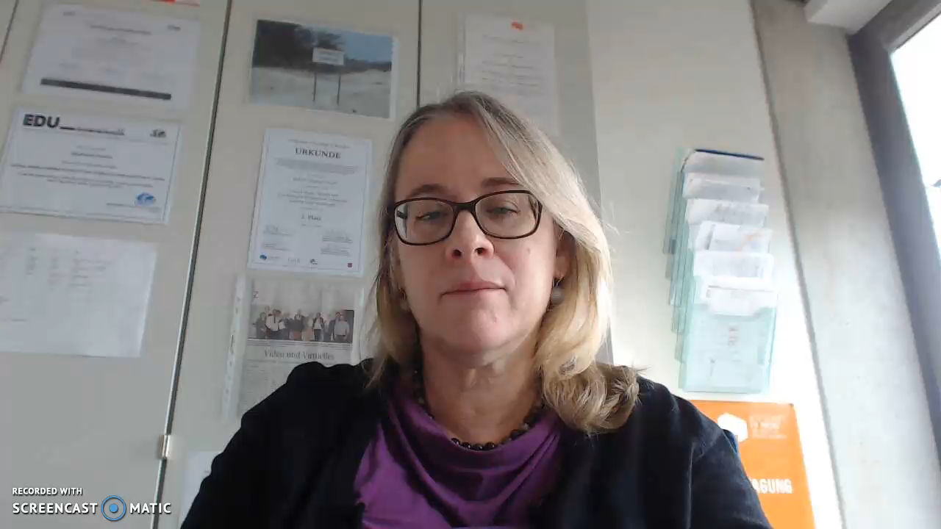
Stephanie Swartz, Professor of English and US-American Culture at Mainz University of Applied Sciences in Mainz, Germany

Slide 7
Student Activities:
In virtual teams:
Research a named company operating in more than one country
Identify three key communication issues and solutions
Prepare ten minute team presentation to class
Submit 500 word individual reflective summary
Notes:
In virtual teams the students had to :
Research a named company operating in more than one country
Identify three key communication issues and solutions
Prepare a ten minute team presentation for their ‘home’ class
Submit a 500 word individual reflective summary
The project involved three main phases:
The initial team building and role allocation
Secondary research into the client
Information sharing among the team and creating the combined presentation
The student work focused on the potential difficulties that companies may experience on the foreign market e.g. brand recognition, human resource policies or competitors. Theoretical tools to support a SWOT, PESTLE, Stakeholder and Competitors analyses were provided by the tutors.
The output and learning from the activity was used to inform various aspects of the students’ assessed coursework.

Slide 8
Core Learning Outcome
To learn how to communicate with people from another culture…

Slide 9
Evaluation Criteria
Chen and Starosta’s intercultural sensitivity five point scale:
Interaction Engagement
Respect of Cultural Differences
Interaction Confidence
Interaction Enjoyment
Interaction Attentiveness
Notes:
In order to determine whether students increased their intercultural competency through this project, instructors had their students complete an online intercultural sensitivity survey based on the Intercultural Sensitivity Scale created by Guo-Ming Chen and William J. Starosta for the University of Rhode Island (2000).
Out of 44 items which Chen and Starosta developed as indicators for the measurement of intercultural sensitivity, we selected 24 items divided into five factors: Interaction Engagement, Respect of Cultural Differences, Interaction Confidence, Interaction Enjoyment and Interaction Attentiveness and asked students to respond to each item on a five-point Likert scale (5 = strongly agree, 4 = agree, 3 = uncertain, 2 = disagree and 1 = strongly disagree).
Students were asked to complete this survey before the project began. At the end of the project, students were again asked to complete the survey but this time we included qualitative questions concerning their personal feelings towards the project, what they found most difficult, their satisfaction with the project, and what they would do differently next time. In addition, they were asked to rate the activity and evaluate both their own and their team members, both at home and abroad, concerning commitment and active participation .
The majority of the 97 respondents to the surveys were female and their ages ranged from 19 to 55. Approximately 20% were over the age of 30. A third of the respondents described themselves as foreign students; in other words, they did not grow up in the country that they were studying in. The majority of students considered their English good to very good; one third were native speakers of English. Thus, in addition to national cultural differences, there existed disparities in gender, ethnicity, generation, educational level, professional experience and family status, as well as areas of study and length of time at university. The group from RGU was the most diverse and included distance learners.
Ethical principles for doing scientific research were applied, including guaranteeing that the survey was anonymous, confidential, and voluntary.
Quantitative data analysis was performed with IBM SPSS Statistics 24, comprising descriptive and bivariate analyses such as t-Tests and ANOVA. Content analysis of qualitative data was also performed.

Slide 10
Key Findings
Increased sensitivity to subtle clues in cultural communication
Slight increase in recognising that students needed to watch behavior to interpret words
Negative effect on willingness to interact with those from another culture
Negative effect on willingness to interact with those from their same culture
Notes:
The survey produced some mixed results including:
Increased sensitivity to subtle clues in cultural communication – the students were more attentive, and took the communication less for granted than ‘normal’ communication
Slight increase in recognising that students needed to watch behavior to interpret words – the activity improved their paralinguistic awareness
Negative effect on willingness to interact with those from another culture – it was more challenging for some groups than others – if communication failed at the first hurdle some students lost confidence and there was a tendency on both sides to blame the other
Negative effect on willingness to interact with those from their same culture – typical negative group work dynamics were magnified due to the additional challenges – the activity was not formally assessed so there was a wide range of motivation levels

Slide 11
Key Findings
Increase in enjoyment in interacting with people from another culture
Decrease in fear around interacting with people from another culture
Decrease in fear of one’s ability to communicate with people from another culture
Increase in willingness to try to convey meaning in a manner outside of one’s own comfort zone.
Notes:
More positive findings included:
increase in enjoyment in interacting with people from another culture – successful groups loved the whole process
decrease in fear around interacting with people from another culture - a ‘safe’ framework was provided through this activity
decrease in fear of one’s ability to communicate with people from another culture – confidence was gained through this experience – it was not as scary as students initially anticipated
increase in willingness to try to convey meaning in a manner outside of one’s own comfort zone – students had to think differently and try new approaches to communication – this was excellent for problem solving ability

Slide 12
Conclusion and next steps
Evolve and refine evaluation methods
Improve timing, composition and support for student teams
Incorporate more international student presentations
Develop more consistent, integrated assessment criteria
Include more frequent multi-way tutor communication
Notes:
The survey findings combined with anecdotal evidence obtained through informal discussions between students and staff involved in the project, suggested that overall the project has been worthwhile. However there are a number of enhancements which will be made when the project is repeated next session including:
Evolve and refine the evaluation methods e.g. include an additional qualitative method such as a focus group in class, to probe the survey responses further
Improve co-ordination, timing, composition and support for student teams
Incorporate more international student presentations to promote engagement
Develop more consistent, integrated assessment criteria
Include more frequent multi-way tutor communication e.g. regular Skype calls
Final word from the North American tutor, Susan Luck, who is currently Professor of Business in the Graduate School at Pfeiffer University in North Carolina…

Slide 13
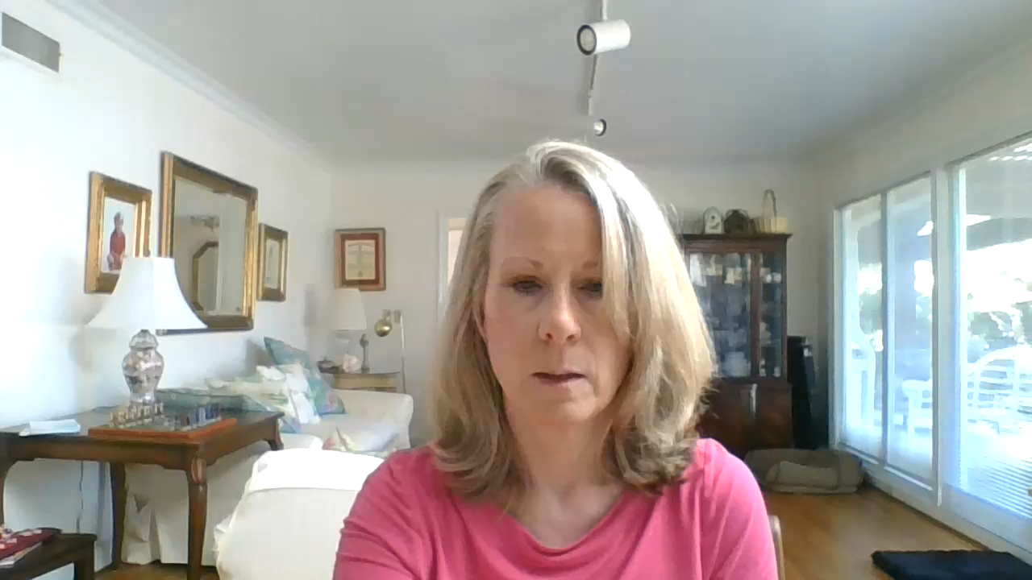
Susan Luck, Professor of Business in the Graduate School at Pfeiffer University in North Carolina

Slide 14
Recommended Reading
Arasaratnam, L. A. (2009). The Development of a New Instrument of Intercultural Communication Competence. http://www.immi.se/intercultural/nr20/arasaratnam.htm
Chen, G. and William J. Starosta (2000). The Development and Validation of the Intercultural Sensitivity Scale. The University of Rhode Island Digital Commons. http://digitalcommons.uri.edu/cgi/viewcontent.cgi?article=1035&context=com_facpubs
Deardoff, D. (2009) Theory Reflections: Intercultural Competence Framework/Model. http://www.nafsa.org/_/file/_/theory_connections_intercultural_competence.pdf
Hall, E.T. (1990). Understanding Cultural Differences, Boston: Nicholas Brealey Publishing
Hofstede, G. (1991). Cultures and Organizations: Software of the Mind, Intercultural Cooperation and Its Importance for Survival, Maidenhead: Mc Graw-Hill
Lewis, R.D. (2006). When Cultures Collide. Leading Across Cultures, Boston: Nicholas Brealey Publishing
Mehrabian, A. (1972). Nonverbal Communication. Chicago, IL: Aldine-Atherton
Meisek and Haefliger (2011) cited in Essig, L., (2013). Frameworks for educating the artist of the future: teaching habits of mind for arts entrepreneurship. Artivate: A Journal of Entrepreneurship in the Arts, 1 (2), pp65-77.
Notes:
Some sources which informed this presentation and may be of interest…

Slide 15
Thank You!
Questions
Notes:
Thank you for listening, any questions?

