Slide 1
“Did you feel that?” Multimodal interactions and making sense of uncanny events
Dr Rachael Ironside
Robert Gordon University, Aberdeen

Slide 2
Context
Why study paranormal experiences?
2/5 UK population reported an experience (Castro, Burrows & Wooffitt, 2014)
Seeking paranormal experiences has become a ‘professionalised’ activity - over 4,000 paranormal groups in the USA (Eaton, 2018)
The challenge
Experiences are often spontaneous, subjective and personal
We know relatively little about what happens when an experience takes place and how people make sense of it
Why do some experiences become ‘uncanny’?
Questions:
How do people experience paranormal events together?
How do people interpret and experience these events as uncanny?

Slide 3
Approach
Collection of video data from personal involvement in a paranormal groups between 2006-2010
Video data of groups (3-10) conducting paranormal investigations across the UK
Collected prior to doctoral research – I am a participant in the data
Selected instances where are experience occurs for analysis
https://youtu.be/3mLMjX-tRjI

Slide 4
Did you feel ‘that’?
Use of the term ‘that’ when referring to events carries with it important social implications:
Acts as a reference
Ambiguous (‘that’ is not immediately defined)
Invites others to participate in the discovery and categorisation of ‘that’
“was that you?”
“what was that?”

Slide 5
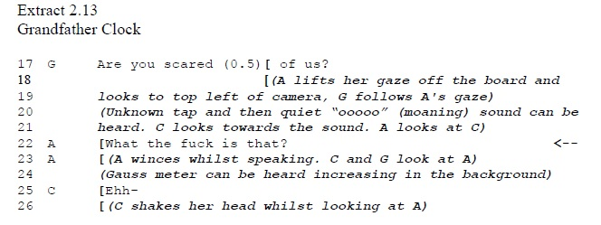
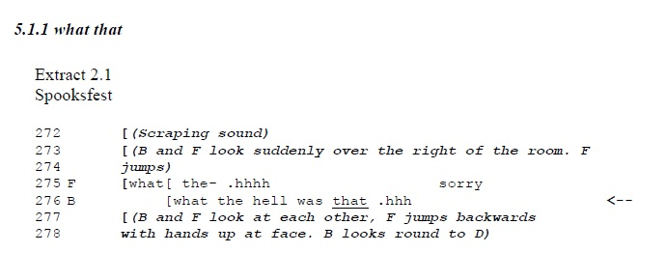

Slide 6
Empty space
‘That’ reference often accompanied by identification of an empty space through gesture/ embodied action.
An empty space also carries important features – it indicates that something has caused the ‘event’ that is not physically present (possibly a ghost!)
Multimodal action towards empty space locates an event and in doing so enables it to be shared and understood in the context of a uncanny/ normal explanation
Empty space
Inhabited space

Slide 9
Feeling ‘spirits’
Events are often experienced on or in the body (touch, feeling, temperature change…)
Individuals display and communicate these experiences through embodied actions
They also use embodied action to verify and substantiate uncanny qualities of an event
They also communicate and describe the features of external events using embodied actions
Individuals present, share and communicate the uncanny qualities of their experience through multimodal and embodied action

Slide 11
Feeling ‘spirits’
Events are often experienced on or in the body (touch, feeling, temperature change…)
Individuals display and communicate these experiences through embodied actions
They also use embodied action to verify and substantiate uncanny qualities of an event
They also communicate and describe the features of external events using embodied actions
Individuals present, share and communicate the uncanny qualities of their experience through multimodal and embodied action

Slide 13
Some reflections…
Paranormal experiences are communicated, shared and made sense of through multimodal and embodied action
Studying interaction enabled a closer analysis of how people make sense of uncanny events and experience these collectively – establishing the status of an uncanny event is a social activity
Reflective ethnographic knowledge helped to provide context, but can present some challenges in analyzing ‘self’ (group data sessions helped with this)
The benefits of ethnographic knowledge surpassed challenges – context, cultural understanding, inner experience – and may be of benefit to wider settings

