Slide 1
Development of an Outcome Measure to Assess Performance of Physiotherapy Cardiorespiratory Skills: A Delphi study
Fiona Roberts
School of Health Sciences

Slide 2
Where are we in evidencing simulation in physiotherapy education?
Evidence focuses on student perceptions
One pilot study investigated actual impact on skill performance
Due to pressures in higher education we need to show it works
What outcome measures there are focus on MSK skills

Slide 3
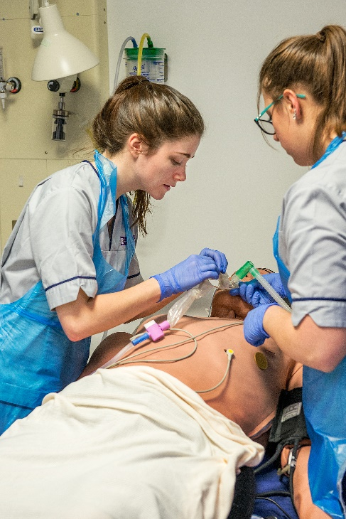
The ultimate aim…
To investigate if using simulated patients in practical teaching session improves skill development
First
Develop an valid and reliable outcome measure to assess the students!
To identify the elements of palpation, auscultation, Active Cycle of Breathing Technique, vibrations and percussion expert cardiorespiratory physiotherapists consider essential for students to be deemed competent.

Slide 4
Method – Modified Delphi
Identified experts – publishing, practicing/teaching
Round 1 – open questions, content analysis
Round 2 – refining, clarifying: Likert scale questions and open questions – content analysis and % agreement
Round 3 - refining, clarifying, Likert scale agreement – 8% agreement reported. Some elements identifying if essential/nice to have/not required - analysed with content validity index
Round 4 – level of consensus with refined statements, confirmation if elements core or nice to have. Analysed with Content Validity Index

Slide 5
Participants
Excluded
Round 1
Round 1 invited, n = 19
Demographic data n = 13,
Responses n = 6
3 no response
3 declined
Round 2
invited n = 29 , 13 (R1), 16 new (R2+)
Responses 15/21, 10/13 R1, 5/8 R2
R2+ 8/16 no response
3 R1 non response
1 non response R2+
Round 3
Invited n = 16 R1 = 10 R2+ = 7
Responses 14/16
2 non-respondents 1 R1, 1R2+
Round 4
Invited n =12
Responses 12/12

Slide 6
Were they experts?
 | Round 1 | Round 2 | Round 3 | Round 4
Participants | 6/13 (45%) | 15/21 (71%) | 14/16 (88%) | 12/12 (100%)
Australia Canada New Zealand UK | 3/3 2/3 0/1 2/6 | 6/12 3/5 0/1 5/11 | 7/8 3/3 - 4/5 | 5/5 3/3 - 4/4
Years Qualified | 27(13-32) | 26 (13-36) | 26 (13-36) | 26 (13-36)
Years in practice | 25 (13-32) | 21 (5-35) | 22 (5-35) | 24 (11-35)
Years in academia | 13 (3-28) | 12 (1-28) | 12 (1-28) | 12 (1-28)
Yrs in CR | 23 (10-30) | 20 (5-32) | 22 (10-32) | 22 (10-32)
Yrs with students | 24 (13-32) | 20 (4-34) | 20 (4-34) | 21 (4-34)
Highest academic qualification |  | 9 PhD 2Ed D 4 Masters | 9 PhD 1Ed D 4 Masters | 7 PhD 1 Ed D42 Masters

Slide 7
Results
372 individual items identified in Round 1
For round 2 - 199 items included
By end Round 4 - 87 items remained + 8 global professional behaviours
Scale CVI = 0.907
 |  | Palp^{n} | Ausc^{n} | BC | TEE | FET | Perc^{n} | Vib^{n} | Total
Reasons/ Communication | R1 | 4 | 8 | 2 | 5 | 5 | 5 | 9 | 38
 | R4 | 5 (+1) | 3(+2) | 2(+0) | 1(+0) | 1(+3) | 1 (+1) | 3(+4) | 26
Skill Performance | R1 | 21 | 27 | 28 | 30 | 20 | 16 | 19 | 161
 | R4 | 1(+0) | 6(+8) | 4(+6) | 2(+7) | 6(+4) | 3(+2) | 4(+6) | 61

Slide 8
Discussion
Currently no suitable outcome measures
Generally agreement for items either very positive or very negative
Currently a draft tool - CrEST
Limitations – recruitment of experts Only 3 countries represented Number of participants

Slide 9
The next steps
Rasch analysis for construct validity
Reliability testing
Fingers crossed -
A study into the effectiveness of high fidelity simulation in skill development for pre-registration physiotherapy students

