Slide 1
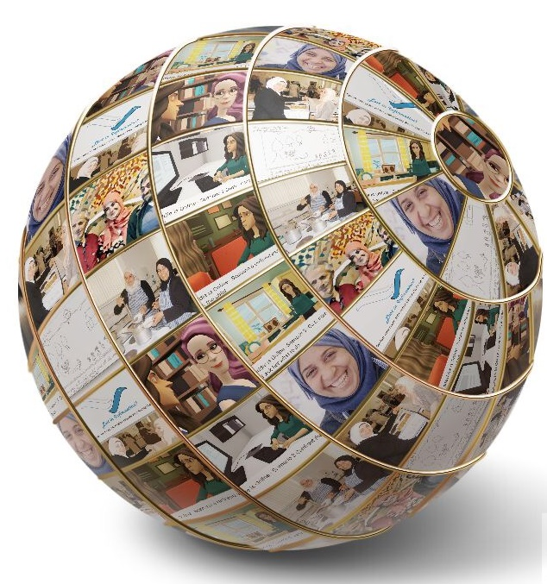
The role of the public library as an enabler of accessible and inclusive information Literacy
Dr Konstantina Martzoukou
Teaching Excellence Fellow - Robert Gordon University
E: k.martzoukou@rgu.ac.uk @Dinamartz @OneHEMindsets
Notes:
I

Slide 2
a
democratic
inclusive
overlaps with
other literacies
empowering
participatory
universal human right
https://infolit.org.uk/ILdefinitionCILIP2018.pdf
Photo by Philipp Berndt@philberndt

Slide 3
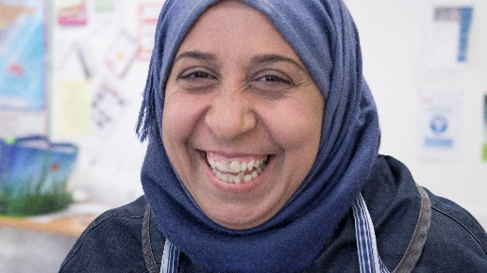
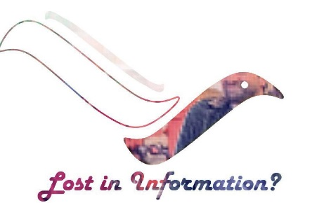
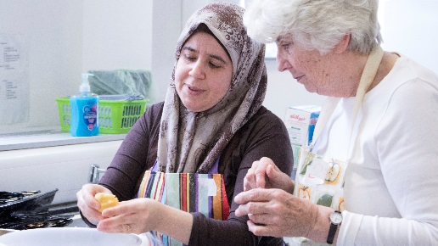
Syrian New Scots: the project and the Way Forward
https://syrian-information-literacy.blogspot.com/

Slide 4
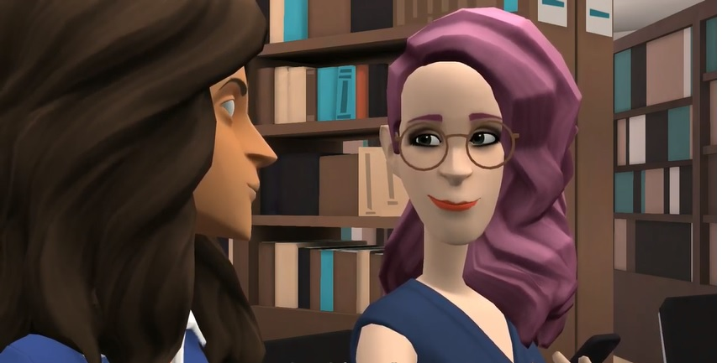
Maddie is online
Some reflections for public librarians
Website:
https://maddiesonline.blogspot.com/
Subscribe to all the video Playlists
bit.ly/2LwnE6T

Slide 5
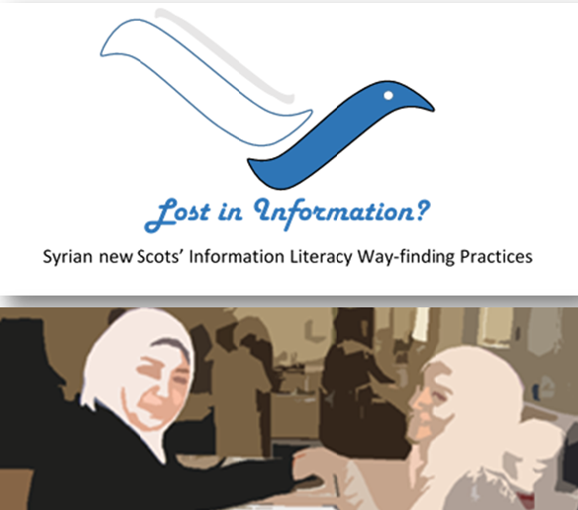
‘Lost in Information: Syrian new Scots’ Information Literacy Way-finding practices’
Presentations
MARTZOUKOU, K. 2016. Lost in Information? Syrian new Scots Information Literacy Way-finding Practices. Information Literacy CoP. Edinburgh, 6th December 2016. Presentation available from https://www.slideshare.net/martzoukou/lost-in-information-syrian-new-scots-information-literacy-wayfinding-practices
MARTZOUKOU, K. 2017. Information Literacy and Syrian new Scots. The Right Information. Digital Skills for the 21st century Scotland. Digital & Information Literacy Forum 2017 organised by the Scottish Library and Information Council (SLIC) and the Scottish Government https://scottishlibraries.org/media/1697/digital-and-information-literacy-forum-2017-programme.pdf
MARTZOUKOU, K. 2017. Syrian new Scots Information Literacy Way-finding practices: Phase 1 Research Findings. LILAC conference. Swansea University (Bay Campus). 10-12 APRIL 2017
MARTZOUKOU, K. 2017. The Information Experiences of Syrian new Scots: more than meets the eye Syrian new Scots Information Literacy Way-findings practices. 2017. I3 Information Interactions and Impact conference 27-30 June 2017 Aberdeen
MARTZOUKOU, K. 2017. Scotland Welcomes refugees – the roles of the library in resettlement and inclusion: Syrian new Scots Information Literacy Way-findings practices. CILIPS Annual Conference 2017: Strategies for Success, 5-6 June 2017, Dundee.
MARTZOUKOU, K. 2017,“Grey in Sepia”: Empowering the everyday life information literacy of Syrian new Scots. CILIP Annual Conference: 5-6 July 2017 Manchester
Journal paper
MARTZOUKOU, K. and BURNETT, S. 2018. Exploring the everyday life information needs and the sociocultural adaptation barriers of Syrian refugees in Scotland. Journal of Documentation [online], 74(5), pages 1104-1132. Available from: https://doi.org/10.1108/JD-10-2017-0142
Report for CILIP ILG
Blog: https://syrian-information-literacy.blogspot.co.uk/2016_09_01_archive.html

Slide 6
MARTZOUKOU, K. 2019. Scottish Public Libraries Welcome Syrian new Scots: a transition from being a refugee to becoming an active part of the community. In S. Goldstein. Informed societies – why information literacy matters for citizenship, participation and democracy. Facet Publishing.

Slide 7
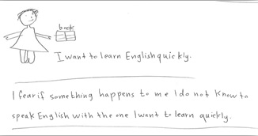
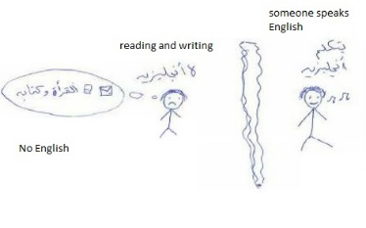
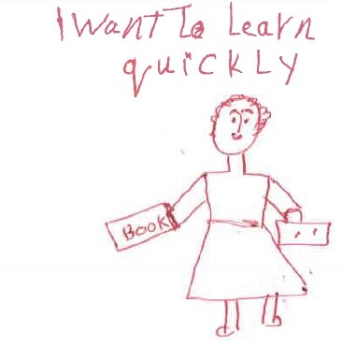
Barriers: English Language
solve everyday life problems
reduce feelings of isolation
secure employment opportunities
ensure financial security
address independently information needs
Age differences
Education
Diverse previous life experiences
Different learning preferences/cultural differences

Slide 8
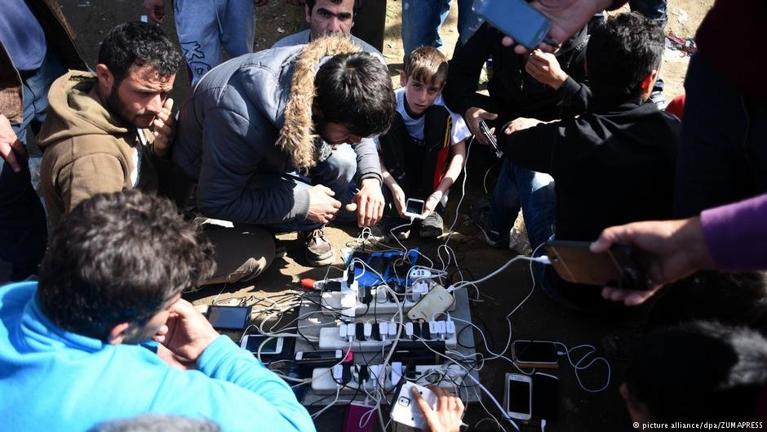
ICT skills
Need for further support with ICT literacy:
mobile apps /online translation tools: communicate, entertain, organise everyday life needs (e.g. utility bills, hospital appointments), learn English, keep in touch with families and friends.
mobile phones as a lifeline but gender, age & life experiences dichotomies
online safety
In need of a signal: Technology is giving refugees, asylum seekers and migrants a voice - Marc Kosciejew.
iRefugee, the iAsylum seeker, the iMigrant.

Slide 9
Otherness versus togetherness
The experiences and knowledge structures refugees bring with them should be considered less from a point of view of ‘otherness’ and more as contributing social capital to the context to which they were becoming a part.

Slide 10
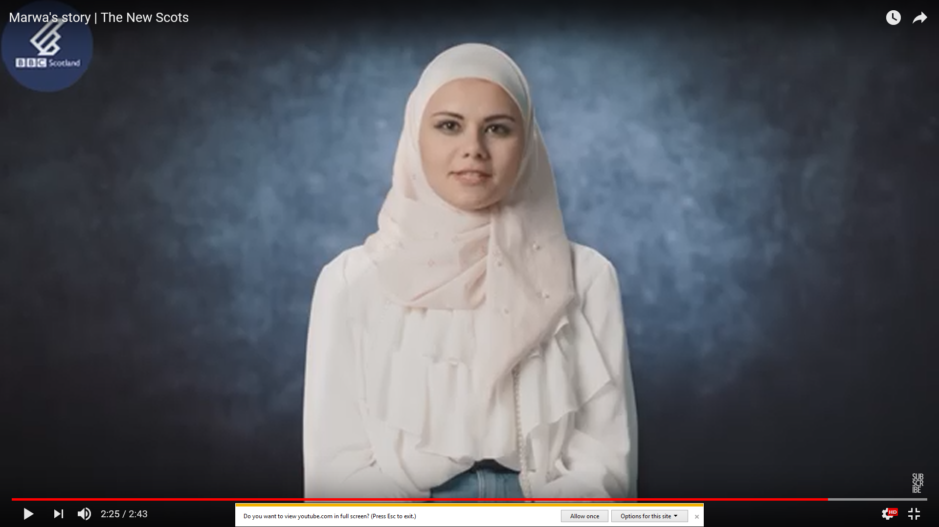
Marwa’s story

Slide 11
Ways of engagement
Designing active programmes: allowed Syrian new Scots to make a direct contribution to local community
Engaging in local community events that celebrate different cultures
Encouraging cultural heritage exchange: https://syrian-information-literacy.blogspot.com/2017/04/safeguarding-syrian-intangible-cultural.html

Slide 12
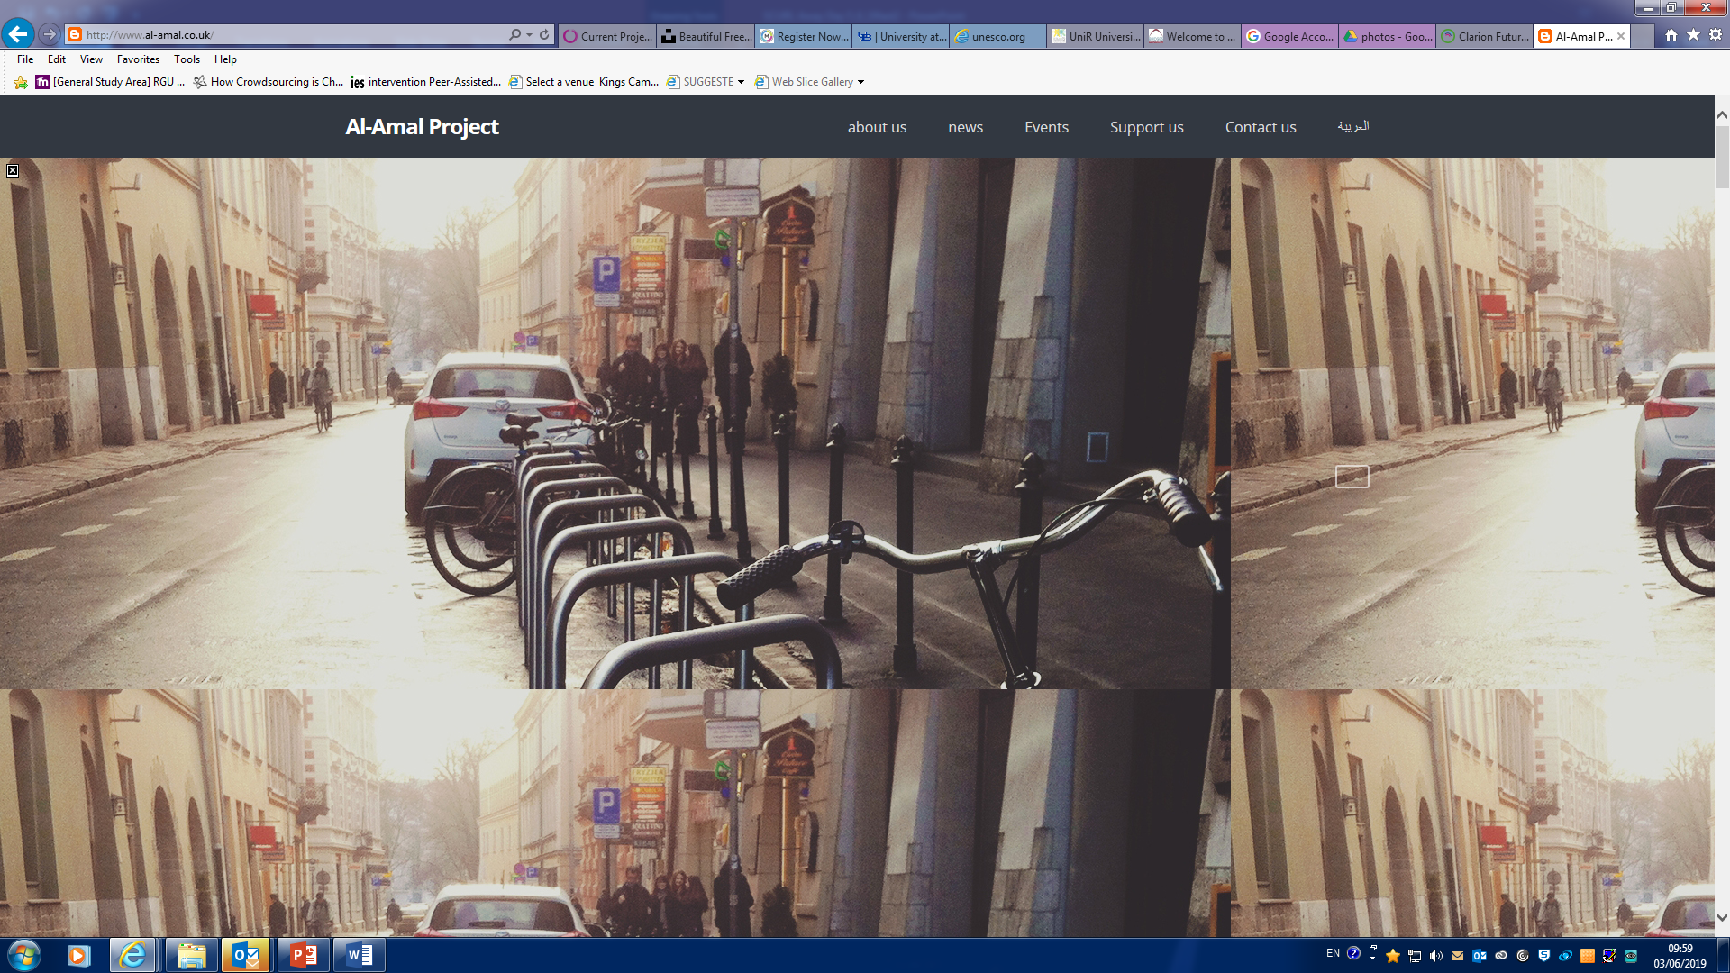
The Al Amal (hope) project http://www.al-amal.co.uk/

Slide 13
Public Libraries
establishing a single library card for Syrian new Scots and automatically signing families as members
offering source material in Arabic (including newspapers and material for children) / Arabic speaker volunteers based in local public libraries
providing health information in accessible pictorial formats
helping the families to develop their health & digital literacy (provision of additional classes)
setting up a community hub with volunteering opportunities for Syrian new Scots
setting up family sessions and getting the families to engage with the early years programme
creating a friendly, welcoming and trusted 'third place' for families to learn, socialise and feel part of the community: e.g. introducing an induction session and a short film on what public libraries could offer
Local Refugee Resettlement Officers
Arabic resources available (for example more resources were in Polish)
-----
“if there was a resource there and every library had guaranteed a hub and they had this information they would go”
------
no Arabic speakers
------
Increasing community awareness, presenting the whole picture of the situation that these families have encountered

Slide 14
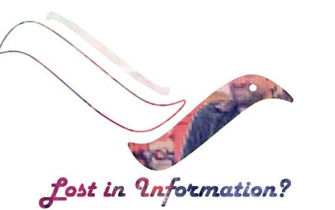
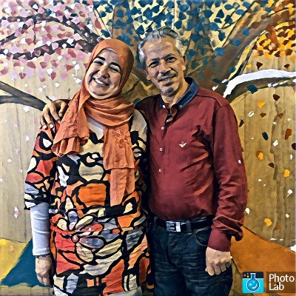
Library Case Studies
The Network http://www.seapn.org.uk supports libraries, museums, archives, galleries and other cultural and heritage organisations (as well as individuals) who are working to tackle social exclusion and towards social justice.
Brief library case-studies by EBLIDA (the European Bureau of Library, Information and Documentation Associations)
‘Welcome to your Library’ (WTYL) (2003- 2007 funded by Paul Hamlyn Foundation (co-ordinated through London Libraries Development Agency)

Slide 15
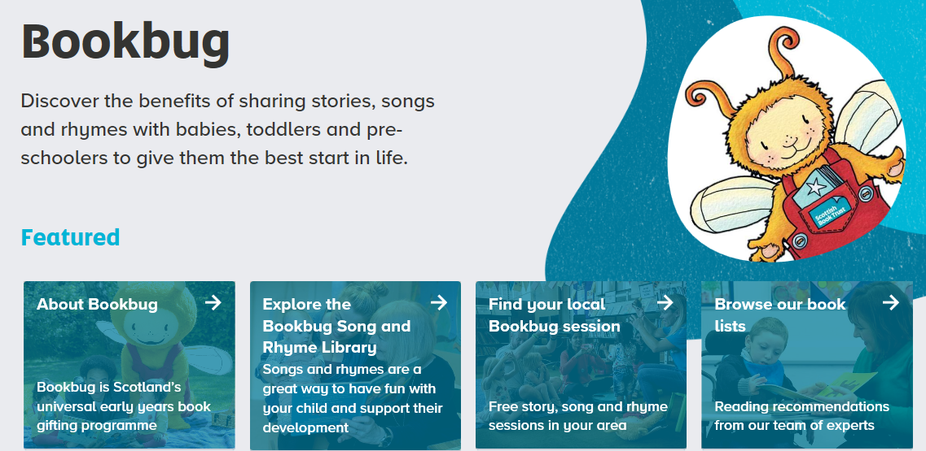
North Ayrshire Council libraries
Met with Housing, Education and Community Learning colleagues
how many Syrian new Scots were expected
where they would be housed
demographic characteristics of the expected families (e.g. children of school age)
Bought a collection of Arabic books
(e.g. children’s books, short stories collections and dual Arabic/English language recourses).
Placed them in the library nearest to where the new families had been housed
Additional Plans
offer meeting spaces in the libraries
recruit Arabic speaking Computer Buddies & BookBug leaders

Slide 16
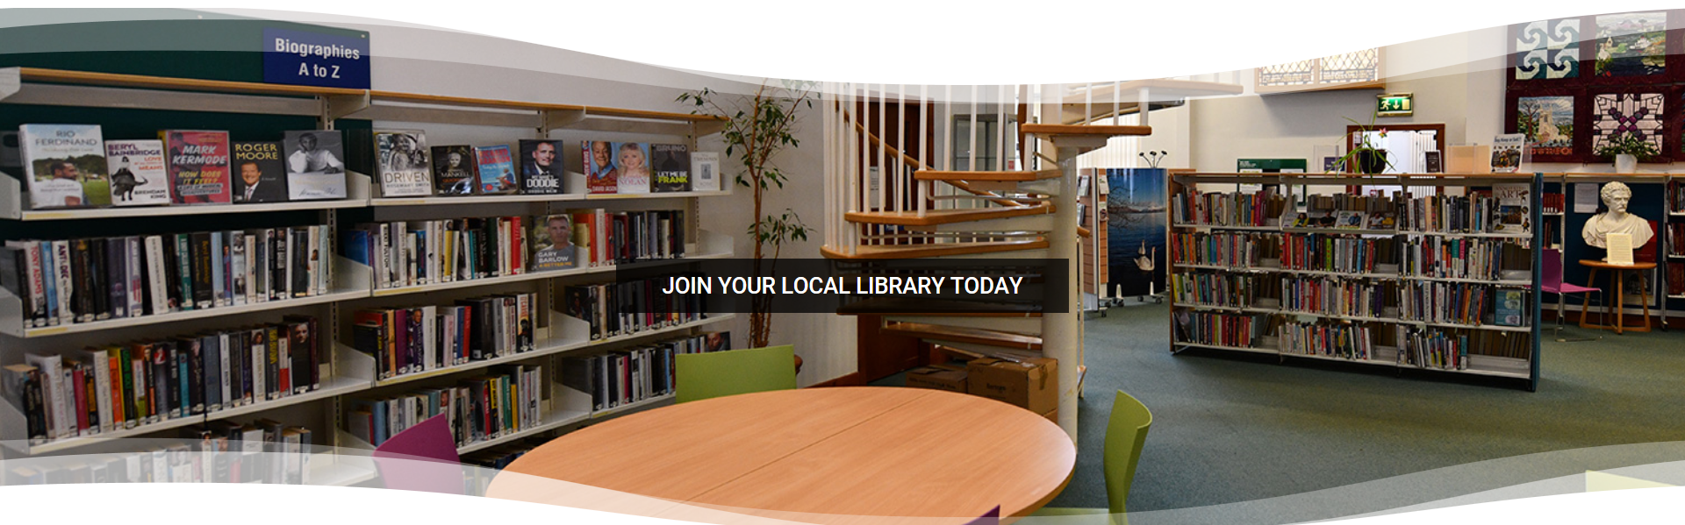
Rothesay library, Isle of Bute
Arabic leaflets in its MCISS (Macmillan Cancer Information and Support Service)
Guest free Internet wi-fi access via the ‘Peoples Network’
Community-based Adult Learning services and classes to female Syrian new Scots
how to keep up with new technology / take the first steps into learning / enjoy community life / more fully progress into further learning / gain skills to find work.
Collection of children's and young adults’ books in Arabic
Syrian children to the library during school visits
Venue for English Language Classes - Adult Learning office or Greet Tree Room (Moat Centre)

Slide 17
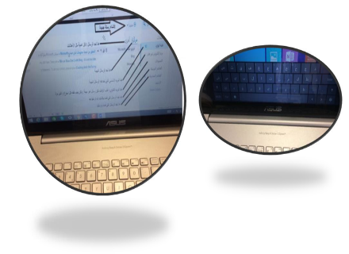
Aberdeenshire libraries
Arabic keyboard stickers/overlays
ICT classes / ICT volunteer from the group of young Syrians (for computer basics; email; shopping online, overview and how to shop from Amazon, eBay, and some of the sites).
Bookbug sessions solely for female Syrians
Book Week Scotland 2017 (theme: Nourish - one of the strands was called ‘Breaking Bread’ - about sharing culture)
event in Inverurie Library with the ‘Al Amal’ group to share the culture of the Syrians and a little of their story coming to Scotland/ created a film – homeland – video

Slide 18
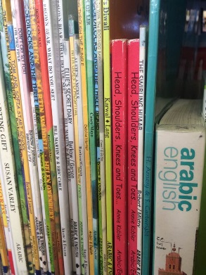
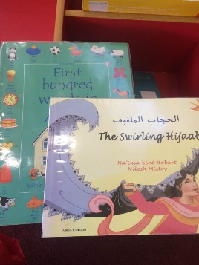
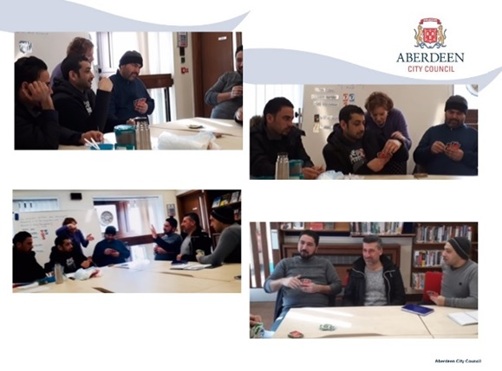
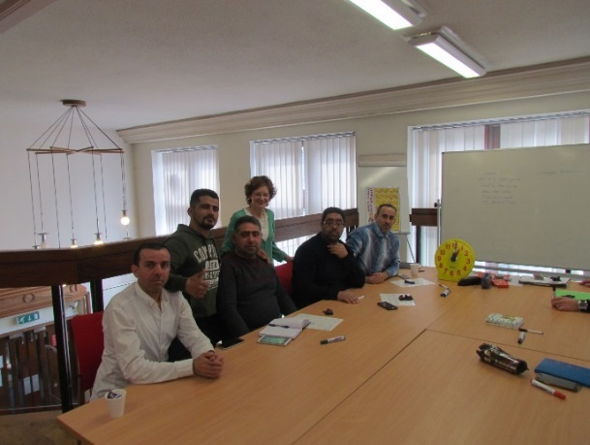
Aberdeen City Libraries
A pop-up classroom area on the library Mezzanine floor to accommodate 10 Syrian learners and a tutor for ESOL classes.
The classes ran twice weekly (a men only class and a women only class). Feedback from the tutor expressed thanks for creating an “effective learning space in the library, for my Syrian classes”. Library staff engaged with the learners to ensure ongoing support upon completion of the classes.
The Syrian new Scots were taken on a guided tour of the Children’s Library and shown resources and services available for children and young people through the library service. Those with families were encouraged to join their children as members of the library service.

Slide 19
Learn MyWay https://www.learnmyway.com/

Slide 20
The MOONLITE Erasmus+ project focussed on Inclusive learning
Access of refugees to European higher education.
https://play.lnu.se/media/t/0_3h31peg3/

Slide 21
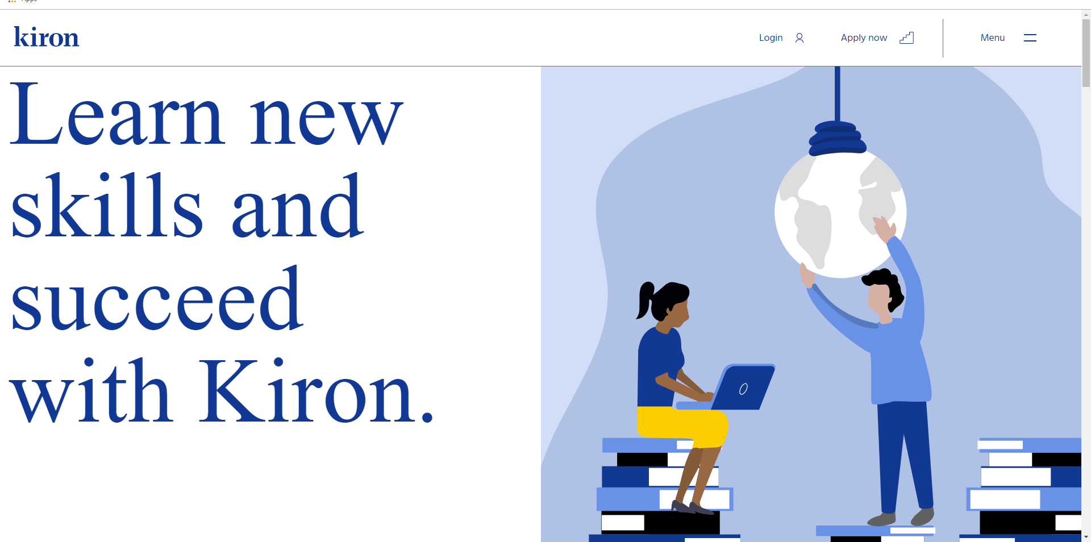
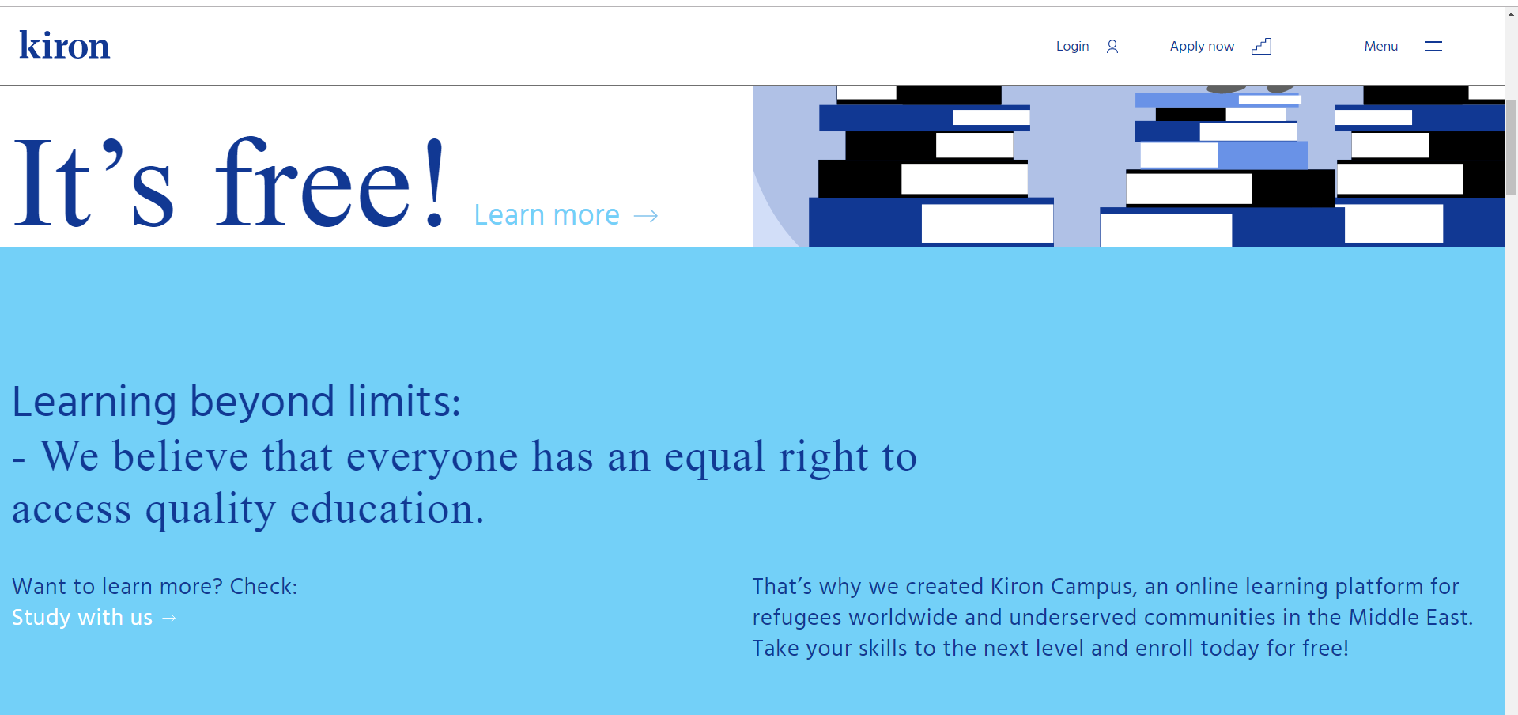
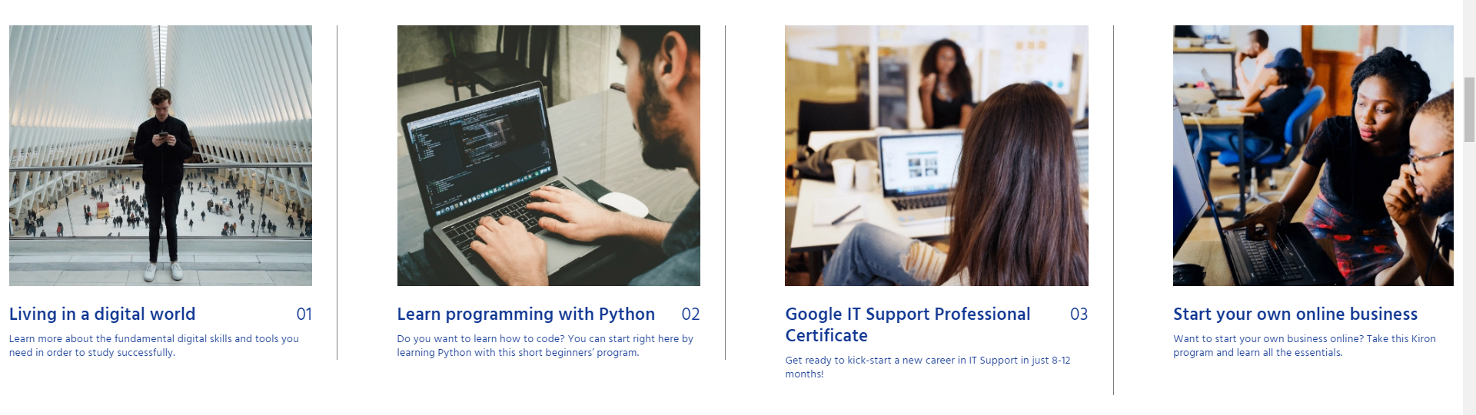

Slide 22
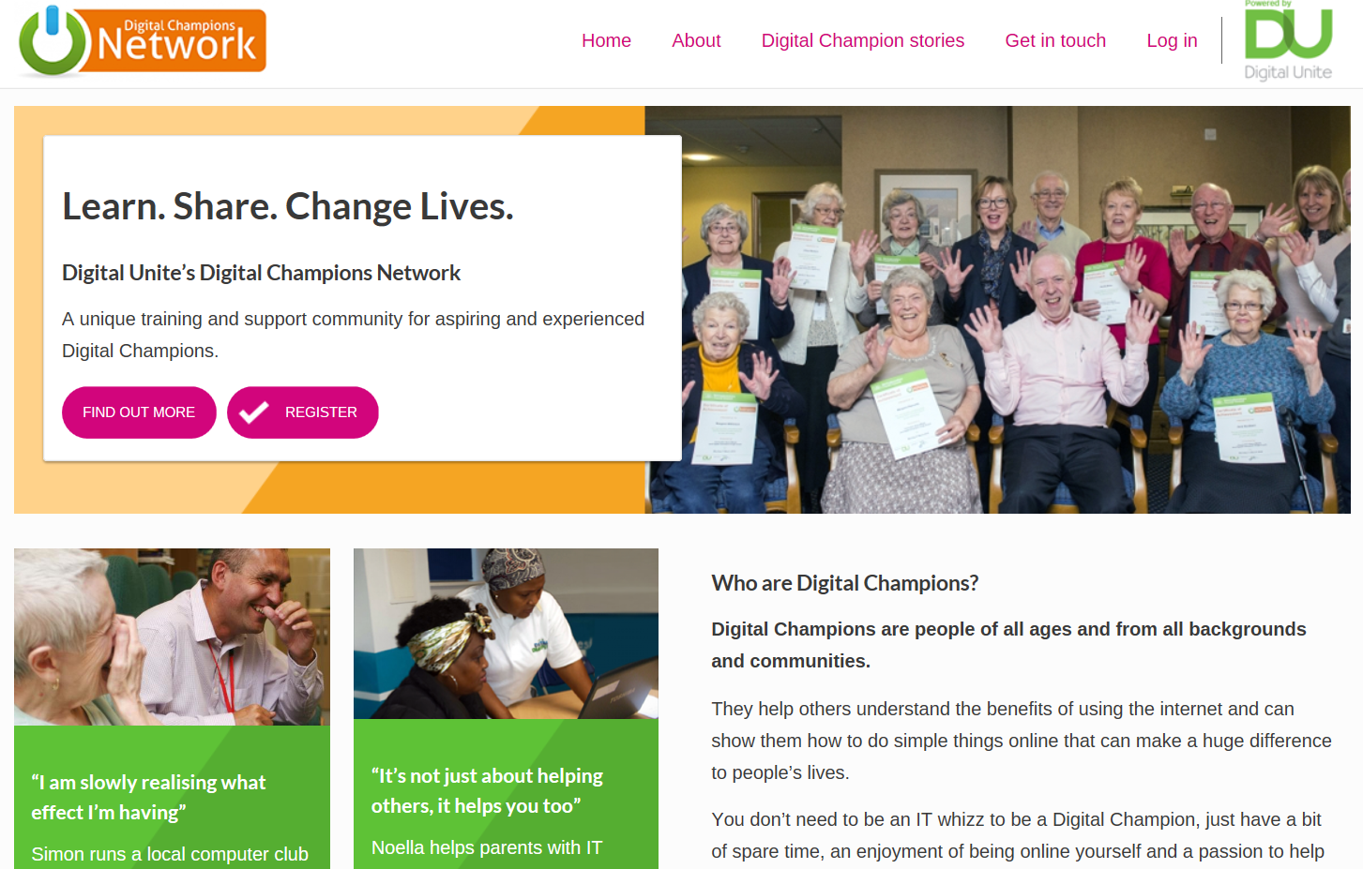
Digital Champions Network (Digital Unite)
Digital Unite https://www.digitalunite.com/
Digital Champions Network https://www.digitalchampionsnetwork.com/content/learn-share-change-lives.

Slide 23
Areas for PUBLIC librarians
Develop external partnerships
colleges and universities
charities and organisations
refugee and asylum seeker support organisations
Invest in Training
Involve staff in digital & media literacy training (cognitive and technical skills)
Identify, select, curate different digital & media literacy resources.
Create own resources with available tools BUT…
Work together
with other public libraries – do not replicate. Create bigger projects
“Twenty-first century digital literacy skills are basic to classroom performance and workforce readiness, as well as full participation in civic life” (Office for Information Technology Policy’s Digital Literacy Task Force, 2013).
Photo Bnejami Dada https://unsplash.com/photos/EDZTb2SQ6j0
Photo by Benjamin Dada@dadaben_https://unsplash.com/photos/EDZTb2SQ6j0

Slide 24
Maddie is online
Some reflections for public librarians
Website:
https://maddiesonline.blogspot.com/
Subscribe to all the video Playlists
bit.ly/2LwnE6T

Slide 25
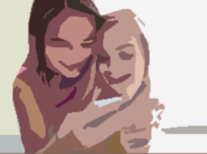
Positive aspects Risks
connect, play and interact with friends.
get inspired: watch videos from others around the world.
develop and showcase creativity and talent.
build a community around interests.
express feelings.
informal learning (social norms, digital skills).
Explore interests.
Validation/emotional support.
Addictive form of screen entertainment.
May replace learning the hard social "work" of dealing face-to-face with peers.
Children are adopting newer social media and games, social pressure.
Parents are not always aware of the social issues.
Safety: default public account - strangers could directly contact children: people can like or react to a video, follow an account and send messages.
Risk taking in order to get more followers/ likes
constant stimulation every single moment
Children may make different types of videos including sexually suggestive.
No real policy to stop young kids to join the community of adults/ kids participating in adult activities, hiding their age.

Slide 26
Warm up exercise
Photo by Jonas Jacobsson@jonasjacobsson https://unsplash.com/photos/2xaF4TbjXT0

Slide 27
Going online: real and virtual self and play
What do children do online? Popular games and apps
Social media & messaging / video sharing
Online gaming
Mind craft
Roblox
Snapchat
Tik Tok
Texting and time being ‘plugged in’

Slide 28
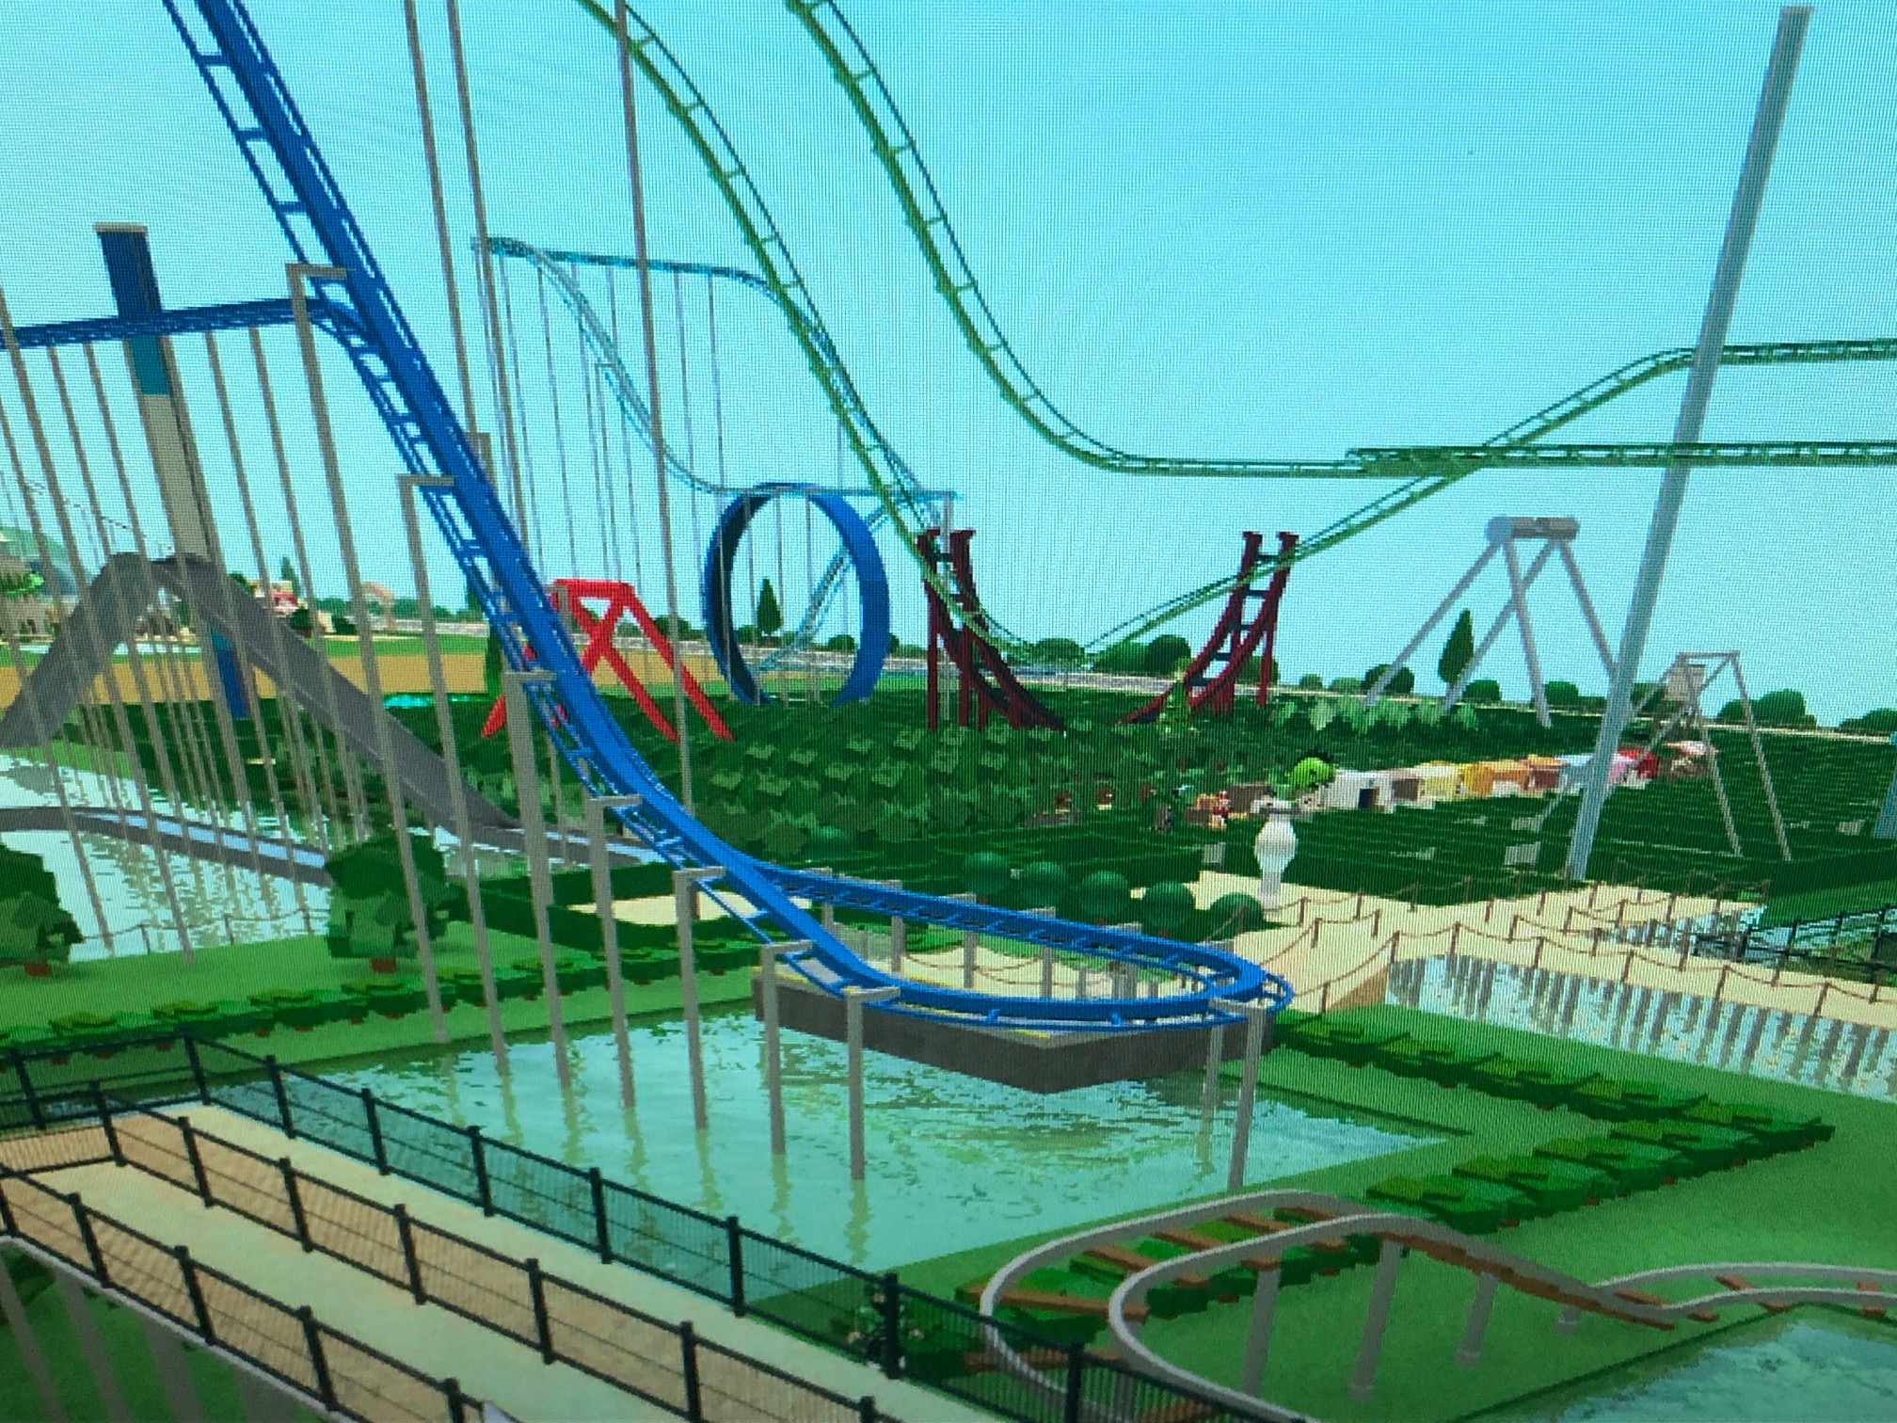
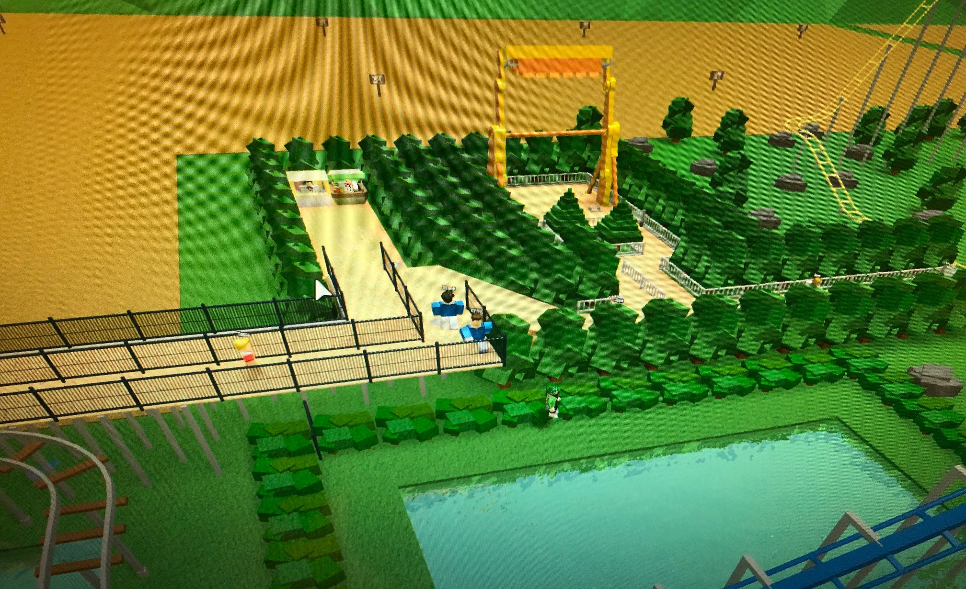
Roblox
Learning about the world, self-expression, identity exploration & formation, acquiring technical skills
How do you make money?
https://youtu.be/JAn0mt0bHtU
Inspired to be a park owner
https://youtu.be/TpfcKj1TaHM
From ‘Roblox Theme Park Tycoon’

Slide 29
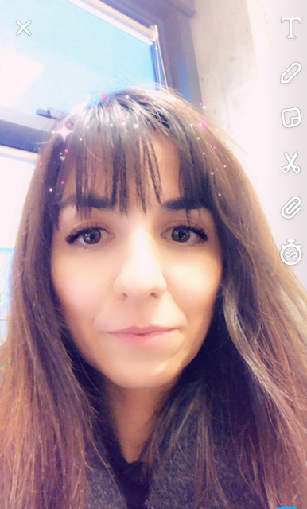
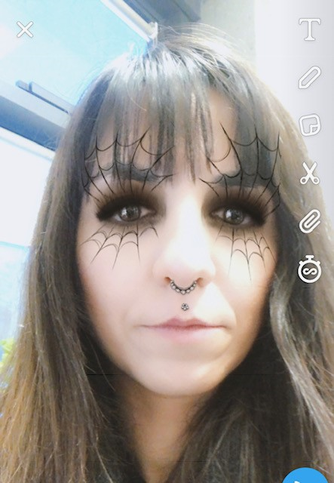
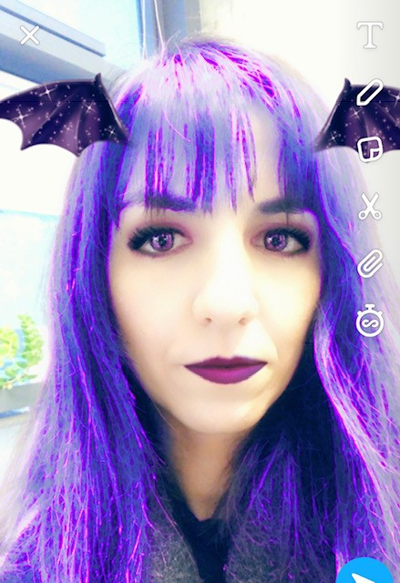
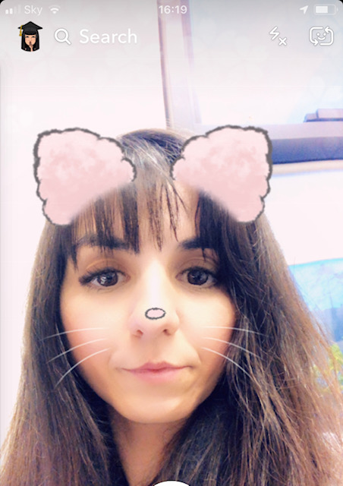
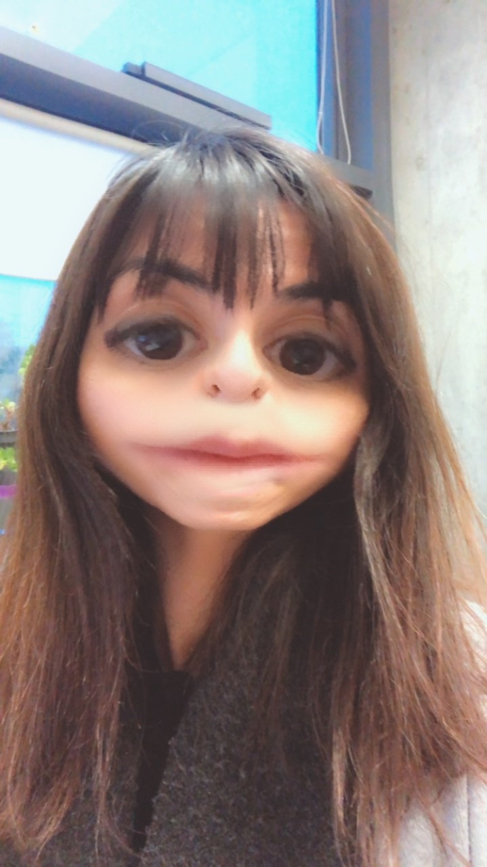
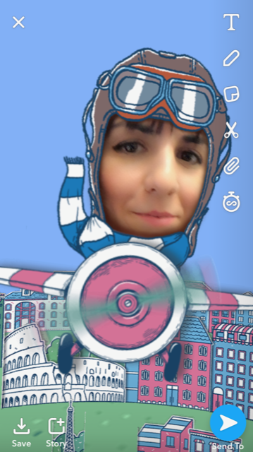
snapchat
Snapchat
Photo and video-sharing app with filters (and with a twist): media you send disappear seconds after they are viewed. Messages in group chat disappear after 24 hours.
There are ways to capture and recover images – a false sense of “security” (e.g. saving images by tapping them or taking a screenshot).
My Eyes Only
“If you ever get a Snap that you want to keep extra private, you can always add it to My Eyes Only! That way, you can hand over your phone to friends when sharing Memories, without being worried they might catch an eyeful of something meant just for you 🙈”

Slide 30
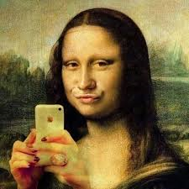
TIK TOk
Challenges
Clothes challenge: https://www.dailymotion.com/video/x6uwk2l
Lip challenge: #kyliejennerchallenge
Kidlipchallenge https://www.youtube.com/watch?v=gf05YGj31SM
#10YearChallenge
Privacy
Private mode: only the creator can watch the videos
Public: anyone within the app can see the videos
By default the settings are public unless a user changes them
Age inappropriate content
Self-harm
Life threatening challenges

Slide 31
U.k. Council For child internet safety

Slide 32
‘Education for a connected wORLD’:
U.k. Council For child internet safety

Slide 33
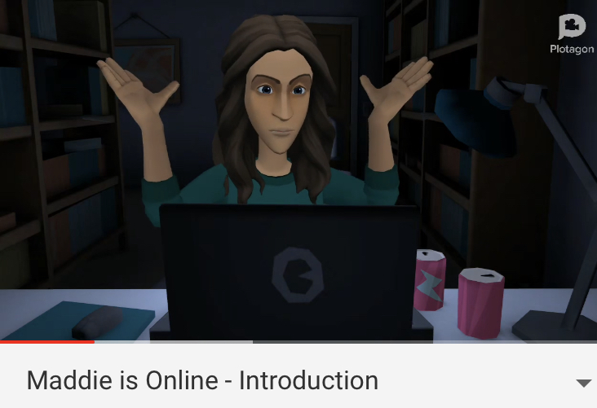
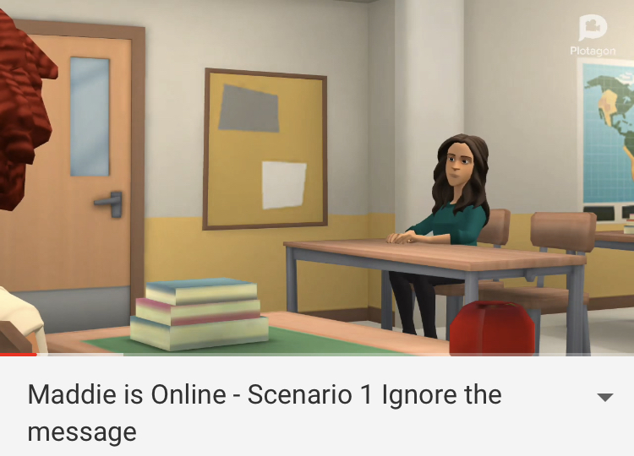
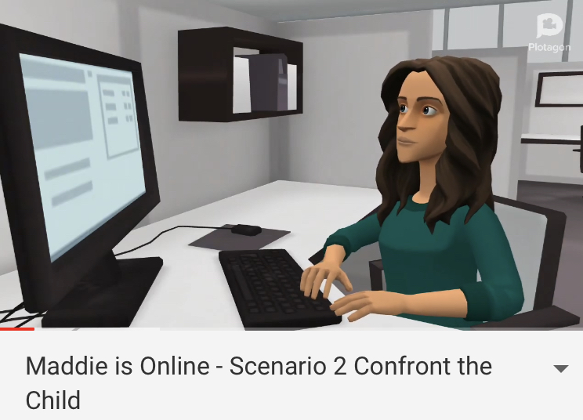
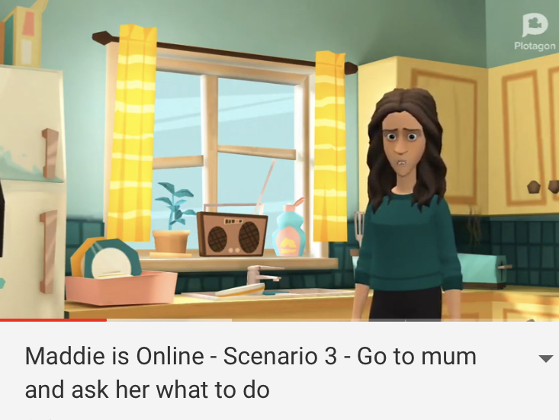
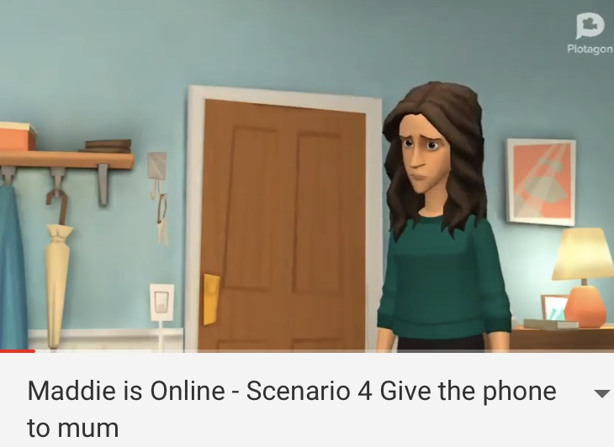
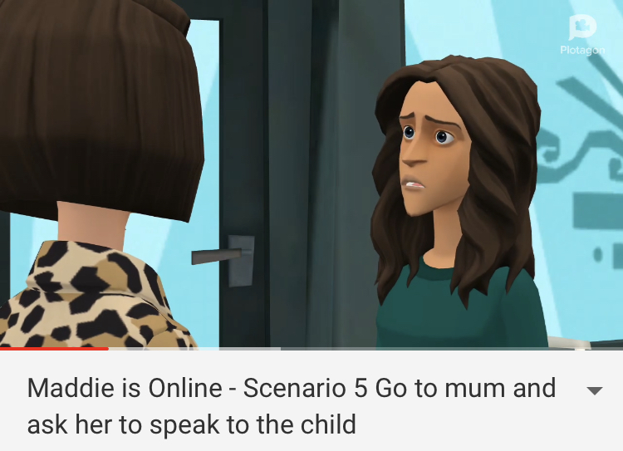
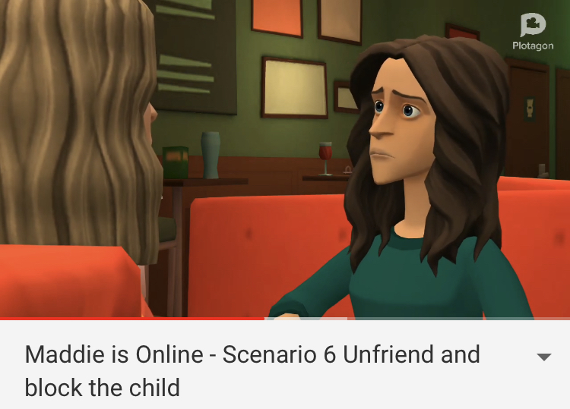
MADDIE is online : Introducing the Story & scenarios – Series 1 Online resilience/safety
https://maddiesonline.blogspot.com/

Slide 34
Series 2 on Misinformation
https://maddiesonline.blogspot.com/

Slide 35
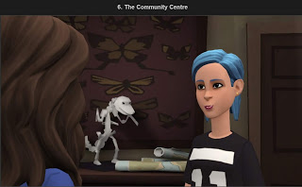
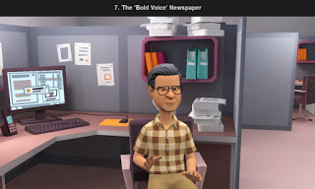
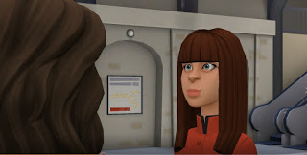
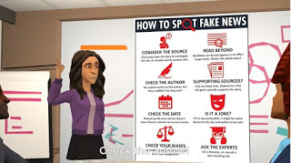
https://maddiesonline.blogspot.com/
If you are interested in using the series in your school or library please get in touch directly with Dina via k.martzoukou@rgu.ac.uk. Twitter @MaddiesOnline
A short anonymous evaluation questionnaire
understand whether the tool was useful
design new episodes of interest.

Slide 36
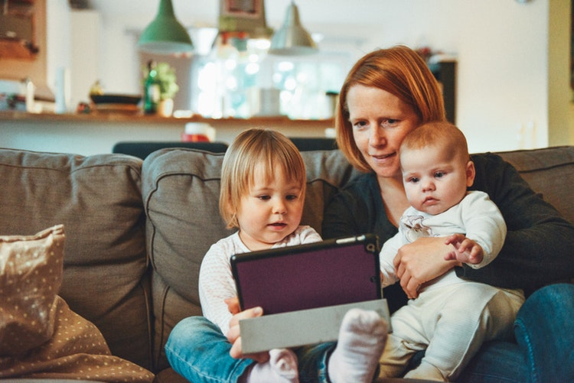
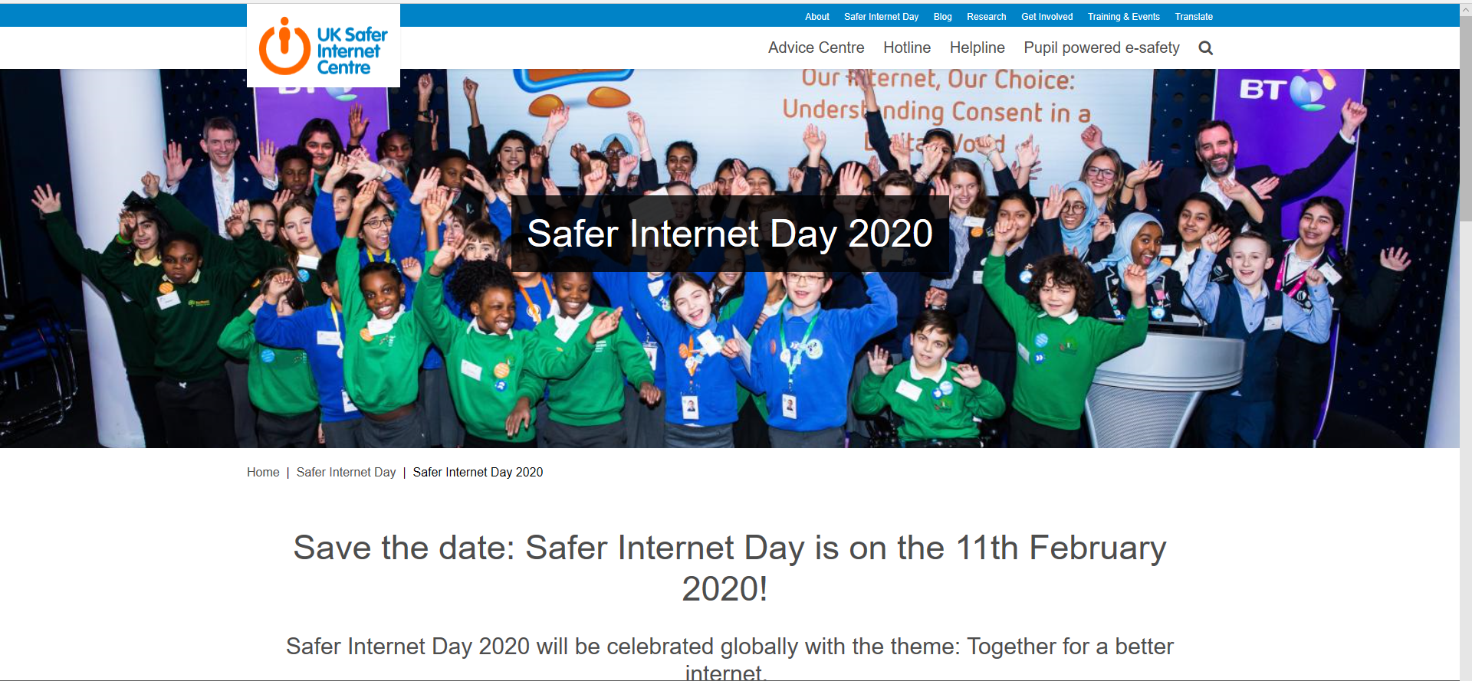
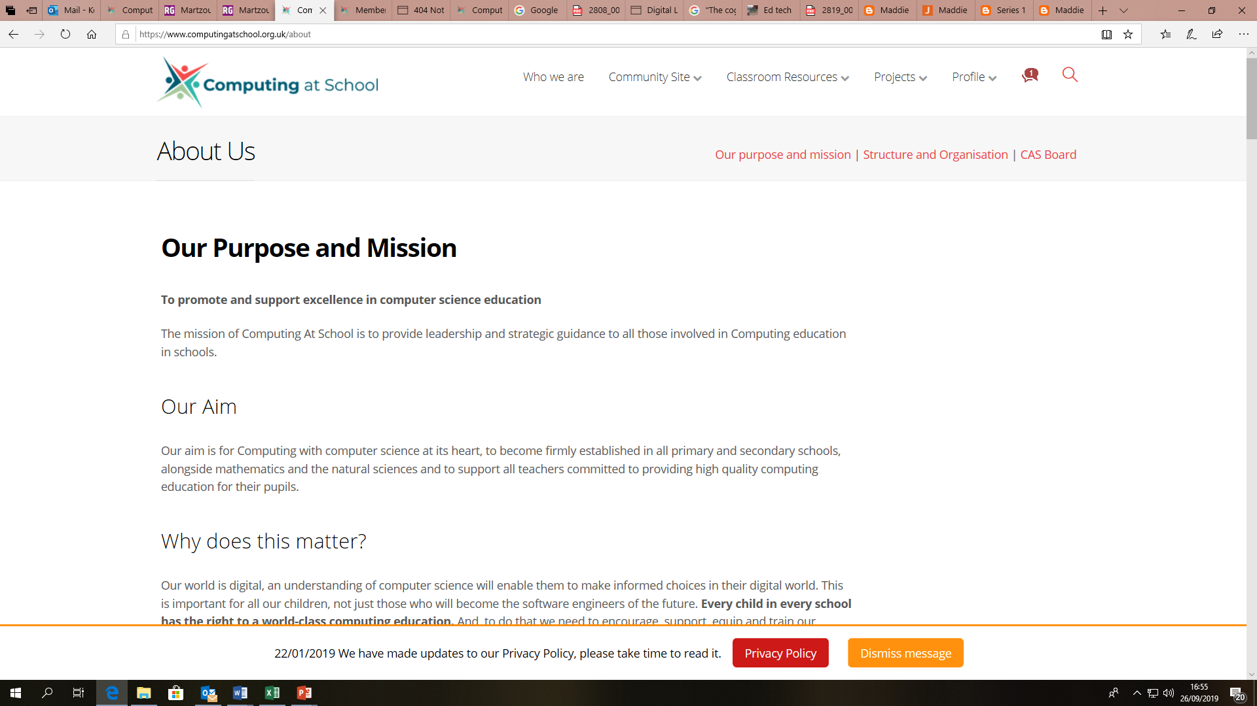
Areas for PUBLIC librarians
Clearly define your digital citizenship role
Make greater efforts to engage families in digital citizenship initiatives/ work (create your own initiatives!)
Make a case for creating a Digital Officer post in schools (and be the one!)
Design and promote learning opportunities and interesting resources to schools and families
Monitor emerging trends and research
Identify and curate resources
Conduct your own research within context to better understand values, attitudes, skills.
Do not reinvent the wheel – work together with other public libraries and schools to create playful, flexible, open learning in collaboration
Promote your activities via national and global events (e.g. UNESCO Global Media & Information Literacy week, UK Safer Internet Week)
Help to add more to these recommendations!
Photo by: Alexander Dummer https://unsplash.com/photos/UH-xs-FizTk

Slide 37
The role of the public library as an enabler of accessible and inclusive information Literacy
Dr Konstantina Martzoukou
Teaching Excellence Fellow - Robert Gordon University
E: k.martzoukou@rgu.ac.uk @Dinamartz @OneHEMindsets
Notes:
I

Slide 38
Resources
EU Kids Online: a multinational research network, funded by the EC’s Better Internet for Kids programme http://www.lse.ac.uk/media-and-communications/research/research-projects/eu-kids-online
Digital resistance: https://pjp-eu.coe.int/en/web/charter-edc-hre-pilot-projects/digital-resistance “To promote digital citizenship of pupils by supporting the development of digital skills and competences through inquiry-based learning”
Ofcom. Protecting your child in the Digital World: https://www.ofcom.org.uk/__data/assets/pdf_file/0015/7107/managemedia.pdf Also published a range of guides
ParentPort was jointly developed by the Advertising Standards Authority, the Authority for Television on Demand, the BBC Trust, the British Board of Film Classification, Ofcom, the Press Complaints Commission and the Video Standards Council/Pan-European Game Information.
Get Safe Online, the UK’s national internet security awareness initiative. Ofcom also works closely with UKCCIS - the UK Council for Child Internet Safety - which brings together more than 180 organisations to help keep children and young people safe online.

Slide 39
Additional references
Livingstone, Mascheroni, & Staksrud. 2017. European research on children’s internet use: Assessing the past, anticipating the future. New Media & Society, 1-20. doi: 10.1177/1461444816685930
Livingstone, S., Haddon, L., Görzig, A., and Ólafsson, K. 2011. Risks and safety on the internet: The perspective of European children. Full Findings. LSE, London: EU Kids Online. http://eprints.lse.ac.uk/33731 Base, Available from http://www.lse.ac.uk/media@lse/research/EUKidsOnline/EU%20Kids%20III/Reports/EUKidsOnlinereportfortheCEOCoalition.pdf
Ofcom, 2017. Children and Parents: Media Use and Attitudes Report . Available from: https://www.ofcom.org.uk/__data/assets/pdf_file/0020/108182/children-parents-media-use-attitudes-2017.pdf
Office for Information Technology Policy’s Digital Literacy Task Force. 2013. Digital Literacy, Libraries, and Public Policy. Available from http://www.districtdispatch.org/wp-content/uploads/2013/01/2012_OITP_digilitreport_1_22_13.pdf.

